Slide 1

NH Energy Data Platform Governance Council GRIP Grant Application Update – Regional Approach
NH PUC Status Conference - 2/8/2024

Slide 2

Agenda
GRIP Grant Concept Paper
  US DOE Funding Opportunity
  Regional Approach
  Proposal
  Regional Interest
  Community Benefits
  Risks
Proposal Schedule
Project Implementation Schedule
Approval

Slide 3
Grid Resilience and Innovation Partnerships (GRIP) Grant – Highlights from US DOE Funding Opportunity Announcement
Applying for Topic Area 2: Smart Grid projects focused on “innovative and ambitious uses of cutting-edge, market-ready technologies. These technologies can include new devices, materials, engineering designs, or software tools”
Priority investment include: Enhancing interoperability and data architecture of systems that support two-way flow of both electric power and localized analytics to provide information between electricity system operators and consumers.
Allowable investments include:
  … the documented purchase costs of the software.
  … the documented expenditures for purchasing and installing such equipment that allows Smart Grid functions to operate and be combined or coordinated among multiple electric utilities and between that region and other regions.
  … the documented purchase costs of the data analytics.

Slide 4
Grid Resilience and Innovation Partnerships (GRIP) Grant – Regional Approach
US DOE communicated a $10M expected minimum grant award ($20M project) which was significant change from previous round.
  US DOE has a strong preference for larger, regional consortia involving multiple utilities and multiple stakeholders across jurisdictions
  Shift to a larger regional approach was deemed the most successful strategy by West Monroe and the Governance Council (NH DOE abstained).
Further discussion needed on what a regional approach looks like - will provide updates as necessary.
  The intent is to defray costs for New Hampshire with regional approach.
  The New Hampshire platform is the design that we are still pursuing and looking to price it as both a New Hampshire platform and a regional platform and make a recommendation based on that information.
  In addition, should other states be involved, an equitable method for cost sharing the construction and operation of the Data Platform would need to be established among the regional stakeholders.

Slide 5
Grid Resilience and Innovation Partnerships (GRIP) Grant – Proposal
Preliminary budget planning to request $14.5M grant
Will reduce costs to rate payers for the platform
Grant requires a 50% match from participating companies (project total $29M)
Monies expected to be split between buying down the platform and assisting with program offerings, which will include:
    Services provided by partner organizations to provide benefits to customers and invest in community outreach, education, etc.
    Connecting third parties to platform
    Providing municipal benefits
There will be value and benefits regardless as the grant as a result of the vendor and service provider relationships and plan development for communications and customer engagement
The full GRIP application is due May 22, 2024, at which point the definitive list of participating utilities, stakeholders, and project budgets must be finalized.

Slide 6

Grid Resilience and Innovation Partnerships (GRIP) Grant - Regional Interest
We are negotiating a new contract with West Monroe that would distribute costs across States and are looking to an overall cost increase in the cost of that engagement but a discount to NH.
Utility Leads:
Justin Eisfeller (Unitil) – CTO and VP of IT
Riley Hastings (Eversource) – Lead Analyst, EE Programs
Heather Tebbetts (Liberty) – Director, Business Development
Nick Corsetti (National Grid) – Director, MA AMI Customer, Community, & Regulatory Engagement
Platform Hub Vendors: Have received RFI responses from 8 potential vendors. A final vendor will be selected through an RFP process.
Community Engagement – NH, MA, CT, and ME have shown interest. Municipal and regional outreach will leverage the organizations who have relevant existing frameworks and relationships:
Community Power Coalition of NH (CPCNH)
Clean Energy NH (CENH)
Office of the Consumer Advocate (OCA)
MA Department of Energy Resources (MA DOER)
CT Department of Energy & Environmental Protection (DEEP)
Sustainable Connecticut
Connecticut Office of Consumer Counsel (OCC)

Slide 7

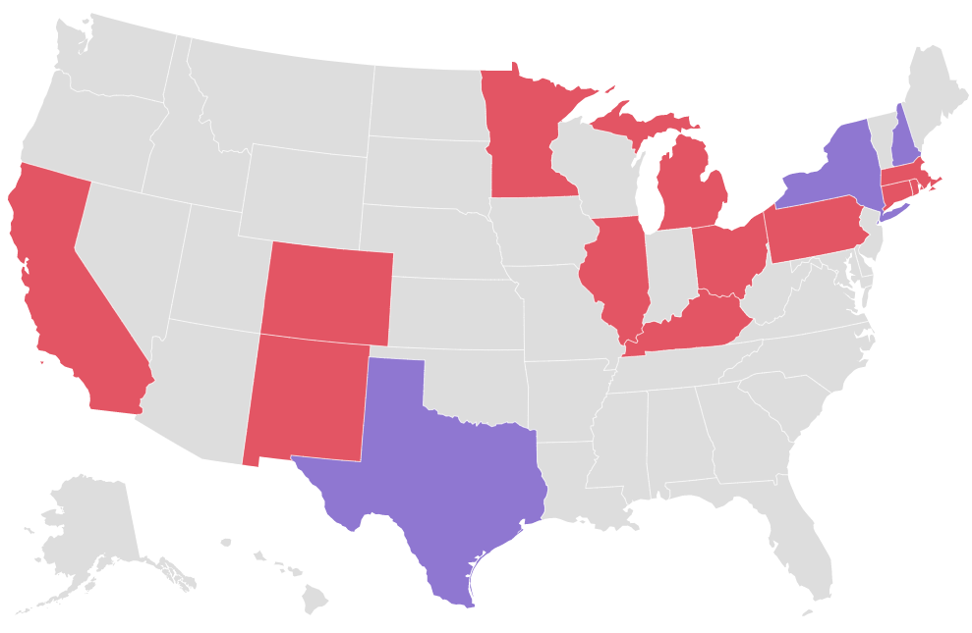
Data-Sharing Platform Activity Across the Country
Multi-Utility Data Platforms
Individual Utility Platforms
 | Texas | New York | New Hampshire
Date begun | 2012 | 2023 | ?
Electricity data | Yes | Yes | Yes
Natural gas data | No | Yes | Yes
API vs. centralized storage | Centralized | Centralized | API
Regional | No | No | ?

Slide 8

Grid Resilience and Innovation Partnerships (GRIP) Grant – Community Benefits Plan
Overarching goals: grid-benefitting operational improvements, advancing energy democracy, workforce development, and community partnerships.
Will support a variety of use cases to be utilized to benefit communities and ensure:
  Awareness of the availability of the Hub for their use;
  How to engage with the Hub API’s to enable/enhance their services;
  How to advise individuals on how to leverage the Hub to support enrollment in energy programs, tax credits, or energy saving programs;
  How to leverage the Hub to evaluate project efficiency costs and savings;
  How to pull the relevant data necessary to support timely siting of projects or verification /validation of performance of energy savings programs; and
  How to leverage the Hub to support facilitation of funding opportunities available in the Inflation Reduction Act (IRA).
Partnership examples may include:
  Clean Energy NH
  CENH’s Circuit Rider Program
  CT Department of Energy & Environmental Protection
  Sustainable CT
  The Community Power Coalition of NH (CPCNH)
  MA Department of Energy Resources (MA DOER)
  Community Engagement Stakeholder Advisory Group (CESAG)

Slide 9

Grid Resilience and Innovation Partnerships (GRIP) Grant – Risks and Mitigations
Legal Obligations
The New Hampshire utilities will work alongside the Council to ensure that the utilities meet all statutory obligations under the Data Platform Statutes RSA 378:51-54.
Governance complexity
Per Order No. 26,589, the Council will continue to exist and oversee NH-specific matters as outlined in the settlement agreement.
Cost allocation considerations
The Council will modify the Data Platform RFP so that bids submit jurisdiction-specific costs, to ensure proper cost allocation.
Schedule impacts
Our consultant, West Monroe, will play an expanded coordination role for the USDOE grant; Data Platform RFP issuance will be slightly delayed in order to gather cost information, which is agreeable to the Council; and the RFP will seek to implement New Hampshire first (subject to Commission approval) before other states.
Consultant cost increases
The Governance Council will seek a fair distribution of the increased consulting costs due to regionalization with the intent of no increased costs to the NH utilities beyond what has already been authorized by the commission.

Slide 10
Timeline
Utilities have partnered with West Monroe to facilitate the Proposal
Seeking agreement on regional planning and governance approach
Beginning regulatory stakeholder outreach for awareness and approvals
Expecting to start work on the full grant proposal in mid-February with West Monroe
Application filing deadline is May 22, 2024 for Topic Area 2 - Smart Grid projects

Slide 11

Project Implementation Milestone Expectations
YEARS 1 & 2: PLATFORM BUILD & MVP
  Issue RFP & Vendor Selection
  Initiate Design / Build / Configuration
  Perform Utility Hub Integrations
  Hub Platform MVP Complete
YEARS 3 & 4: LEVERAGE PLATFORM FOR COMMUNITY BENEFITS
  Initiation of Community Benefit Plan
  Engage targeted Disadvantaged Communities (“DAC”) and support partner development and deployment of community dashboards and other applications
  Next stage planning and Hub extensibility exploration
  Ramp up technical resources and on-boarding community support

Slide 12
Approval
The Council respectfully requests that the Commission give approval to continue with the consultant in developing a grant application (May 22nd deadline) that includes a regional approach to the Data Platform. The development of a grant application is extremely time intensive, and the approach needs to be solidified before significant time and effort is put forth.
If the Commission approves, then in the coming months, the Council will provide the Commission with monthly reports that provide the Commission more detail about the implications for New Hampshire should the US DOE grant the award (likely Q4 2024).
The Council is keenly aware of any risk from regionalization that could diminish the Commission’s oversight or decision-making authority on matters in New Hampshire.
Both the New Hampshire and the regional utilities, should the project successfully receive federal funding, would need to first receive all necessary regulatory approvals and a reasonable mechanism for cost recovery to support the required investment before proceeding with the project in each of the supporting states.

Slide 13
Appendix

Slide 14
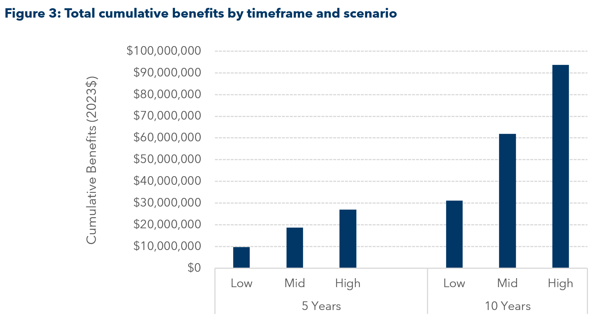
Estimated NH Benefits of the Data Platform

