Slide 1
THOUGHTS ON PERFORMANCE INCENTIVES
FOR UTILITY ENERGY EFFICIENCY ACHIEVEMENTS
Presentation to
the New Hampshire Performance Incentive Working Group
by
Martin Kushler, Ph.D.
Senior Fellow
ACEEE
March 21, 2019

Slide 2
THE AMERICAN COUNCIL FOR AN
ENERGY-EFFICIENT ECONOMY (ACEEE)
Nonprofit 501(c)(3) dedicated to advancing energy efficiency through research, communications, and conferences. Founded in 1980.
~50 staff in Washington DC, + field offices in DE, MI, and WI.
Focus on End-Use Efficiency in Industry, Buildings, Utilities, and Transportation; and State & National Policy
Funding: Foundations (34%), Federal & State Grants (7%), Contract research work (21%) Conferences and Publications (34%), Contributions and Other (4%)
Martin Kushler, Ph.D. (Senior Fellow, ACEEE)
30 years conducting research in the utility industry, including:
10 years as Director of the ACEEE Utilities Program
10 years as Director of Evaluation at the Michigan PSC
Have assisted over a dozen states with utility EE policies

Slide 3
TOPICS
Background
  Putting performance incentives in context
  Utility business model issues, and effect on energy efficiency
  National review of state policy approaches and results
Responses to the OCA February 21st presentation
Recommendations

Slide 4
THE CORE CHALLENGE…
Utilities do not voluntarily engage in (or fund)
“serious” customer energy efficiency programs
Why not?
Economics
  Higher energy sales typically means higher profit (and vice-versa)
Organizational Traditions
  Institutional focus traditionally on supply side

Slide 5
UTILITIES HAVE 3 SPECIFIC REGULATORY CONCERNS REGARDING THE FINANCIAL EFFECTS OF EE PROGRAMS
Cost recovery for the direct costs of a program
Addressing the disincentives of “lost revenues” resulting from energy efficiency improvements that reduce customer energy use
Providing an opportunity for earnings from energy efficiency program activity (to reflect the fact that they can generate earnings from supply-side investment)
5
5

Slide 6
3 LEGS OF THE FINANCIAL STOOL FOR UTILITY ENERGY EFFICIENCY PROGRAMS
Cost recovery (of expenditures on programs, incl. customer incentives and program costs)
Addressing “Through-put incentive” (more sales = more revenue).
[policy: “decoupling”]
Opportunity to earn on investments (comparable to supply-side)
[policy: performance incentives]

Slide 7
NATIONAL REVIEW OF STATE POLICIES
From:
Policies Matter: Creating a Foundation for an Energy-Efficient Utility of the Future
ACEEE White Paper, Maggie Molina and Marty Kushler, 2015
https://aceee.org/policies-matter-creating-foundation-energy

Slide 8
NUMBER OF STATES WITH EACH TYPE OF UTILITY EE POLICY
(As of our 2015 Analysis)
Policy for Electric Utility Sector | # of States
Energy Efficiency Resource Standard (EERS) | 26
Utility Performance Incentives | 25
Decoupling | 12
LRAM | 14
IRP | 40

Slide 9
PRESENCE OF EERS
VS. UTILITY EE PERFORMANCE INDICATORS
Policy | No. of States | Average EE spending as % of revenues* | Average EE savings as % of sales*
No EERS | 24 | 0.7 | 0.3
Yes EERS | 26 | 2.6 | 1.1
Note: all of these figures in this and subsequent tables are reported as simple averages.

Slide 10
UTILITY PERFORMANCE INCENTIVES, w and w/o EERS
VS. UTILITY EE PERFORMANCE INDICATORS
Policy | No. of States | Average EE spending as % of revenues | Average EE savings as % of sales
No Utility Performance Incentives | 25 | 1.4 | 0.5
Yes Utility Performance Incentives | 25 | 2.0 | 0.9
No EERS, No Utility Performance Incentives | 17 | 0.8 | 0.3
No EERS, Yes Utility Performance Incentives | 7 | 0.8 | 0.4
Yes EERS, No Utility Performance Incentives | 8 | 2.9 | 1.1
Yes EERS, Yes Utility Performance Incentives | 18 | 2.5 | 1.1

Slide 11
PRESENCE OF DECOUPLING, w and w/o EERS
VS. UTILITY EE PERFORMANCE INDICATORS
Policy | No. of States | Average EE spending as % of revenues | Average EE savings as % of sales
No Decoupling | 38 | 1.1 | 0.5
Yes Decoupling | 12 | 3.8 | 1.4
No EERS, No Decoupling | 23 | 0.7 | 0.3
No EERS, Yes Decoupling* | 1* | 2.1* | 0.8*
Yes EERS, No Decoupling | 15 | 1.6 | 0.9
Yes EERS, Yes Decoupling | 11 | 4.0 | 1.4
*Note that only one state falls into this category, and therefore we do not recommend relying on this as a useful comparison. We present it here for information purposes only.

Slide 12
PRESENCE OF LRAM (LOST REVENUE ADJUSTMENT MECHANISM) w and w/o EERS
VS. UTILITY EE PERFORMANCE INDICATORS
Policy | No. of States | Average EE spending as % of revenues | Average EE savings as % of sales
Yes LRAM | 14 | 1.2 | 0.6
No LRAM | 36 | 2.0 | 0.8
No LRAM or decoupling | 26 | 1.1 | 0.5
No EERS, No LRAM or decoupling | 16 | 0.7 | 0.2
No EERS, Yes LRAM | 7 | 0.6 | 0.4
Yes EERS, No LRAM or decoupling | 10 | 1.8 | 0.9
Yes EERS, Yes LRAM | 7 | 1.7 | 0.9

Slide 13
PRESENCE OF IRP, w and w/o EERS
VS. UTILITY EE PERFORMANCE INDICATORS
Policy | No. of States | Average EE spending as % of revenues | Average EE savings as % of sales
No IRP | 10 | 1.5 | 0.5
Yes IRP | 40 | 1.8 | 0.8
No EERS, No IRP | 6 | 0.8 | 0.2
No EERS, Yes IRP | 18 | 0.8 | 0.3
Yes EERS, No IRP | 4 | 2.7 | 1.0
Yes EERS, Yes IRP | 22 | 2.6 | 1.1

Slide 14
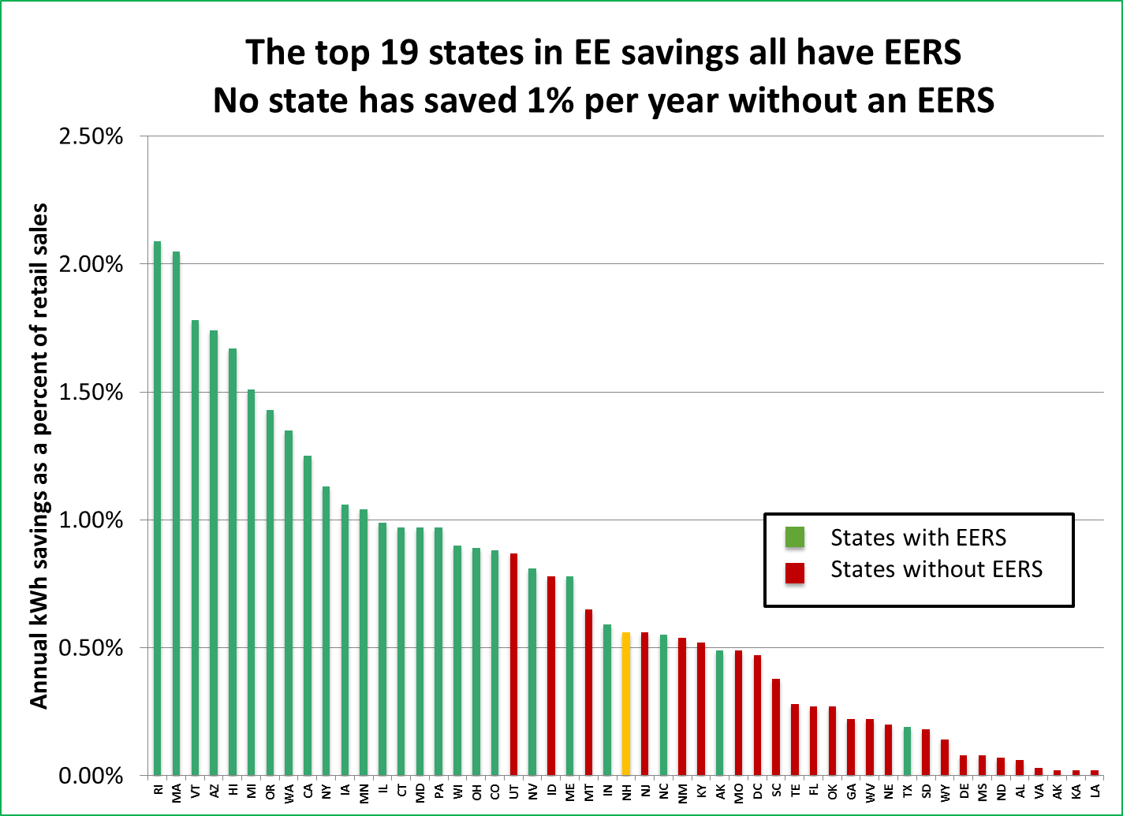
ENERGY SAVINGS FOR STATES WITH AN EERS
VS. STATES WITHOUT EERS
[EE savings as a % of retail sales]
14

Slide 15
The purpose of that data review is to emphasize one point:
By far the most important factor in determining utility EE performance is what the state tells the utility to do…
i.e., the EERS
Other policies, such as performance incentives,
are the sugar that helps the medicine go down
[That said, a good combination of policies can be very successful in achieving strong results]

Slide 16
PRESENCE OF COMPREHENSIVE APPROACH
VS. AVERAGE UTILITY EE PERFORMANCE INDICATORS
Policy | No. of States | Average EE spending as % of revenues | Average EE savings as % of sales
EERS and all three utility business model tools (program cost recovery, decoupling and incentives) | 8 | 4.0 | 1.5
Partial set of policies | 42 | 1.3 | 0.6

Slide 17
UTILITY EE PERFORMANCE INCENTIVES

Slide 18
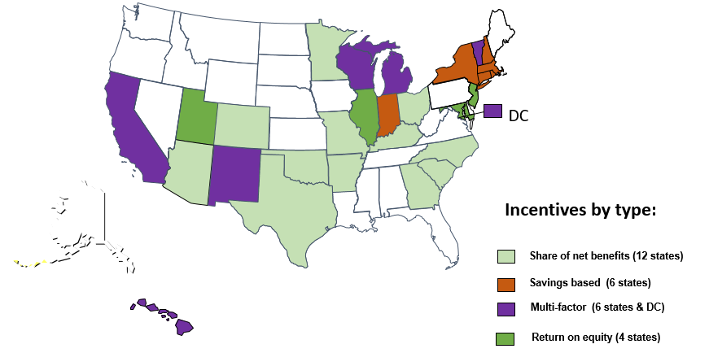
STATE POLICIES REGARDING UTILITY EE PERFORMANCE INCENTIVES

Slide 19
FUNDAMENTAL PURPOSES OF UTILITY PERFORMANCE INCENTIVES:
TO GET THE UTILITY TO DO WHAT IT OTHERWISE WOULD NOT BE INCLINED TO DO
TO HELP GUIDE THE UTILITY’S ACTIONS TOWARD SPECIFIC DESIRED OUTCOMES
TO ENCOURAGE STRONG EFFORT TOWARD DESIRED OUTCOMES

Slide 20
TYPICAL UTILITY ORDER OF PREFERENCE
REGARDING DEMAND SIDE OPTIONS
LEAST DESIRED
Long-term MWh savings
Short-term MWh savings
EE produced demand savings (“passive” demand savings)
CAN BE NEUTRAL OR MILD POSITIVE
Load shifting (“active” demand savings)
Saving other company’s fuels (incl. oil, propane, water)
ESSENTIALLY POSITIVE
Saving other company’s fuels and increasing own sales (e.g. through “beneficial electrification”)
----------------------------------------------------------
These inherent utility preferences should influence
  Whether any special performance incentive is needed, and
  The relative amount of any such incentive

Slide 21
RESPONSE TO THE FEBRUARY 21ST OCA PRESENTATION*
(* which was presented by Phil Mosenthal of Optimal Energy)

Slide 22
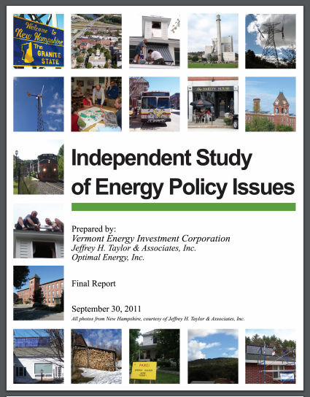
Guiding Principles of PI Design
(ACEEE generally agrees)
Performance ≠ Actions
Measurable and Objective
Multivariate
Drive key policy objectives
Scalable
Countervailing influences
A little money can go along way
Avoid Perverse Incentives

Slide 23
Utility Illustrative Proposal
OCA Assessment (ACEEE RESPONSE)
Agree
  Portfolio-wide screen allows for program innovation (AGREE)
  Agree to savings and value as components, with value component utilizing utility cost (OK)
  Threshold for PI should be 75% of each target (5.5 percent spend), and should scale linearly to 125% of target (6.85% of spend)
(RECOMMEND HIGHER THRESHOLD, OR SET TARGET MORE AGGRESSIVELY. NOT ENOUGH DIFFERENCE BETWEEN 75% REWARD AND 125%.)
Recommendation/Clarification
  Further demand reduction emphasis; VT and RI place 30% of PI on passive demand reduction, while Mass is only 4% because ADR is new (MWh should be highest component)
  Passive demand savings set for 2020 at current target and should be component of current PI pool, not additional PI (ONLY INCLUDE PASSIVE [EE BASED] DEMAND)
  Moving to portfolio wide screen could be accompanied by move to benefit-cost threshold of 1.2:1 (OK)

Slide 24
OCA Proposed Framework
Electric Programs
[ACEEE suggested changes]
Electric Program Quantifiable Performance Indicators
QPI # | Title | Performance Indicator | Award Weight
1 | Annual Electricity Savings | Annual incremental MWh savings | 15% 15%
2 | Lifetime Electricity Savings | Lifetime incremental MWh savings | 15% 25%
3 | Summer Peak Demand Savings | Cumulative net summer peak kW demand savings “Passive” (EE caused) savings only | 15% 15%
4 | Winter Peak Demand Savings | Cumulative net winter peak kW demand savings “Passive” (EE caused) savings only | 15% 15%
5 | Total Resource Savings | Present worth of lifetime resource benefits | 20%
6 | Value | Total resource savings minus utility cost | 15%
Total |  |  | 95% 95%
]25%
Consider combining into single Value? YES
Resources = Electric, gas, unregulated fuels, and water only. No NEIs OK
Electric Program Minimum Performance Requirements: No performance incentive award if utility fails to achieve
Title | Minimum Requirement
Benefit/Cost Ratio | Total benefits divided by total costs is greater than 1.2 OK
Equity for Low-Income Customers | Spending on low-income programs is at least 17% of total program spending OK TO HAVE A LOW INCOME METRIC

Slide 25
OCA Proposed Framework
Gas Programs
(ACEEE suggested changes)
Gas Program Quantifiable Performance Indicators
QPI # | Title | Performance Indicator | Award Weight
1 | Annual Natural Gas Savings | Annual Incremental Mcf savings | 15% 15%
2 | Lifetime Natural Gas Savings | Lifetime incremental Mcf Savings | 15% 25%
3 | Peak Day Natural Gas Savings | Peak Day Incremental Savings (Mcf) (From EE caused savings only) | 30% 30%
4 | Total Resource Benefits | Present worth of lifetime resource benefits | 15%
5 | Value | Total resource savings minus utility cost | 20%
Total |  |  | 95%
]25%
Consider combining into single Value? YES
Resources = Electric, gas, unregulated fuels, and water only. No NEIs OK
Gas Program Minimum Performance Requirements: No performance incentive award if utility fails to achieve
Title | Minimum Requirement
Benefit/Cost Ratio | Total benefits divided by total costs is greater than 1.2 OK
Equity for Low-Income Customers | Spending on low-income programs is at least 17% of total program spending OK TO HAVE SOME LOW INCOME METRIC

Slide 26
Energy Optimization
OCA recommends no additional incentive to encourage the electric utilities to embrace “energy optimization” because utilities already have an incentive to fuel switch via Averch-Johnson effect: load growth>rate base growth>more utility ROE>more utility profits (AGREE)
Averch-Johnson effect has led regulators to be skeptical of utilities encouraging load growth — including NH — because it has the potential to be detrimental to ratepayers (AGREE)
Because of strong inherent incentive, need to ensure only appropriate energy optimization is happening (AGREE)
  Should be only both cost-effective (TRC BCR>1.0) AND positive source Btu savings
  (AGREE. SUGGEST ADDING TWO ELEMENTS FROM MINNESOTA APPROACH:
  Should produce net reduction in GHG emissions
  Should be designed and implemented so as to not increase utility peak demand
  Understand a separate working group will be dealing with this regarding cost-effectiveness
          Savings claims are the important issue to resolve: recommend source Btu savings converted back to kWh at source for kWh savings claims (or just have MMBtu goals)

Slide 27
OTHER ITEMS FOR FEEDBACK
Weighting of demand reduction vs. other metrics
  Should only incentivize EE driven peak demand reduction (“passive”) in the EE incentive framework
  (might consider a separate goal and framework for ‘active’ demand reduction, with lesser levels of incentive)
  MWh should still receive highest proportion (highest inherent disincentive to overcome)
What about low-income metrics? (Other than minimum spend?)
  Could have an LI savings metric, or LI participation targets (MI has had both)
Screening at the portfolio level?
  That’s ok, another option is allowing certain exemptions from B/C screening (e.g., Low-Income program, pilot programs, etc.)
Relevance of ‘energy optimization’ to EE performance incentives
  EE performance incentives should focus on EE metrics. (recall slide on utility inherent preferences) Need to ensure that ‘energy optimization’ doesn’t displace actual utility EE
  To the extent ‘energy optimization’ results in increases in MWh sales and/or peak demand, those amounts should be netted out of EE savings claims

Slide 28
EXAMPLE PERFORMANCE INCENTIVE
FROM CONSUMERS ENERGY (MICHIGAN)
Company must achieve the 1.0% annual savings EERS target in order to qualify for any incentive, then the metrics below come into play to calculate the incentive amount

Slide 29
EXAMPLE STATES WITH MULTI-FACTOR EE INCENTIVES

Slide 30
RECOMMENDATIONS
Focus the Energy Efficiency performance incentives structure on Energy Efficiency outcomes
  That is the area of the utility’s greatest reluctance
  Other areas (e.g., load shifting, energy optimization, etc.) can be addressed with separate goals, and incentives (if any) can be lower
The earlier slide (w/ ACEEE comments) is a reasonable weighting of energy, peak and total resource benefits
A multi-factor approach featuring additional goals (e.g., low income EE) could be incorporated
Leaving NEI’s out of the total resource benefits is ok, as long as ‘utility cost’ is the cost metric used (i.e., participant costs not included) See the new National Standard Practice Manual (NSPM) https://nationalefficiencyscreening.org/wp-content/uploads/2017/05/NSPM_May-2017_final.pdf
Cost-effectiveness screening could be done at the portfolio level, or exceptions could be made for special program categories (e.g., low-income programs, pilot programs, etc.)

Slide 31
SOME KEY REFERENCES FOR EE INCENTIVES POLICY
Carrots for Utilities: Providing Financial Returns for Utility Investments in Energy Efficiency
ACEEE Research Report U111, January 2011
http://www.aceee.org/research-report/u111
Beyond Carrots for Utilities: A National Review of Performance Incentives for Energy Efficiency
ACEEE Research Report 2015
https://aceee.org/research-report/u1504
Policies Matter: Creating a Foundation for an Energy-Efficient Utility of the Future
ACEEE White Paper, 2015
https://aceee.org/policies-matter-creating-foundation-energy
Snapshot of Energy Efficiency Performance Incentives for Electric Utilities
aceee Topic Brief, December, 2018
https://aceee.org/topic-brief/pims-121118

