Slide 1
Efficiency Program Administration Performance Incentives
New Hampshire
Office of the Consumer Advocate

Slide 2
Presentation Outline
Guiding Principles and EERS Objectives
Electric Framework:
VT Model
OCA Testimony
Gas Framework:
VT Model
OCA Testimony
Joint Utilities January Presentation
OCA Assessment
OCA Proposed Framework
Massachusetts DPU Order
Energy Optimization and Performance Incentives
Appendices

Slide 3
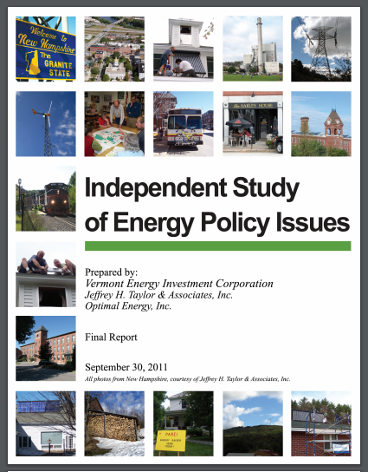
Guiding Principles of PI Design
Performance ≠ Actions
Measurable and Objective
Multivariate
Drive key policy objectives
Scalable
Countervailing influences
A little money can go along way
Avoid Perverse Incentives
Notes:
All cost-effective goal seems contradictory to HB317. Ditto for demand reduction goal.
NH and ME growth a function of less pursuit of EE. Better load factors.
Delete ICAP tags
Commissioners consistently pushing each regulated electric utility in last year’s default service hearing to hear how they’re trying to reduce ICAP tags

Slide 4
EERS Objectives
Goals originally set by PUC according to savings as % retail sales, embracing “all cost effective” as long-term goal
Legislature also directed PUC to set demand reduction goal
NH is one of only two states in ISO-NE with forecasted peak load growth (other is ME)
2019 Settlement specifies demand reduction metric without specifying Summer kW, Winter kW, Electric, or Gas
Notes:
All cost-effective goal seems contradictory to HB317. Ditto for demand reduction goal.
NH and ME growth a function of less pursuit of EE. Better load factors.
Delete ICAP tags
Commissioners consistently pushing each regulated electric utility in last year’s default service hearing to hear how they’re trying to reduce ICAP tags

Slide 5
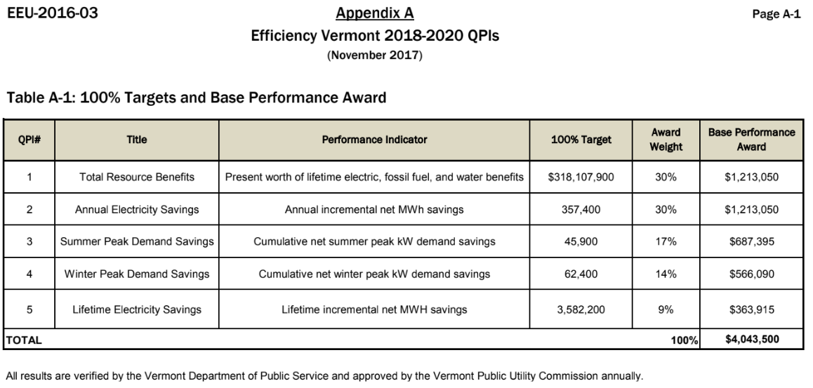
Vermont Framework Electric Performance Incentives
Similar to MA “Benefits” component, but without NEIs
RI MW Target is also 30% of PI
Source: https://drive.google.com/file/d/1TioHRzhBUON27te1rPfnvI4Q9mGbCYEc/view
Notes:
Showing 100%, threshold 75% and stretch 125%.
Stretch payout 50% higher than first band.
Is the 6.875 and/or the 5.5% set in stone?
VT has lots of countervailing metrics – will discuss below and recommend some.
VT and RI weights for Demand approx. 30%, but MA only 4%
- recommend somewhat less, discuss below

Slide 6
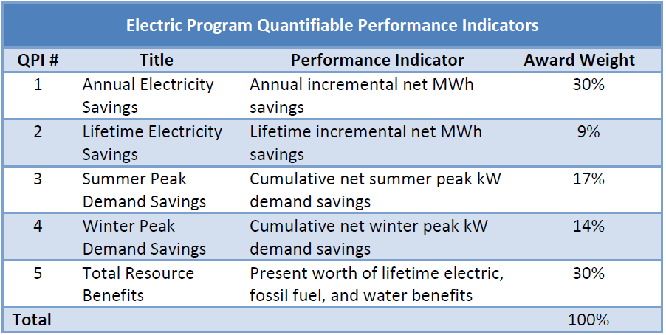
OCA Testimony Proposal Electric Framework
Quantifiable Performance Indicators (QPIs) taken directly from VT QPI model, though some have been left out (see early VEIC advice)
Minimum Performance requirements (MPRs) based on existing NH precedent, but near mirror of some of the VT MPRs
Source: https://www.puc.nh.gov/regulatory/Docketbk/2017/17-136/TESTIMONY/17-136_2018-11-02_OCA_DTESTIMONY_LOITER.PDF

Slide 7
OCA Testimony Proposal Eversource Electric Illustrative
PI begins at 75% of target
Stretch (PI ceiling) is 125%, linear slope
No stretch MWh target, based on utility interpretation of HB 317
TRB and others at portfolio level
Target QPIs, target PI, and ceiling PI all same as in plan
Source: https://www.puc.nh.gov/regulatory/Docketbk/2017/17-136/TESTIMONY/17-136_2018-11-02_OCA_DTESTIMONY_LOITER.PDF
Notes:
This is an example with the strict testimony approach.
Things to consider and discuss later:
- can we do non-linear scaling?
- 6.875/5.5% issues
HB317 and contradictions/limitations

Slide 8
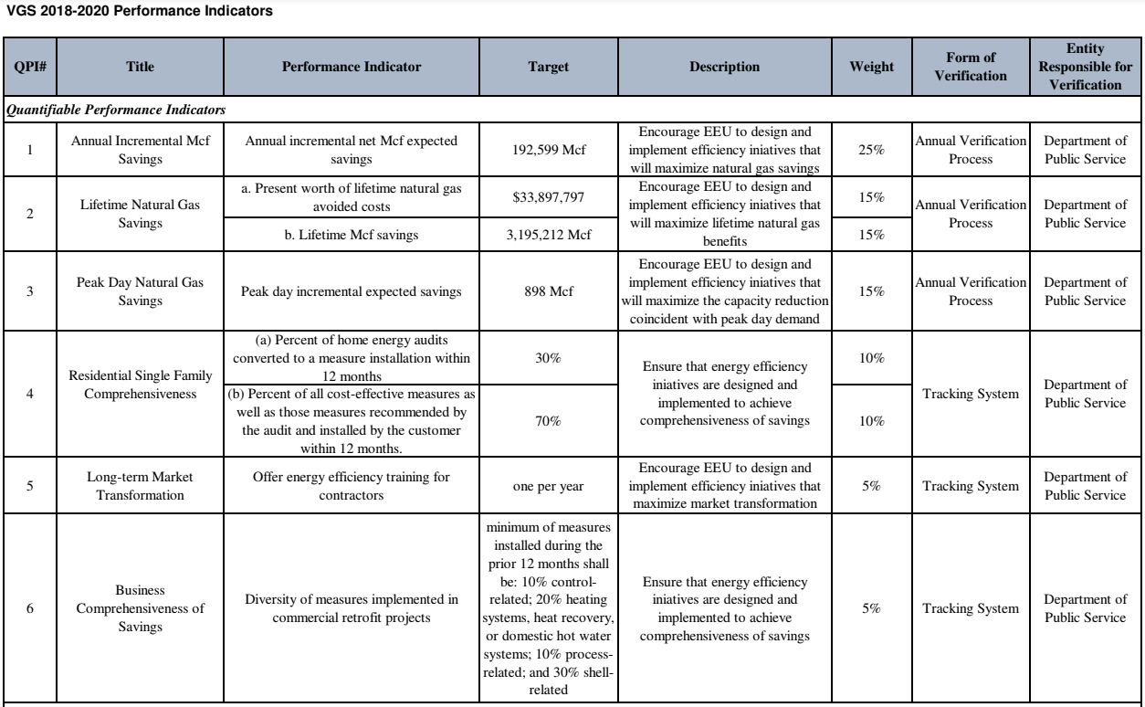
Vermont Framework Vermont Gas Systems PIs
Includes Peak day savings
Resource Benefits metric under development @ filing
Source: https://drive.google.com/file/d/14cM_AtyR2WH_K6O3SLPWOMQKCCqeT0Ll/view
Notes:
Basically have TRB metric, just exprested as lifetime savings gas benefits.
Lifetime 30%, and should be less of an issue than Electric because hasn’t traditionally been a problem with gas programs. Recommend consider higher weight for lifetime for NH
Peak Day:
Does NH have peak day goals?
If not, should they?
Pipeline capacity?
Weight for peak is half of elec.
Market transformation goal is really a milestone metric, not a performance one.
Comprehensiveness is example of countervailing concept.
Note only 5%

Slide 9
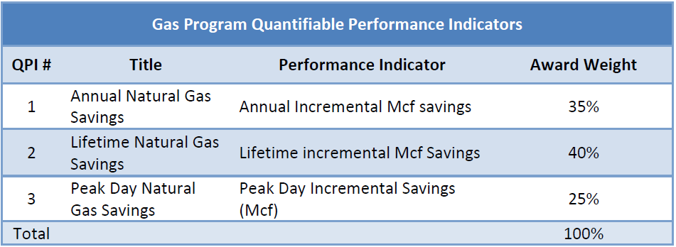
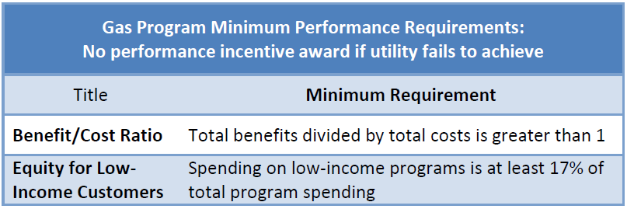
OCA Testimony Proposal Gas Framework
Would need to add total resource benefit QPI
Should be able to deduce from benefit-cost model/TRM
Source: https://www.puc.nh.gov/regulatory/Docketbk/2017/17-136/TESTIMONY/17-136_2018-11-02_OCA_DTESTIMONY_LOITER.PDF
Notes:
Note no TRB
Believe this was oversight because in VT bundled in one box
Regardless, it doesn’t make sense to eliminate a TRB goal if have one for electric.

Slide 10
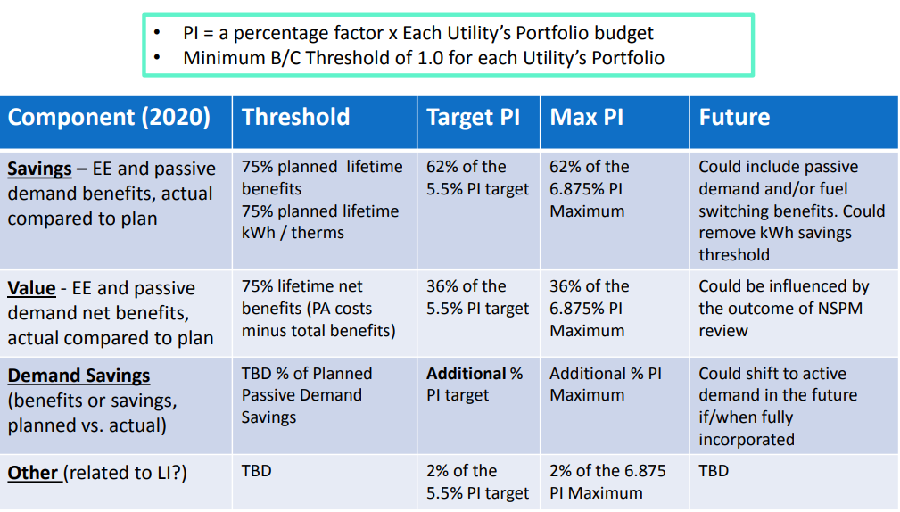
Joint Utilities’ January Presentation Potential 2020 Performance Incentive
Notes:
Not clear how they would allocate between benefits and savings (62% combined)
Not clear why suggesting possible removal of threshold.
KW only possible for future, but Order requires it.
Referents NSPM and value based on total net benefits.
-- recommend going to TRB less utility cost.
Demand listed but not recommended to have any weight.
Like concept of 2% on other related to LI
--- would recommend 2-3 metrics and perhaps 2% of money on each ($50k eversource)
smaller utilities might need more than 2%
floor of $25,000?

Slide 11
Utility Illustrative Proposal OCA Assessment
Agree
Portfolio-wide screen allows for program innovation
Agree to savings and value as components, with value component utilizing utility cost
Threshold for PI should be 75% of each target (5.5 percent spend), and should scale linearly to 125% of target (6.85% of spend)
Recommendation/Clarification
Further demand reduction emphasis; VT and RI place 30% of PI on passive demand reduction, while Mass is only 4% because ADR is new
Passive demand savings set for 2020 at current target and should be component of current PI pool, not additional PI
Moving to portfolio wide screen could be accompanied by move to benefit-cost threshold of 1.2:1
Notes:
Like value, but should be TRB-UCT
-- can consider eliminating TRB then and just putting all weight to value.
-- HB317 interpretation may dictate this.
Threshold and stretch appear to be fixed amounts, but if flexibility recommend inflection point.
Suggest lowering Demand to total 20%
DR should not be in this, and once a plan developed can have its own PIs, and they likely don’t need to be as large.
If just minimum, then really should be BCR > 1.2
--- if <1.0 than complete failure, clearly not deserving PI and some parties likely to push for not full cost recovery.
--- 1.2 would still clearly be a failure too for most electric plans at least.
--- do we really need?
EVT history of why this is there.

Slide 12
OCA Proposed Framework Electric Programs
Electric Program Quantifiable Performance Indicators
QPI # | Title | Performance Indicator | Award Weight
1 | Annual Electricity Savings | Annual incremental MWh savings | 15%
2 | Lifetime Electricity Savings | Lifetime incremental MWh savings | 15%
3 | Summer Peak Demand Savings | Cumulative net summer peak kW demand savings | 15%
4 | Winter Peak Demand Savings | Cumulative net winter peak kW demand savings | 15%
5 | Total Resource Savings | Present worth of lifetime resource benefits | 20%
6 | Value | Total resource savings minus utility cost | 15%
Total |  |  | 95%
1:1
or
1:1.2
Consider combining into single Value?
Resources = Electric, gas, unregulated fuels, and water only. No NEIs
Electric Program Minimum Performance Requirements: No performance incentive award if utility fails to achieve
Title | Minimum Requirement
Benefit/Cost Ratio | Total benefits divided by total costs is greater than 1.2
Equity for Low-Income Customers | Spending on low-income programs is at least 17% of total program spending
Notes:
Proposed changes from original OCA testimony:
Increased weight on lifetime savings – this pushes toward more comprehensiveness and persisting benefits.
MWh still equal to lifetime because actual goals are annual.
Demand reduced to total 20% weight from 30%
Not as critical as energy, comes anyway, but want to encourage broad range of comprehensiveness and not just focus on the “peakiest” things.
Consider combing TRB and Value:
Given budget is capped, in a way this is same thing
If HB317 stands, then should all be value because only thing that can be pursued for stretch. 100% weight on value, remove from demand because can’t pursue passive demand without some energy savings.
Leaves 5% for countervailing metrics:
Suggest at least one on equity (LI? MF? Small Biz?)
Suggest one on comprehensiveness (average % savings for a particular segment or program?)
Consider overarching policy goals as have been expressed by legislature and all stakeholders in setting.
Different than Minimums, not penalty but extra earnings.

Slide 13
OCA Proposed Framework Gas Programs
Gas Program Quantifiable Performance Indicators
QPI # | Title | Performance Indicator | Award Weight
1 | Annual Natural Gas Savings | Annual Incremental Mcf savings | 15%
2 | Lifetime Natural Gas Savings | Lifetime incremental Mcf Savings | 15%
3 | Peak Day Natural Gas Savings | Peak Day Incremental Savings (Mcf) | 30%
4 | Total Resource Benefits | Present worth of lifetime resource benefits | 15%
5 | Value | Total resource savings minus utility cost | 20%
Total |  |  | 95%
1:1
or
1:1.2
Consider combining into single Value?
Resources = Electric, gas, unregulated fuels, and water only. No NEIs
Gas Program Minimum Performance Requirements: No performance incentive award if utility fails to achieve
Title | Minimum Requirement
Benefit/Cost Ratio | Total benefits divided by total costs is greater than 1.2
Equity for Low-Income Customers | Spending on low-income programs is at least 17% of total program spending
Notes:
Still leaves 5% for countervailing for gas too.

Slide 14
Massachusetts PI Framework PI Inputs and MA DPU 2019-21 EE Plan Order
Issue | Approve? | Notes
Removes participant cost from value component of PI | Yes | MA DOER argued unsuccessfully against this
Active Demand Reduction PI Component (~4%) | Yes | Only included in plan at last minute after settlement with AG/DOER
Renter PI Component | No | DPU says utilities should already be tracking/targeting renters, and don’t deserve extra PI
Programs screen at sector level | Yes | But PI pool reduces for programs that don’t screen
Energy Optimization benefits/costs | Yes/No | Accepted energy optimization as a strategy, but were concerned about accuracy of inputs and asked for another filing
GHG Benefit Value | Yes/No | Rejected DOER Report’s value for EE GHG Benefits, and instead accepted localized marginal abatement cost (which is essentially offshore wind cost)
Source: https://drive.google.com/file/d/1vpQE50E9icAnQRxnuoDSqzjqsmmmf7hg/view?usp=sharing

Slide 15
Energy Optimization
OCA recommends no additional incentive to encourage the electric utilities to embrace “energy optimization” because utilities already have an incentive to fuel switch via Averch-Johnson effect: load growth>rate base growth>more utility ROE>more utility profits
Averch-Johnson effect has led regulators to be skeptical of utilities encouraging load growth — including NH — because it has the potential to be detrimental to ratepayers
Because of strong inherent incentive, need to ensure only appropriate energy optimization is happening
Should be only both cost-effective (TRC BCR>1.0) AND positive source Btu savings
Understand a separate working group will be dealing with this regarding cost-effectiveness
Savings claims are the important issue to resolve: recommend source Btu savings converted back to kWh at source for kWh savings claims (or just have MMBtu goals)

Slide 16
Energy Optimization, cont.
What’s changed?
Successful EE programs reducing overall usage more than peak load growth, leading to declining load factor (we use less kWhs, but the kWs continue to cost more)
NY PSC: “In cases of conversion from oil or propane, heat pumps present a near-term benefit to non-participating customers by increasing the number of electricity sales units across which the utility revenue requirement is recovered.” (December 2018)
Technologies have evolved so that we can encourage conversion from delivered fuels to highly efficient end uses technologies which build load during the non-peaking hours of the system but can also be dependably dispatched/controlled during peak hours.
Any performance incentive associated with energy optimization should be demand or active demand management-based to ensure its as good for ratepayers as it is utilities

Slide 17
OCA Proposal Stretch Goals
Original OCA Testimony proposed no stretch incentives on MWh or Therms. All stretch PI weight put on Demand and Benefits.
Result of response to HB317 Interpretation and EER Settlement
OCA believes, however, that interpreting statute as restricting increased savings, rather than only capping spending is:
Not an appropriate interpretation of legislative intent
Directly contradicts clear policy intent of a long term goal of all cost-effective efficiency
Significantly constrains development of meaningful stretch PI metrics
Programs will be difficult to manage, and disruptive to the market, if utilities can never exceed goals while trying to still meet 100% targets.
If interpretation stands, OCA recommends all stretch PI is allocated 100% to the Value metric
Only utility option for improved performance will be to be more cost efficient and underspend and return SBC funds to ratepayers (after carryover).
Passive demand and TRB cannot be effectively pursued without obtaining some energy savings too

Slide 18
Energy Efficiency Resource Standard Historical Perspective and $/kWh SBC Rate
Order No. 25,932 Establishing an EERS
Near term electric goals as a percent of 2014 delivered sales:
2018= .8%; 2019= 1.0%; 2020= 1.3% (page 55)
SBC rate to achieve those goals (page 52):
EERS Order | Eversource | Unitil | Liberty
2018 | $0.00488 | $0.00486 | $0.00480
2019 | $0.00631 | $0.00626 | $0.00615
2020 | $0.00850 | $0.00841 | $0.00825
Also embraced
“all cost-effective”
as long term goal
2018-20 Plan & 2019 Settlement | Eversource | Unitil | Liberty
2018 | $0.00455 | $0.00456 | $0.00457
2019 | $0.00586 | $0.00576 | $0.00535
C&LM Adjustment Factor | Liberty
1991 | $0.00739
1992 | $0.00805

Slide 19
Thank You
Philip Mosenthal, Optimal Energy
On Behalf of NH OCA
mosenthal@optenergy.com

Slide 20
Appendix Peak Load Growth/Other Aspects of VT Framework
Peak Load Growth in NH v. New England
VT Electric PI Framework Minimum Performance Requirements
VT PI Framework Thermal Efficiency and Process Goals
VT PI Framework Thermal Efficiency and Process Minimum Performance Requirements
VT Gas PI Framework Minimum Performance Requirements

Slide 21
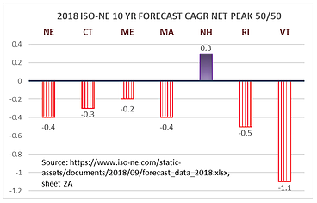
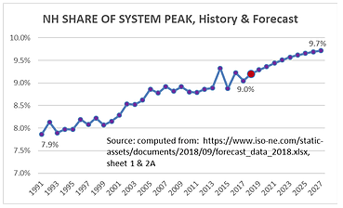
Peak Load Growth New Hampshire v. New England

Slide 22
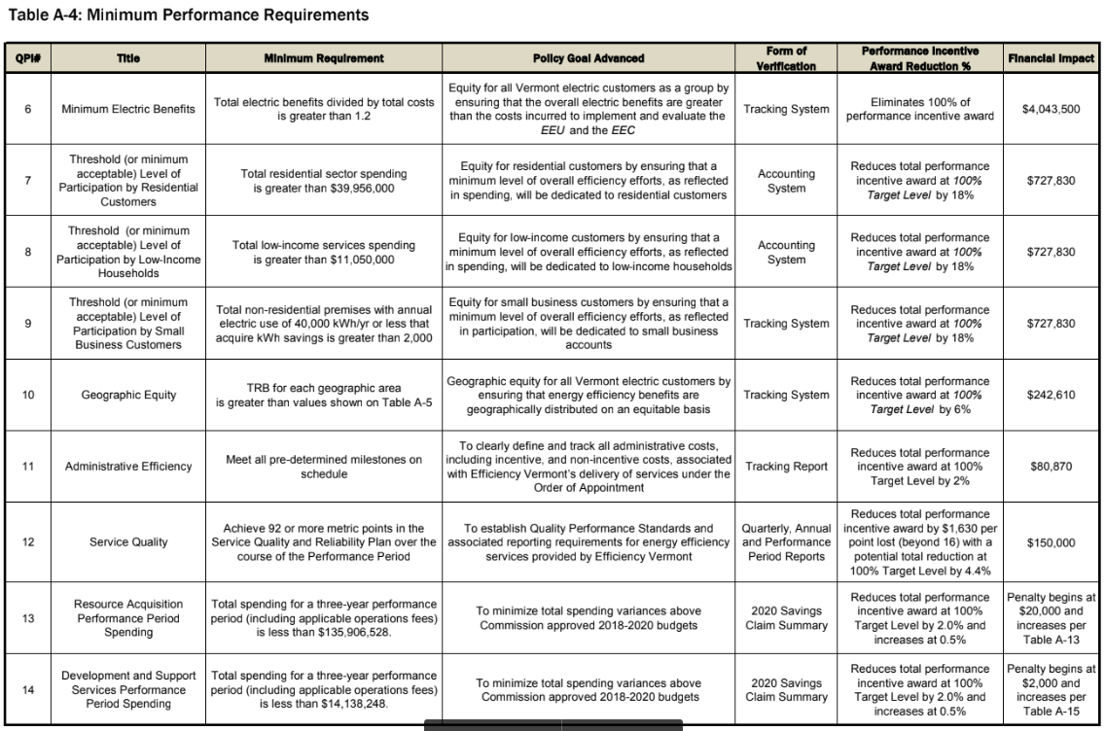
Vermont Framework- Electric MPRs
Source: https://drive.google.com/file/d/1TioHRzhBUON27te1rPfnvI4Q9mGbCYEc/view

Slide 23
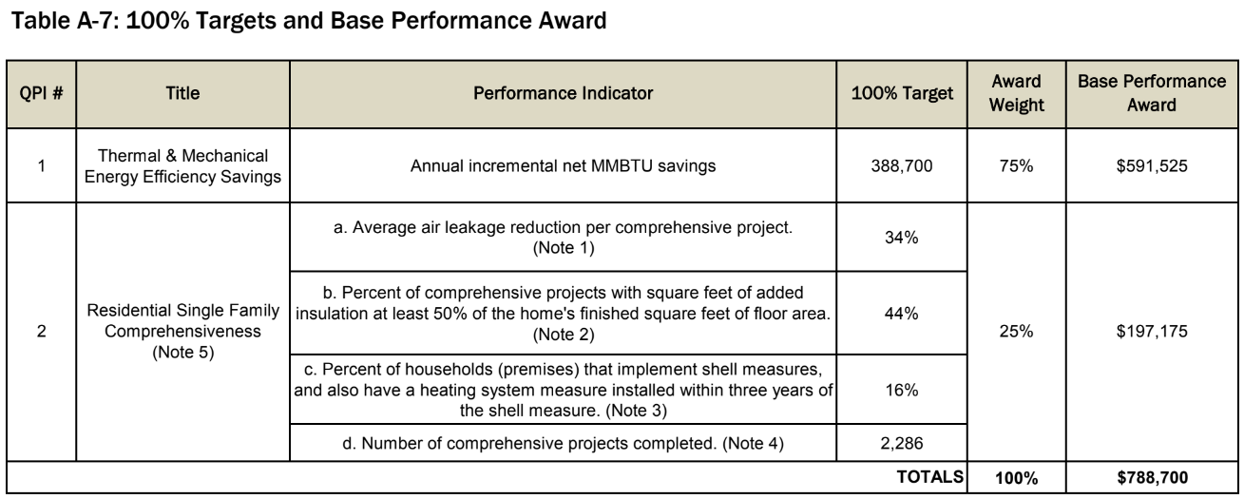
Vermont Framework Thermal Energy and Process Fuels PIs
Source: https://drive.google.com/file/d/1TioHRzhBUON27te1rPfnvI4Q9mGbCYEc/view

Slide 24
Vermont Framework Thermal Energy and Process Fuels MPRs
Source: https://drive.google.com/file/d/1TioHRzhBUON27te1rPfnvI4Q9mGbCYEc/view

Slide 25
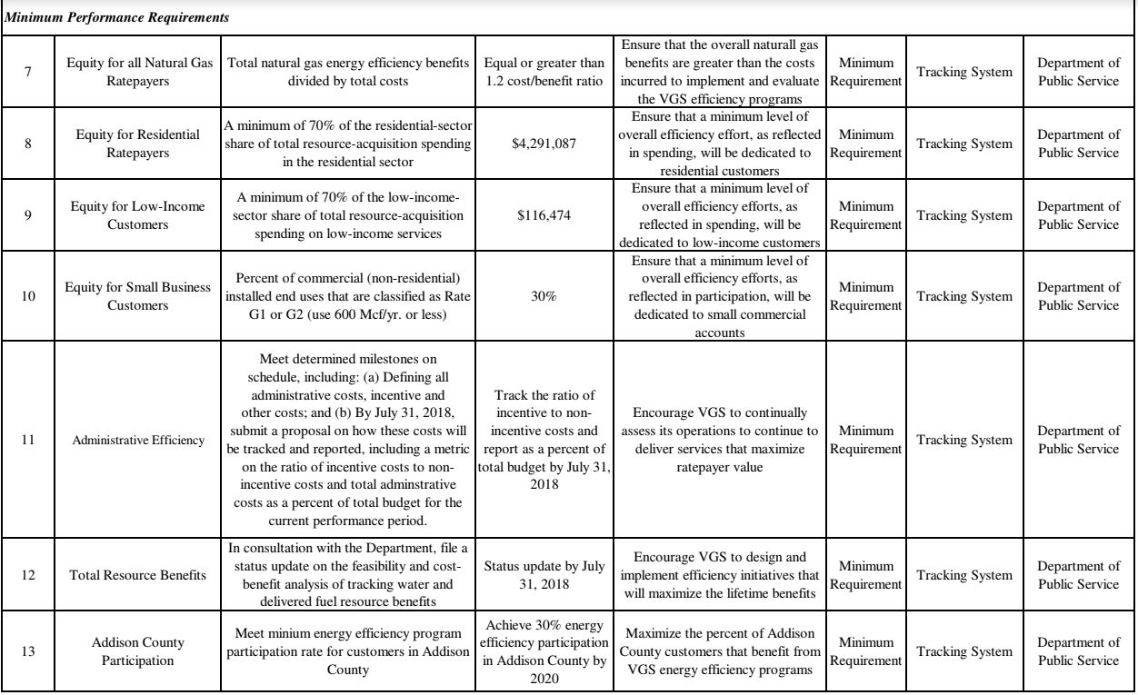
Vermont Framework Vermont Gas Systems MPRs
Source: https://drive.google.com/file/d/14cM_AtyR2WH_K6O3SLPWOMQKCCqeT0Ll/view

