Slide 1
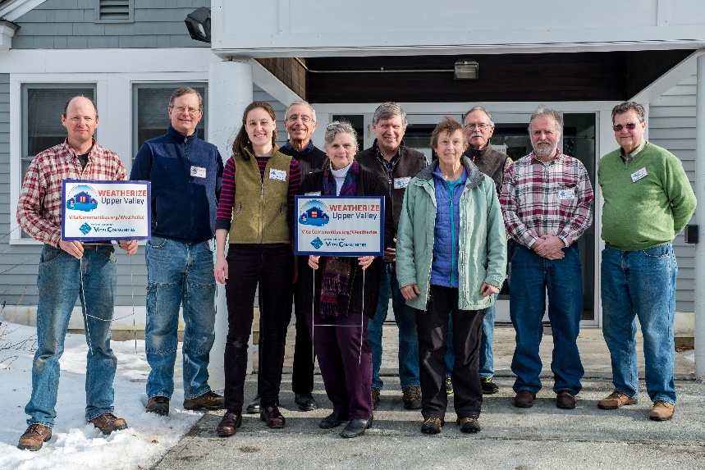
Weatherize Upper Valley
Sarah Brock
Energy Program Manager
Sarah@VitalCommunities.org
802.291.9100 x109

Slide 2
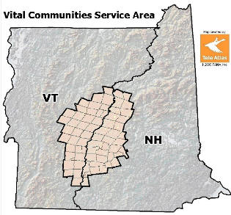
We bring people together to take on issues where an independent voice and regional approach are essential

Slide 3
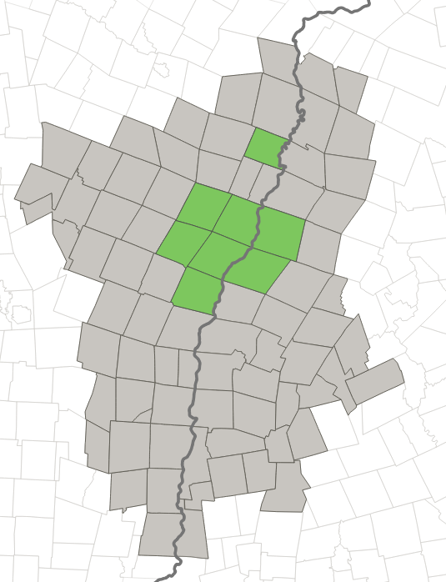
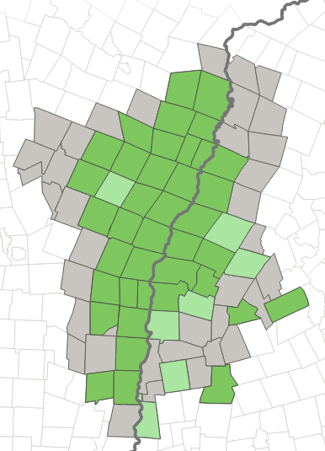
Town Energy Committees
2007
2017

Slide 4
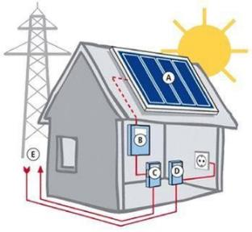
Our Strategy: Bring People Together
Volunteer
Teams
Local Contractors
Residents

Slide 5
Starting Point: 2016
New Hampshire
We have:
Rebate Program
Financing Program
We need:
Contractors ( )
Marketing
Program Participation
2016 NHSaves Program Participation
38

Slide 6
Barriers
Cost
Finding & trusting a contractor
Not everyone can use HPwES
Awareness
Complexity
Norming
Inertia
Low fuel costs, weather

Slide 7
Barriers
Cost
Not all can use HPwES
Finding a contractor
Awareness
Complexity
Norming
Inertia
Low fuel costs / weather
$100 audit for ALL
Trusted Contractors
Volunteer Support & Shared Participant Info
Deadlines
Incentives

Slide 8
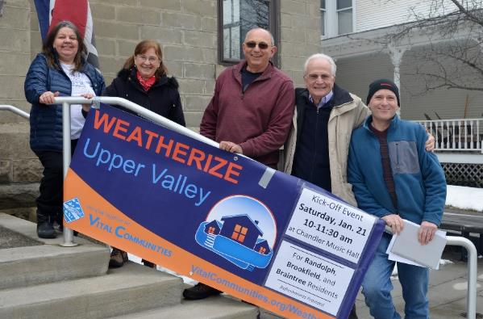
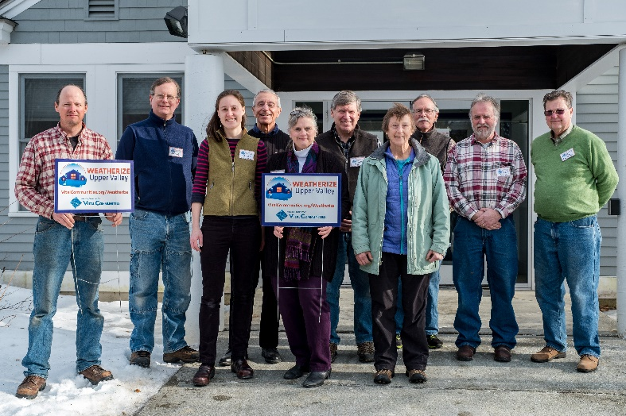
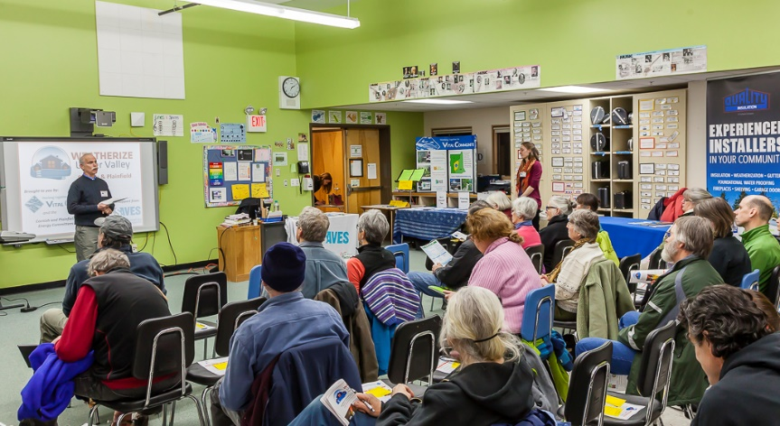
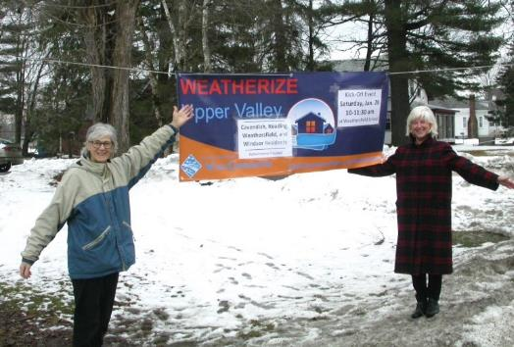

Slide 9
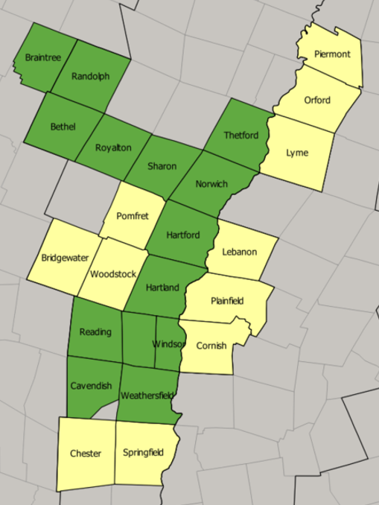
2016 participation:
6 towns, 6 HPwES participants
 | 2018 NH
Towns | 6
Contractors | 7
Sign Ups | 371
Energy Audits | 242
Weatherized Homes | 97
Notes:
Stabilize and fund rebate programs.
Grow the contractor base.
Get on the ground in underserved communities to tap ready demand.

Slide 10
 | 2018 NH - HPwES
Qualified for HPwES | 60-70%
Contracts Signed | 71 HPwES / 26 not
On Wait List at Program End | ~20 (16 Liberty, 4 NHEC)
Eversource | 62 qualified → 38 contracts
NHEC | 29 qualified → 20 contracts
Liberty | 44 qualified / 19 approved →13 contracts 16 wait list / 9 declined
2016 participation:
Notes:
Ended the program with 20 on the wait list

Slide 11
Looking Ahead
2019
Canaan/Enfield
Kearsarge Region
Mt. Washington Valley
2020
Hanover
Claremont
Others?
Notes:
Ended the program with 20 on the wait list

Slide 12
Lessons Learned
Still lots of unmet demand for HPwES
Local partnerships AND traditional marketing needed
Utilities and contractors were not quite prepared
Notes:
Having well organized local volunteers to spread the word and help customers through the process seemed to make a difference.
I think your campaigned showed that there are still pockets of high fuel use customers out there so that HPwES budget still needs to be robust.

Slide 13
On the other side of the river…
Vermont
We have:
Rebate Program
Financing Program
Marketing
Contractors ( )
We need:
Program Participation
New Hampshire
We have:
Rebate Program
Financing Program
We need:
Program Participation
Marketing
Contractors ( )
118
38

Slide 14
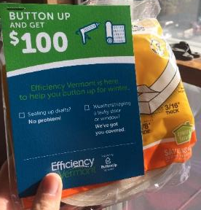
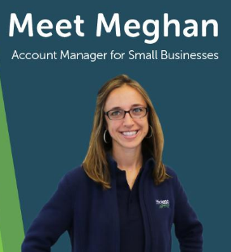
On the other side of the river…
Notes:
Button Up program (mention evolution, including current model)
DIY program iterations (mention old model, and current seasonal model) Note that our original program is still available, though we are making a few tweaks – regardless, the new model is intended to provide an even easier way for folks to engage in concert with Button Up
Downtown program (getting staff on the ground to do walk-throughs, business and residential) note there will be 4 more towns served in 2019 (2 in Northern VT, 2 in Southern VT)
Heat Saver interest rate buy downs, income based, Re-introducing the 0% interest rate for income-qualified customers in 2019
income-based incentives This will be moving forward in stages over the course of Q1-Q3 2019 – what we are working on defining are the specific incentive levels and what the transition period and contractor process looks like; the incentive tiers will be aligned with the 3 current income buckets for Heat Saver Loan
Serving customers on the low income wait list - partnership with Capstone to help bring service to customers on the waiting list for low income weatherization – through a combination of enhanced incentives, 0% Heat Saver Loans, financial counseling, and a savings guarantee. If it works, we will definitely be looking at how this type of approach can be scaled statewide, in partnership with the other low income weatherization agencies.
Volunteer Crews - We are also looking at how we can help train and deploy volunteer crews to do light weatherization in homes of low income and senior citizen customers – the goal is to improve comfort and reduce costs for these customers, while supporting local energy committee capacity and engagement (this is more of an “in the works” program than one that is officially deployed – but we did test it earlier this fall and were excited with the results: 10-20% air leakage reductions in 4 homes where current DIY measures were deployed)
Contractor Training/Deployment - likely leveraging our Efficiency Excellence Network as a platform for investing in areas where new contractors need to be trained/deployed or where current contractors need more staff, etc.

Slide 15
Thank You!
Sarah Brock
Energy Program Manager | VitalCommunities.org/Energy
Sarah@VitalCommunities.org
802.291.9100 x109

