Slide 1

Beneficial Electrification: The Basics
21 September 2018
EESE Board, Concord, New Hampshire
David Farnsworth Senior Associate
The Regulatory Assistance Project®
+1 802 498 0708
Jessica Shipley Associate
The Regulatory Assistance Project®
+1 802 498 0734

Slide 2

Introduction
The Regulatory Assistance Project is a global,
non-profit, non-advocacy team of veteran regulators advising current regulators on energy sector issues. (www.raponline.org)
Regulatory Assistance Project (RAP)®
2

Slide 3
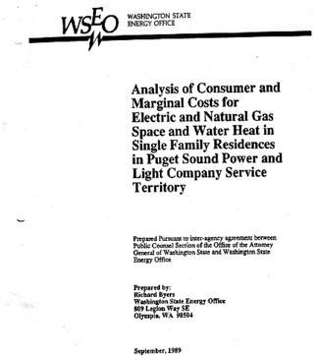
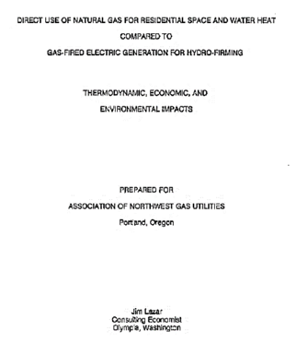
Regulatory Assistance Project (RAP)®
3

Slide 4
Fuel Choice – 1989
Wind and solar were not viable economic resources
Best heat pumps had a coefficient of about 2
Heat pump water heaters were not commonly available
Best natural gas generating plants had about 42% conversion efficiency
Regulatory Assistance Project (RAP)®
4

Slide 5
Fuel Choice Today
Wind and solar are coming in at two and three cents per kWh
Modern heat pumps and heat pump water heaters have COPs of 3 or better in mild climates, and improving results in cold climates
New gas generation is as much as 62% efficient, converting gas to electricity when wind not blowing and sun not shining
Modern technology enables load control
Regulatory Assistance Project (RAP)®
5

Slide 6
December, 2017
Xcel bid median prices $/kWh
$.029
$.018
SOLAR
WIND
Regulatory Assistance Project (RAP)®
6

Slide 7
Existing plants vs. Excel bids
$37/MWh
$30/MWh
_{$25/MWh} $30/MWh
$18/MWh
Fuel O&M Xcel Bids
$.030/kWh
$.037/kWh
$.029/kWh
$.025/kWh
$.018/kWh
COAL
GAS NUCLEARSOLAR
WIND
Existing Plant Average Fuel and O&M from USEIA Table 8.4 Electric Power Annual 2016
Regulatory Assistance Project (RAP)®
7

Slide 8
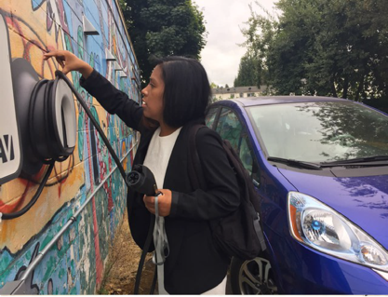
Innovative & Efficient End Uses – Electrification Is Underway
Photo credits: EPA Energy Star / Cassandra Profita/OPB/EarthFix
Regulatory Assistance Project (RAP)®
8

Slide 9
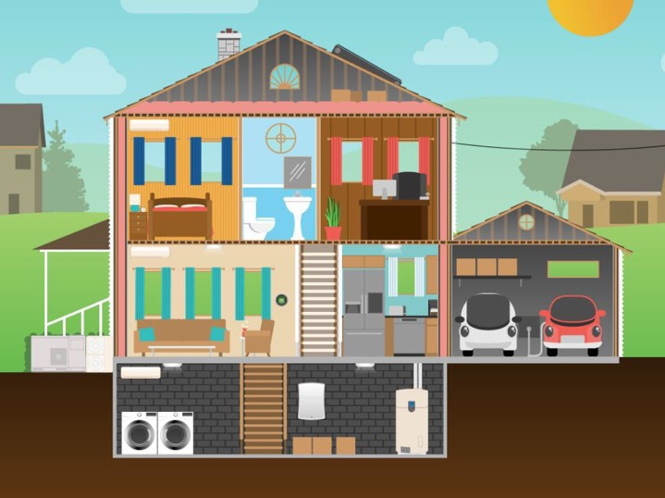
Regulatory Assistance Project (RAP)®

Slide 10

Efficient Building Code
Regulatory Assistance Project (RAP)®

Slide 11

High-efficiency Heat Pump with Air Exchangers
Regulatory Assistance Project (RAP)®

Slide 12

Ice Storage
Regulatory Assistance Project (RAP)®

Slide 13

Smart Thermostat
Regulatory Assistance Project (RAP)®

Slide 14
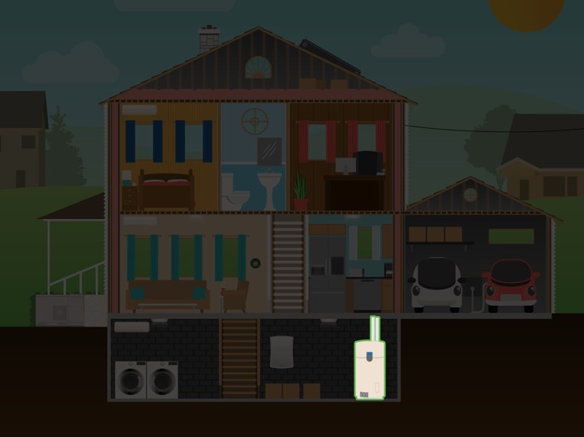
Grid-Integrated, Heat-pump Water Heater
Regulatory Assistance Project (RAP)®

Slide 15

Solar PV
Regulatory Assistance Project (RAP)®

Slide 16

Battery Storage
Regulatory Assistance Project (RAP)®

Slide 17

Smart Charging Electric Vehicles
Regulatory Assistance Project (RAP)®

Slide 18
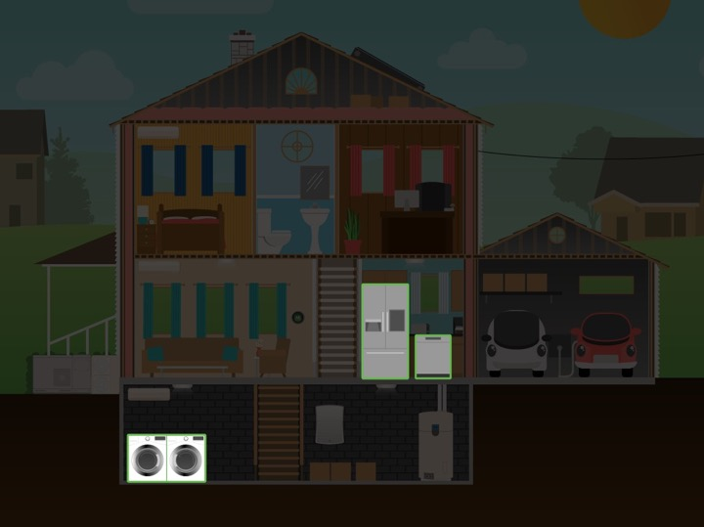
Smart Appliances
Regulatory Assistance Project (RAP)®

Slide 19
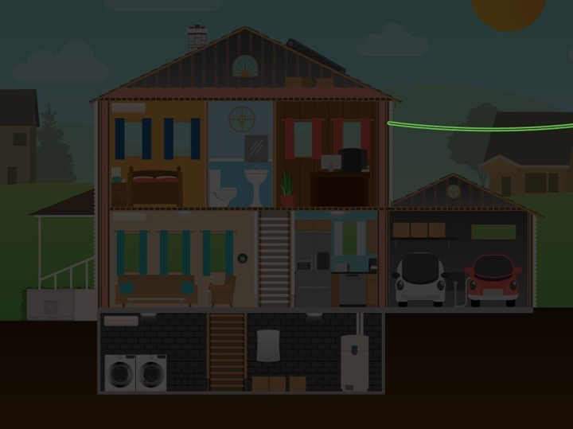
Still Connected to the Grid
Regulatory Assistance Project (RAP)®

Slide 20
Regulatory Assistance Project (RAP)®

Slide 21
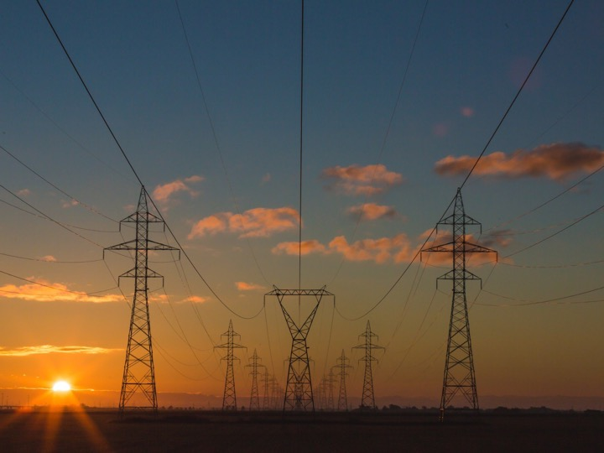
What’s “Beneficial Electrification”?
Isn’t ALL Electrification “Beneficial”?
Regulatory Assistance Project (RAP)®

Slide 22



Beneficial Electrification (BE) Better Positions Utilities for the Future
1. Saves Customers Money
Long-Term; More Services
2. Reduces Environmental Impacts
3. Enables Better Grid Management
Regulatory Assistance Project (RAP)®
22

Slide 23
Operationalizing Beneficial Electrification
Regulatory Assistance Project (RAP)®

Slide 24
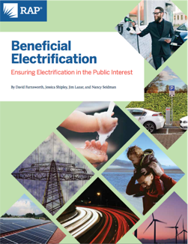
New RAP paper to help regulators:
Beneficial Electrification:
Ensuring Electrification in the Public Interest
Sets out six principles for regulators to help ensure that electrification is beneficial to consumers, the environment, and the grid.
https://www.raponline.org/knowledge-center/beneficial-electrification-ensuring-electrification-public-interest/
Regulatory Assistance Project (RAP)®

Slide 25

1. Put Efficiency First
Regulatory Assistance Project (RAP)®

Slide 26
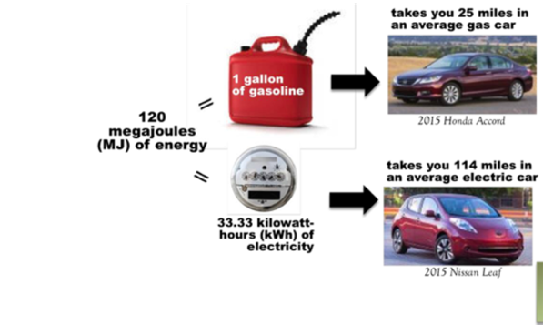
Efficiency Across Fuel Types
Source: JJ MCoy, ”Building “good load” to reduce carbon emissions”, 2016. http://nwenergy.org/wp- content/uploads/2016/01/Transpo-Electrification-TE-Workpaper-1-25-2016-FINAL.pdf.zip
Regulatory Assistance Project (RAP)®

Slide 27
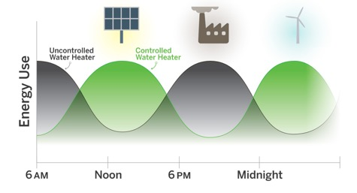
2. Recognize the Value of Flexible Load for Grid Operations
Regulatory Assistance Project (RAP)®

Slide 28
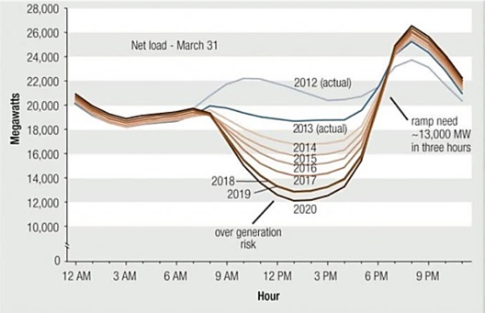

Value of Flexibility for Integrating Renewable Energy
Avoid Home Charging during these hours
Workplace Charging
Source: California ISO
Regulatory Assistance Project (RAP)®

Slide 29
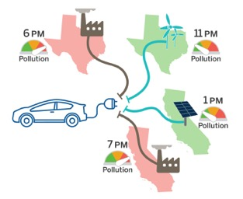
3. Understand the Emissions Effects of Changes in Load
Regulatory Assistance Project (RAP)®
29

Slide 30
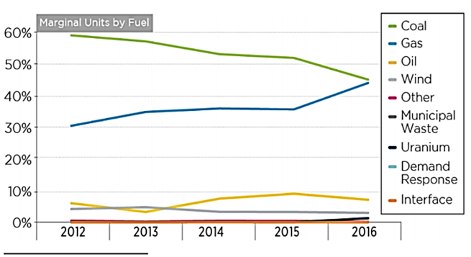
The Grid Is Getting Cleaner
Regulatory Assistance Project (RAP)®
39

Slide 31
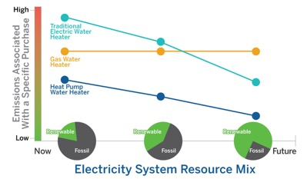
4. Use Emissions Efficiency as One Measure of Beneficial Electrification
Regulatory Assistance Project (RAP)®

Slide 32
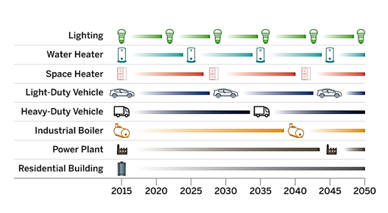
5. Measure Life Matters
Regulatory Assistance Project (RAP)®

Slide 33

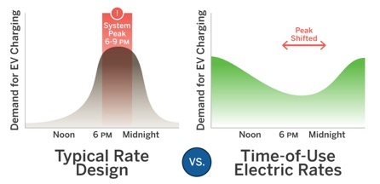
6. Design Rates to Encourage Beneficial Electrification
Regulatory Assistance Project (RAP)®

Slide 34
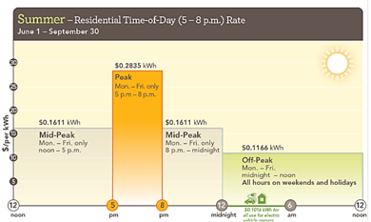
TOU Rates Can Focus on System Peak
Rate design should make customers’ choices to minimize their own bills…
Consistent with the choices necessary to minimize system costs.
Source: Sacramento Municipal Utility District https://www.smud.org/en/Rate-Information/Time-of-Day-Rates/Time-of-Day-5-8pm-Rate
Regulatory Assistance Project (RAP)®

Slide 35
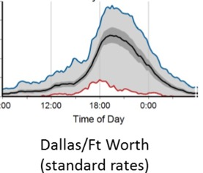
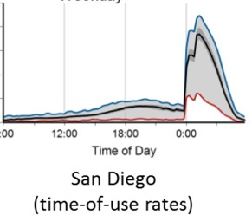
Price Can Influence When EVs Are Charged
Adapted from: M.J. Bradley, 2017
Regulatory Assistance Project (RAP)®

Slide 36
Not All Smooth Sailing:
Beneficial Electrification Will Encounter Policy Obstacles
Regulatory Assistance Project (RAP)®

Slide 37
Develop Your Policy Framework
Set Goals
Identify Barriers
Adopt Metrics
Recognize Timing
Include Affected Participants
Develop an Inclusive Process
Regulatory Assistance Project (RAP)®

Slide 38
Some Final Thoughts
Given the innovations occurring in today’s electric sector, there are many opportunities for electrification.
Beneficial Electrification sets out a framework and principles to help decision-makers ensure that electrification is beneficial to consumers, the environment and the grid.
Regulatory Assistance Project (RAP)®

Slide 39
If It’s Not Beneficial Then Don’t Do It
For electrification to be beneficial, it must satisfy at least one of the three following conditions, without adversely affecting the other two:
Saves consumers money over the long run
Enables better grid management
Reduces negative environmental impacts
Regulatory Assistance Project (RAP)®

Slide 40
Beneficial Electrification Resources from RAP
äBeneficial Electrification: Ensuring Electrification in the Public Interest
äUtilities Can Get a “LEG” Up with Beneficial Electrification—But Regulators Also Have to be Ready
äBeneficial Electrification: A Growth Opportunity
äBeneficial Electrification: A Key to Better Grid Management
äEnvironmentally Beneficial Electrification: The Dawn of Emissions Efficiency (Electricity Journal)
Regulatory Assistance Project (RAP)®
40

Slide 41



About RAP
The Regulatory Assistance Project (RAP)® is an independent, non- partisan, non-governmental organization dedicated to accelerating the transition to a clean, reliable, and efficient energy future.
Learn more about our work at raponline.org
David Farnsworth Senior Associate
The Regulatory Assistance Project®
+1 802 498 0708
Jessica Shipley Associate
The Regulatory Assistance Project®
+1 802 498 0734

