Slide 1
National Standard Practice Manual for
Energy Efficiency Cost-Effectiveness
Prepared by
The National Efficiency Screening Project
New Hampshire
EERS Benefit-Cost Workgroup
Tim Woolf, Synapse Energy Economics
March 15, 2018

Slide 2
NATIONAL STANDARD PRACTICE MANUAL
Published May 2017
New guidelines for
cost-effectiveness testing
Drivers…
  The traditional tests often do not capture or address pertinent state policies.
  The traditional tests are often modified by states in an ad hoc manner, without clear principles or guidelines.
  Efficiency is not accurately valued in many jurisdictions.
  There is often a lack of transparency on why tests are chosen and how they are applied.
National Standard Practice Manual

Slide 3
NSPM - BACKGROUND
NSPM Stakeholders
National Efficiency Screening Project (NESP) includes stakeholders working to improve EE cost-effectiveness.
Over 75 organizations representing a range of perspectives.
NSPM Authors
Tim Woolf, Synapse Energy Economics
Chris Neme, Energy Futures Group
Marty Kushler, ACEEE
Steve Schiller, Schiller Consulting
Tom Eckman (Consultant and formerly Northwest Power & Conservation Council)
National Standard Practice Manual

Slide 4
NSPM – BACKGROUND CONTINUED
NSPM Review Committee
Roughly 40 experts representing a variety of organizations from around the country.
Provided several rounds of review/feedback on draft manual.
NSPM Funding, Coordination, and Advisors
Coordinated and funded by E4TheFuture
Managed by Julie Michals, E4TheFuture
Earlier work on the NESP and NSPM was managed by the Home Performance Coalition
For more information: http://www.nationalefficiencyscreening.org/
Advisory Committee input on outreach & education
National Standard Practice Manual

Slide 5
NSPM: Purpose
  Defining policy-neutral principles for developing cost-effectiveness tests.
  Establishing a framework for selecting and developing a primary test.
  Providing guidance on key inputs.
National Standard Practice Manual

Slide 6
NSPM: Scope
Focus is on utility customer-funded energy efficiency resources.
Addresses 1st order question: “which EE resources merit acquisition?”
  Principles and framework apply to all other resources (including other types of distributed energy resources).
NSPM provides a foundation on which jurisdictions can develop and administer a cost-effectiveness test, but does not prescribe “the answer”
National Standard Practice Manual

Slide 7
What’s Covered -- NSPM Outline
Executive Summary
Introduction
Part 1: Developing Your Test
Principles
Resource Value Framework
Developing Resource Value Test
Relationship to Traditional Tests
Secondary Tests
Part 2: Developing Test Inputs
Efficiency Costs & Benefits
Methods to Account for Costs & Benefits
Participant Impacts
Discount Rates
Assessment Level
Analysis Period & End Effects
Analysis of Early Retirement
Free Rider & Spillover Effects
Appendices
Summary of Traditional Tests
Cost-Effectiveness of Other DERs
Accounting for Rate & Bill Impacts
Glossary

Slide 8
Part I
Developing the Primary Cost-Effectiveness Test Using the Resource Value Framework
Universal Principles
Resource Value Framework
Primary Test:
Resource Value Test (RVT)

Slide 9
NSPM Principles
Recognize that energy efficiency is a resource.
Account for applicable policy goals.
Account for all relevant costs & benefits, even if hard to quantify impacts.
Ensure symmetry across all relevant costs and benefits.
Conduct a forward-looking, long-term analysis that captures incremental impacts of energy efficiency.
Ensure transparency in presenting the analysis and the results.

Slide 10
Implementing the Resource Value Framework Involves Seven Steps
Step 1 | Identify and articulate the jurisdiction’s applicable policy goals.
Step 2 | Include all utility system costs and benefits.
Step 3 | Decide which additional non-utility system costs and benefits to include in the test, based on applicable policy goals.
Step 4 | Ensure the test is symmetrical in considering both costs and benefits.
Step 5 | Ensure the analysis is forward-looking, incremental, and long-term.
Step 6 | Develop methodologies and inputs to account for all impacts, including hard-to-quantify impacts.
Step 7 | Ensure transparency in presenting the analysis and the results.

Slide 11
Cost-Effectiveness Perspectives
CaSPM Perspectives
Utility Cost Test
Utility system
perspective
TRC Test
Utility system plus the participant perspective
Societal Cost Test Societal perspective
NSPM Regulatory Perspective
Public utility commissions
Legislators
Muni/Coop advisory boards
Public power authorities
Other decision-makers
California Standard Practice Manual (CaSPM) – test perspectives are used to define the scope of impacts to include in the ‘traditional’ cost-effectiveness tests
NPSM introduces the ‘regulatory’ perspective, which is guided by the jurisdiction’s energy and other applicable policy goals

Slide 12

Identify and Articulate Applicable Policy Goals
Laws, Regulations, Orders: | Policy Goals Reflected in Laws, Regulations, Orders, etc.
 | Low-Cost | Fuel Diversity | Risk | Reliability | Environ-mental | Economic Development
PSC statutory authority | X |  |  | X
Low-income protection |  |  |  |  |  | X
EE or DER law or rules | X | X | X | X | X | X
State energy plan | X | X | X | X | X | X
Integrated resource planning |  | X | X |  | X | X
Renewable portfolio standard |  | X | X |  | X | X
Environmental requirements |  |  |  |  | X
Each jurisdiction has a constellation of energy policy goals embedded in statutes, regulations, orders, guidelines, etc.
The table illustrates how laws, regulations, orders, etc. might establish applicable policy goals.

Slide 13

Include All Utility System Costs and Benefits
Illustrative Utility System Costs | Illustrative Utility System Benefits
EE Measure Costs (utility portion – e.g. rebates) | Avoided Energy Costs
EE Program Technical Support | Avoided Generating Capacity Costs
EE Program Marketing/Outreach | Avoided T&D Upgrade Costs
EE Program Administration | Avoided T&D Line Losses
EE Program EM&V | Avoided Ancillary Services
Utility Shareholder Performance Incentives | Wholesale Price Suppression Effects
 | Avoided Costs of RPS Compliance
 | Avoided Costs of Environmental Compliance
 | Avoided Credit and Collection Costs
 | Reduced Risk
 | Increased Reliability
The principle of treating energy efficiency as a resource dictates that utility system costs and benefits serve as the foundation for all tests

Slide 14
Market Price Suppression Impacts (aka DRIPE)
Price suppression impacts are a utility system impact.
  They should be included in all cost-effectiveness tests.
EE savings in NH will have impacts for all customers in New England.
Several options for treating these impacts:
  Include impacts for the utility only.
  Include impacts for the entire state.
  Include impacts for all of New England.
Decision depends upon policy goals.
  Do you want to consider just the utility impacts, the state impacts, or the regional impacts?
Societal perspective:
  Are the price suppression benefits netted out by the costs to generators?

Slide 15

Include Non-Utility System Impacts Based on Jurisdiction's Applicable Policy Goals
Applicable policy goals include all policy goals adopted by a jurisdiction that could have relevance to the choice of which energy resources to acquire. Examples include:
Common Overarching Goals: | Provide safe, reliable, low-cost electricity and gas services; protect low-income and vulnerable customers; maintain or improve customer equity.
Efficiency Resource Goals: | Reduce electricity and gas system costs; develop least-cost energy resources; promote customer equity; improve system reliability and resiliency; reduce system risk; promote resource diversity; increase energy independence (and reduce dollar drain from the jurisdiction); reduce price volatility.
Other Applicable Goals: | Support fair and equitable economic returns for utilities; provide reasonable energy costs for consumers; ensure stable energy markets; reduce energy burden on low-income customers; reduce environmental impact of energy consumption; promote jobs and local economic development; improve health associated with reduced air emissions and better indoor air quality.
These goals are established in many ways:
Statutes
Regulations
Commission Orders
EE Guidelines
EE Standards
Directives
And Others

Slide 16
Illustrative Non-Utility System Impacts
Impact | Description
Participant impacts | Impacts on program participants, includes participant portion of measure cost, other fuel savings, water savings, and participant non-energy impacts
Impacts on low-income customers | Impacts on low-income program participants that are different from or incremental to non-low-income participant impacts. Includes reduced foreclosures, reduced mobility, and poverty alleviation
Other fuel impacts | Impacts on fuels that are not provided by the funding utility, for example, electricity (for a gas utility), gas (for an electric utility), oil, propane, and wood
Water impacts | Impacts on water consumption and related wastewater treatment
Environmental impacts | Impacts associated with CO2 emissions, criteria pollutant emissions, land use, etc. Includes only those impacts that are not included in the utility cost of compliance with environmental regulations
Public health impacts | Impacts on public health; includes health impacts that are not included in participant impacts or environmental impacts, and includes benefits in terms of reduced healthcare costs
Economic development and jobs | Impacts on economic development and jobs
Energy security | Reduced reliance on fuel imports from outside the jurisdiction, state, region, or country
This table is presented for illustrative purposes, and is not meant to be an exhaustive list.

Slide 17
Whether to Include Participant Impacts
Is a policy decision (based on jurisdiction’s policy goals)
  Policies may support inclusion of certain participant impacts (e.g., low-income, other fuels, etc.), but not necessarily all participant impacts
If participant costs are included, participant benefits should also be included (to ensure symmetry and avoid bias), even hard to quantify benefits
Key Questions:
  Why does it matter what participants pay?
  Why should non-participants pay for benefits to participants?

Slide 18
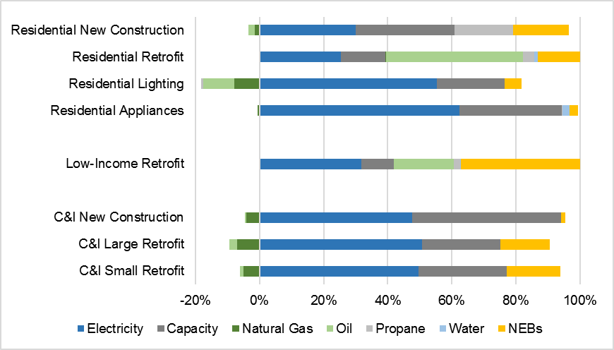
Implications of Including Participant Impacts

Slide 19
Reasons for Including Participant Impacts
Participant impacts should be included to account for the impacts on all utility customers: participants and non-participants.
Participant impacts should be included to account for the total cost of the resource, which is necessary to avoid uneconomic outcomes.
Participant impacts should be included to protect program participants.
Participant impacts should be included so that low-income participant benefits can be included.
Participant impacts should be included so that other fuel and water impacts can be included.
Question:
What are the counter-points?

Slide 20
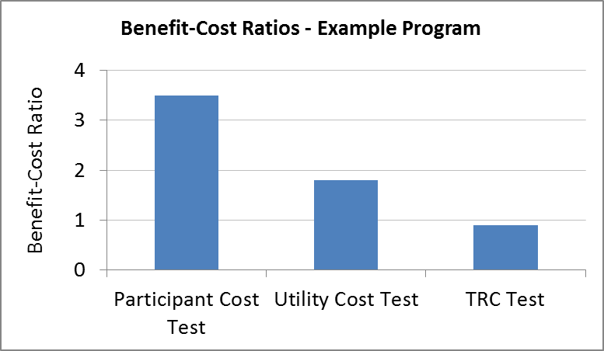
Impacts on the Utility + Participants?
The Total Resource Cost test supposedly indicates the utility system impacts plus the participant impacts.
However:
  Utility benefits = avoided costs
  Participant benefits = avoided prices
  Therefore the TRC test does not indicate impacts on participants
The TRC test is really the Societal Cost test without the societal benefits

Slide 21
Avoiding Uneconomic Outcomes
Hypothetical Example:
  Retail electric rates = 14 ȼ/kWh
  Total avoided costs = 10 ȼ/kWh
  EE measure cost = 11 ȼ/kWh
  EE measure rebate = 5 ȼ/kWh
 | Total Resource Cost With Participant Cost | Utility Cost Without Participant Cost | Participant Cost Without Utility Cost
Cost (ȼ/kWh) | 11 | 5 | 6
Benefit (ȼ/kWh) | 10 | 10 | 14
Benefit -Cost Ratio | 0.91 | 2.0 | 2.3
Would excluding the participant cost result in an uneconomic outcome?

Slide 22
Impacts on Low-Income Customers
Affected Party | Costs | Benefits
Efficiency Program Participant | Typically, none. Well-designed low-income programs cover all costs and remove all barriers to low-income customers. | Reduced energy burden Reduced O&M costs Increased comfort Increased health & safety/reduced medical costs Increased productivity Improved aesthetics Property improvements Reduced home foreclosures Reduced need to move/relocate due to unpaid bills
Society | Typically, none. | Alleviating poverty Improving low-income community strength and resiliency Reduced home foreclosures

Slide 23
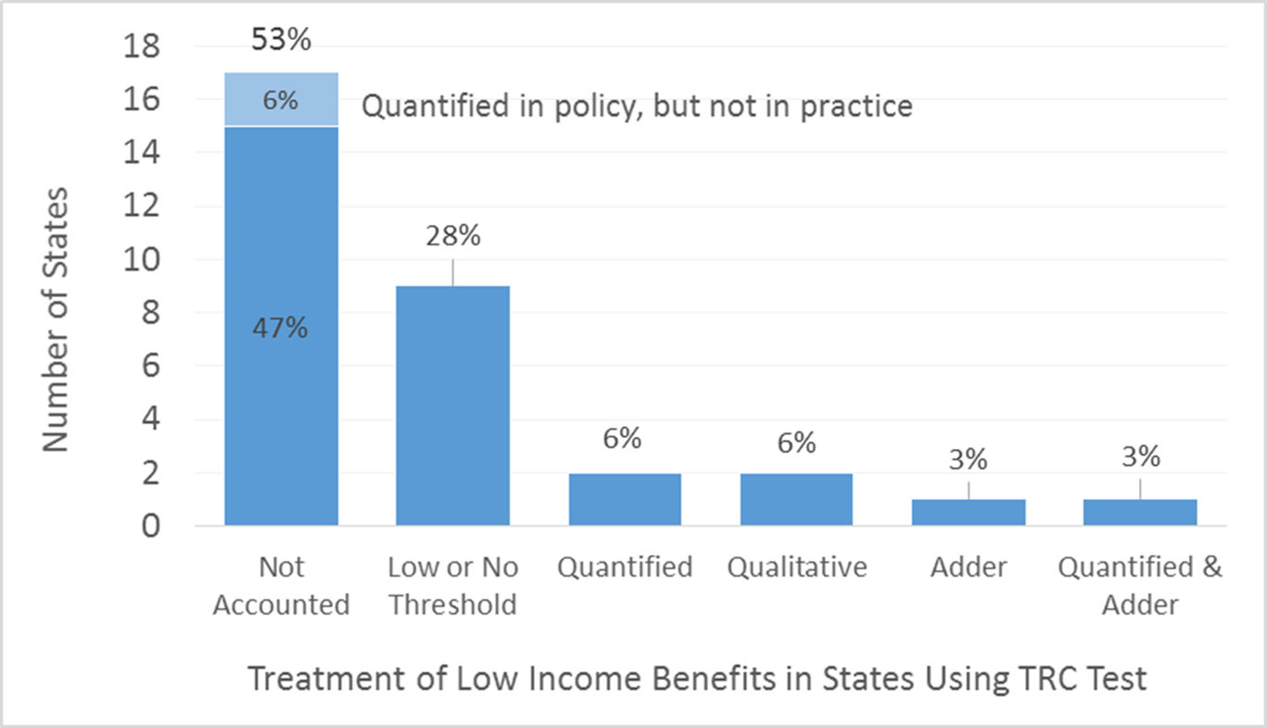
Treatment of Low-Income Impacts:
States using TRC Test

Slide 24
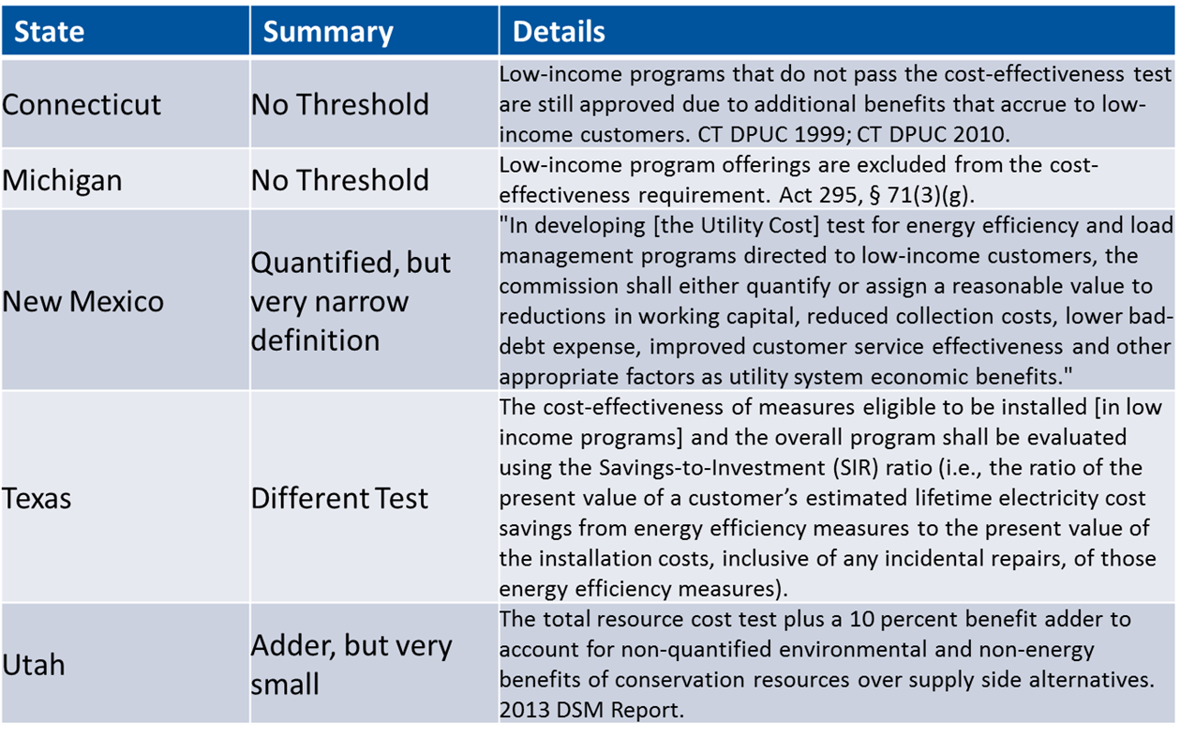
Treatment of LI Impacts:
States with Utility Cost Test

Slide 25
Other Fuel Impacts
When an efficiency program paid for by electricity customers also reduces (or increases) consumption of other fuels (gas, oil, propane, wood).
Program Options | Examples
Multi-Fuel Measures and Programs | To address new construction, home energy retrofits, HVAC measures
Fuel-Optimization Programs | To switch fuels use to the most efficient or least carbon intensive
Fuel-Neutral Programs | To offer whole-building programs and one-stop-shopping
CHP Programs | To make process heat as efficiently as possible
Strategic Electrification Programs | To reduce carbon emissions from space heating and electric vehicles
Question: Why should electricity customers pay for other fuel savings that accrue to gas, oil, and other customers?

Slide 26
Participant Non-Energy Impacts
Category | Examples
Asset value | Equipment functionality/performance improvement Equipment life extension Increased building value Increased ease of selling building
Productivity | Reduced labor costs Improved labor productivity Reduced waste streams Reduced spoilage/defects Impact of improved aesthetics, comfort, etc. on product sales
Economic well-being | Fewer bill-related calls to utility Fewer utility intrusions & related transactions costs (e.g., shut-offs, reconnects) Reduced foreclosures Fewer moves Sense of greater “control” over economic situation Other manifestations of improved economic stability
Comfort | Thermal comfort Noise reduction Improved light quality
Health & safety | Improved “well-being” due to reduced incidence of illness—chronic (e.g., asthma) or episodic (e.g., hypothermia or hyperthermia) Reduced medical costs (emergency room visits, drug prescriptions) Fewer sick days (work and school) Reduced deaths Reduced insurance costs (e.g., for reduced fire, other risks)
Satisfaction/pride | Improved sense of self-sufficiency Contribution to addressing environmental/other societal concerns

Slide 27
Participant Non-Energy Impacts
There are many such impacts.
Some of them can be very large.
Some of them are more important to customers than energy benefits.
They vary significantly across programs.
They can be difficult to measure, quantify, and monetize.
Estimates are often uncertain.
Symmetry Principle:
  If participant costs are included, then participant NEIs should be also.
  If participant NEIs are not included, participant costs should not be.
Hard-to-Quantify Principle:
  Relevant impacts cannot be ignored just because they are difficult to quantify.
The choice of whether to include participant NEIs is up to each jurisdiction, based on policy goals and considerations above.

Slide 28
Economic Development and Job Impacts
Job Impact estimates must be sound:
  Reflect the net impact, relative to supply-side options
  Be clear about boundaries (typically this means state impacts)
Three types of job impacts:
  Implementation of EE measures
  Jobs created by supplying and supporting EE implementation
  Jobs created as a result of utility bill savings
Whether to include job impacts is a policy decision.
How to include job impacts is challenging:
  Potential for double counting
  Can the job dollars be added to the other dollars?
Safest option is to present the job impact results alongside the other results.

Slide 29

Ensure Symmetry Across Benefits and Costs
Ensure that the test includes costs and benefits symmetrically
  If category of cost is included, corresponding benefits should be too
  (e.g., if participant costs included, participant benefits should also be included)
Symmetry is necessary to avoid bias:
  If some costs excluded, the framework will be biased in favor of EE;
  If some benefits excluded, the framework will be biased against EE.
  Bias in either direction can result in misallocation of resources (over or under investment)
    higher than necessary costs to meet energy needs
    too little or too much investment in actions to achieve jurisdiction's energy related policies goals

Slide 30

Conduct Incremental, Forward Looking and Long-Term Analysis
Incremental: What would have occurred relative to baseline.
    Has implications for avoided costs.
Forward looking: Sunk costs and benefits are not relevant to cost-effectiveness analysis.
    Has implications regarding the Rate Impact Measure (RIM) test.
Long-term: Analysis should capture full remaining lifecycle costs and benefits.
    Has implications for the length of the study period.

Slide 31
Limitations of the Rate Impact Measure Test
The RIM Test not appropriate for cost-effectiveness analyses:
  Is inconsistent with economic theory. The RIM test includes sunk costs, which should not be used for choosing new investments
  Does not provide meaningful information about the magnitude of rate impacts, or customer equity
  Will not result in lowest costs to customers
  Can lead to perverse outcomes, where large benefits are rejected to avoid de minimus rate impacts
  Can be misleading. Results suggest that customers will be exposed to new costs, which is not true
Other approaches should be used to assess rate and equity issues.

Slide 32
Better Options for Assessing Rate Impacts
A thorough understanding of rate impacts requires a comprehensive analysis of three important factors:
  Rate impacts, to provide an indication of the extent to which rates for all customers might increase.
  Bill impacts, to provide an indication of the extent to which customer bills might be reduced for those customers that install distributed energy resources.
  Participation impacts, to provide an indication of the portion of customers that will experience bill reductions or bill increases.
Taken together, these three factors indicate the extent to which customers will benefit from energy efficiency resources.
Participation impacts are also key to understanding the extent to which energy efficiency resources are being adopted over time.

Slide 33
Example Bill Impact Analysis – Rhode Island

Slide 34
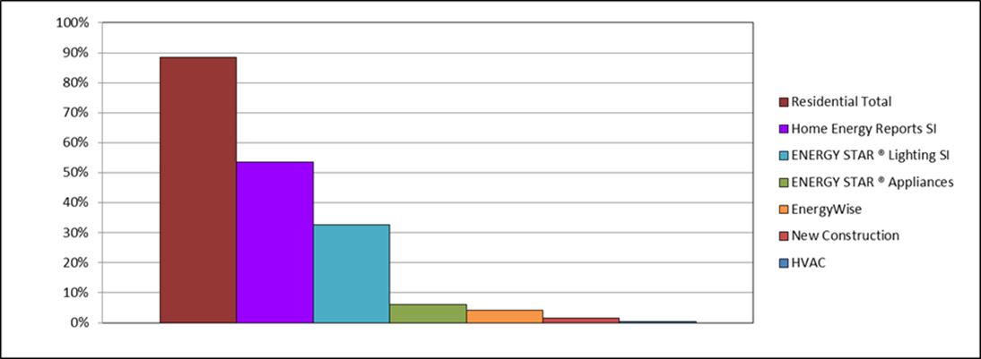
Rhode Island EE Participation - Annual

Slide 35
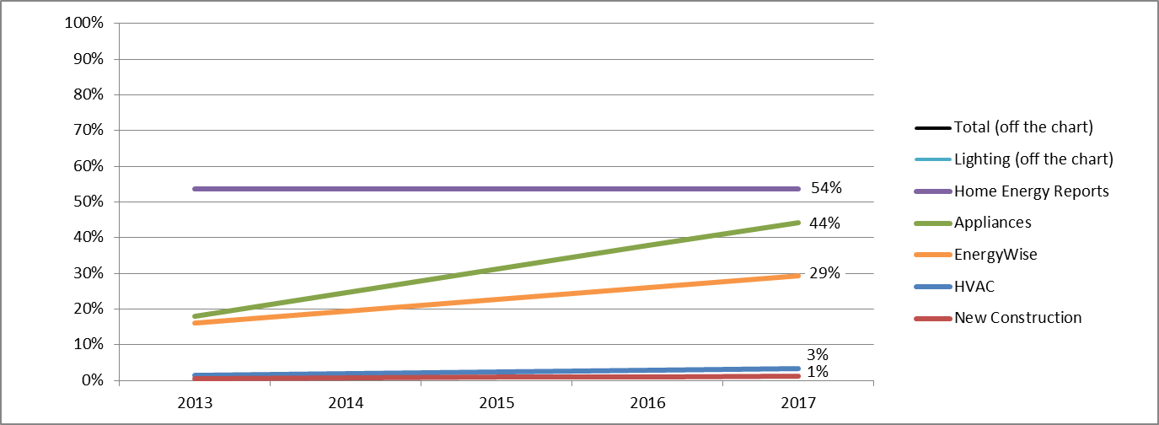
Rhode Island EE Participation - Cumulative

Slide 36
Participation Can be Increased by Program Design
EE programs should address all end-uses.
EE programs should address all customer types.
EE programs should address all relevant markets:
  retrofit, new construction, point-of-sale, upstream, etc.
All customers should have an opportunity to participate.
Customer incentives and support should be tailored to assist all customers in overcoming barriers to energy efficiency.
Program Administrators should actively pursue the non-participants and those who have not participated in a while.

Slide 37
Participation Can Be Increased by Policy Directives
Increase budgets to increase participation.
  This is the exact opposite of the typical response to rate impact concerns.
Require program administrators to gather better data on participation.
Require program administrators to analyze participation rates when designing programs.
Include participation requirements in efficiency plans and goals.
Incorporate participation rates in utility shareholder incentives.
Make the participation goal explicit:
  Achieving all cost-effective energy efficiency means serving all customers.

Slide 38

Develop Methodologies and Inputs to Account for All Impacts, Including Hard-to-Quantify Impacts
Approach | Application
Jurisdiction-specific studies | Best approach for estimating and monetizing relevant impacts.
Studies from other jurisdictions | Often reasonable to extrapolate from other jurisdiction studies when local studies not available.
Proxies | If no relevant studies of monetized impacts, proxies can be used
Alternative thresholds | Benefit-cost thresholds different from 1.0 can be used to account for relevant impacts that are not monetized.
Other considerations | Relevant quantitative and qualitative information can be used to consider impacts that cannot or should not be monetized.

Slide 39

Ensure Transparency in Reporting
Sample Template

Slide 40
Ensure Transparency in Decisions on Which Non-Utility System Impacts To Include
Process should be open to all stakeholders.
Stakeholder input can be achieved through a variety of means:
  rulemaking process,
  generic jurisdiction-wide docket,
  working groups or technical sessions,
Address objectives based on current jurisdiction policies
  However, be flexible to incorporate evolution of policies through time.
Policy goals may require consultation with other government agencies
  Environmental protection
  Health and human services
  Economic development

Slide 41
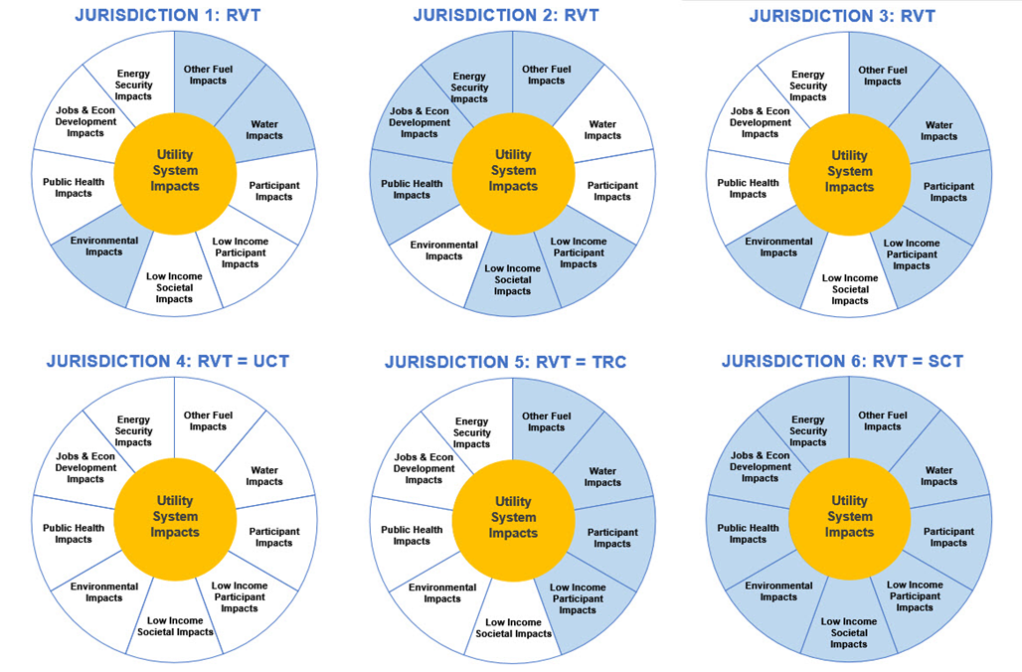
Relationship of Resource Value Test (RVT) to
Traditional Tests – Results May Align or Not

Slide 42
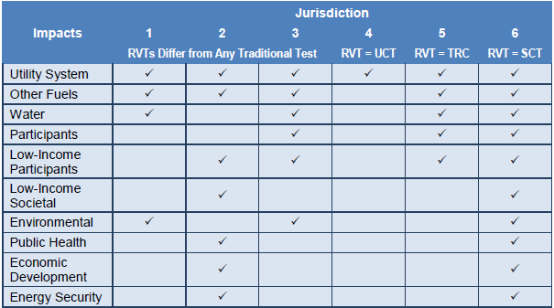
Relationship of RVT to Traditional Tests (2)
Each cost-effectiveness test should include the utility system impacts.
The other impacts included should be based on a jurisdiction’s applicable policy goals.
In some jurisdictions, this may result in a Resource Value Test equal to one of the traditional tests.
In other jurisdictions, the RVT may be different.

Slide 43
Part II
Developing Inputs for
Cost-Effectiveness Tests

Slide 44
Part II
Efficiency Costs and Benefits
Methods to Account for Costs & Benefits
Participant Impacts
Discount Rates
Assessment Level
Analysis Period and End Effects
Analysis of Early Retirement
Free Rider and Spillover Effects

Slide 45
Steps for Choosing a Discount Rate
Choice of discount rate should reflect analysis objective: to identify resources that will best serve customers over the long term, while achieving applicable policy goals
Step A | Articulate the jurisdiction’s applicable policy goals. These should be the same goals used in developing the RVT.
Step B | Consider the relevance of a utility’s weighted average cost of capital. Is the utility investor time preference consistent with the jurisdiction’s policy goals?
Step C | Consider the relevance of the average customer discount rate. Should the discount rate be based on the average utility customer time preference? Does this time preference adequately address applicable policy goals and future customers?
Step D | Consider the relevance of a societal discount rate. Is a societal time preference and use of a societal discount rate consistent with the jurisdiction’s policy goals and associated regulatory perspective?
Step E | Consider an alternative discount rate. Given that the regulatory perspective may be different from the utility, customer, and societal perspective, the discount rate does not need to be tied to any one of these three perspectives.
Step F | Consider risk implications. Consider using a low-risk discount rate for EE cost-effectiveness, if the net risk benefits of EE resources are not somehow accounted for elsewhere in the cost-effectiveness analysis

Slide 46
Additional Foundational Information

Slide 47
Appendix A
The Traditional Cost-Effectiveness Tests
Test | Perspective | Key Question Answered | Summary Approach
Utility Cost | The utility system | Will utility system costs be reduced? | Includes the costs and benefits experienced by the utility system
Total Resource Cost | The utility system plus participating customers | Will utility system costs plus program participants’ costs be reduced? | Includes the costs and benefits experienced by the utility system, plus costs and benefits to program participants
Societal Cost | Society as a whole | Will total costs to society be reduced? | Includes the costs and benefits experienced by society as a whole
Participant Cost | Customers who participate in an efficiency program | Will program participants’ costs be reduced? | Includes the costs and benefits experienced by the customers who participate in the program
Rate Impact Measure | Impact on rates paid by all customers | Will utility rates be reduced? | Includes the costs and benefits that will affect utility rates, including utility system costs and benefits plus lost revenues

Slide 48
Appendix B
EE vs Distributed Energy Resources Utility System Impacts
 |  | Energy Efficiency | Demand Response | Distributed Generation | Distributed Storage
Costs
Utility System | Measure costs (utility portion) | ● | ◑ | ○ | ○
 | Other financial incentives | ● | ● | ◑ | ◑
 | Other program and administrative costs | ● | ◑ | ◑ | ◑
 | Evaluation, measurement, and verification | ● | ● | ● | ●
 | Performance incentives | ◑ | ◑ | ◑ | ◑
 | Interconnection costs | ○ | ○ | ● | ●
 | Distribution system upgrades | ○ | ○ | ● | ●
Benefits
Utility System | Avoided energy costs | ● | ◑ | ● | ◑
 | Avoided generation capacity costs | ● | ● | ● | ●
 | Avoided reserves or other ancillary services | ● | ● | ● | ●
 | Avoided T&D system investment | ● | ● | ● | ●
 | Avoided T&D line losses | ● | ● | ● | ●
 | Wholesale market price suppression | ● | ● | ● | ●
 | Avoided RPS or EPS compliance costs | ● | ◑ | ● | ◑
 | Avoided environmental compliance costs | ● | ◑ | ● | ◑
 | Avoided credit and collection costs | ◑ | ◑ | ◑ | ◑
 | Reduced risk | ● | ● | ◑ | ◑

Slide 49
Appendix B
EE vs Distributed Energy Resources Non-Utility System Impacts
 |  | Energy Efficiency | Demand Response | Distributed Generation | Distributed Storage
Costs
Non-Utility | Measure costs (participant portion) | ● | ● | ● | ●
 | Interconnection fees | ○ | ○
 | Annual O&M | ○ | ○ | ● | ●
 | Participant increased resource consumption | ◑ | ◑ | ◑ | ◑
 | Non-financial (transaction) costs |  | ● | ○ | ○
Benefits
Non-Utility | Reduced low-income energy burden | ◑ | ◑ | ◑ | ◑
 | Public health benefits | ● | ◑ | ● | ◑
 | Energy security | ● | ◑ | ● | ◑
 | Jobs and economic development benefits | ● | ● | ● | ●
 | Environmental benefits | ● | ◑ | ● | ◑
 | Participant health, comfort, and safety | ◑ | ○ | ○ | ○
 | Participant resource savings (fuel, water) | ◑ | ○ | ○ | ○

Slide 50
Appendix C
Limitations of the Rate Impact Measure Test
The RIM Test not appropriate for cost-effectiveness analyses:
  Does not provide meaningful information about the magnitude of rate impacts, or customer equity
  Will not result in lowest costs to customers
  Is inconsistent with economic theory. The RIM test includes sunk costs, which should not be used for choosing new investments
  Can lead to perverse outcomes, where large benefits are rejected to avoid de minimus rate impacts
  Can be misleading. Results suggest that customers will be exposed to new costs, which is not true
Other approaches should be used to assess rate and equity issues.

Slide 51
Appendix C
Better Options for Assessing Rate Impacts
A thorough understanding of rate impacts requires a comprehensive analysis of three important factors:
  Rate impacts, to provide an indication of the extent to which rates for all customers might increase.
  Bill impacts, to provide an indication of the extent to which customer bills might be reduced for those customers that install distributed energy resources.
  Participation impacts, to provide an indication of the portion of customers that will experience bill reductions or bill increases.
Taken together, these three factors indicate the extent to which customers will benefit from energy efficiency resources.
Participation impacts are also key to understanding the extent to which energy efficiency resources are being adopted over time.

Slide 52
For more information visit: http://www.nationalefficiencyscreening.org/

