Slide 1
Applying the National Standard Practice Manual Experience to Date
Julie Michals – E4TheFuture
Presented to the NH EM&V Working Group
February 14, 2019

Slide 2
Agenda
Review meeting objectives
NSPM (very) brief overview
Case studies: What has NSPM application looked like in other states to date?
New cost-effectiveness screening resources that can assist NH in its process
Q&A

Slide 3
Meeting Objectives
Share with working group experiences from NSPM case studies to date: opportunities, challenges, and considerations from NSPM application
Share resources: templates, data, and documents that can help New Hampshire’s process
Answer questions and allow for discussion
Anything else that you’d like to learn or address today not noted above?

Slide 4
NATIONAL STANDARD PRACTICE MANUAL
Published May 2017
New guidelines for
cost-effectiveness testing
Drivers…
  The traditional tests often do not capture or address pertinent state policies.
  The traditional tests are often modified by states in an ad hoc manner, without clear principles or guidelines.
  Efficiency is not accurately valued in many jurisdictions.
  There is often a lack of transparency on why tests are chosen and how they are applied.
National Standard Practice Manual

Slide 5
NSPM Universal Principles
Recognize that energy efficiency is a resource.
Account for applicable policy goals.
Account for all relevant costs & benefits (based on applicable policies), even if hard to quantify impacts.
Ensure symmetry across all relevant costs and benefits.
Conduct a forward-looking, long-term analysis that captures incremental impacts of energy efficiency.
Ensure transparency in presenting the analysis and the results.

Slide 6
Resource Value Framework (RVT)
7-Step Process
Step 1 | Identify and articulate the jurisdiction’s applicable policy goals.
Step 2 | Include all utility system costs and benefits.
Step 3 | Decide which additional non-utility system costs and benefits to include in the test, based on applicable policy goals.
Step 4 | Ensure the test is symmetrical in considering both costs and benefits.
Step 5 | Ensure the analysis is forward-looking, incremental, and long-term.
Step 6 | Develop methodologies and inputs to account for all impacts, including hard-to-quantify impacts.
Step 7 | Ensure transparency in presenting the analysis and the results.

Slide 7
Cost-Effectiveness Perspectives
CaSPM Perspectives
Utility Cost Test
Utility system
perspective
TRC Test
Utility system plus the participant perspective
Societal Cost Test Societal perspective
NSPM Regulatory Perspective
Public utility commissions
Legislators
Muni/Coop advisory boards
Public power authorities
Other decision-makers
California Standard Practice Manual (CaSPM) – test perspectives are used to define the scope of impacts to include in the ‘traditional’ cost-effectiveness tests
NPSM introduces the ‘regulatory’ perspective, which is guided by the jurisdiction’s energy and other applicable policy goals

Slide 8
NSPM Part I
Developing the Primary Cost-Effectiveness Test Using the Resource Value Framework (RVT)
Universal Principles
Resource Value Framework
Primary Test:
Resource Value Test (RVT)

Slide 9
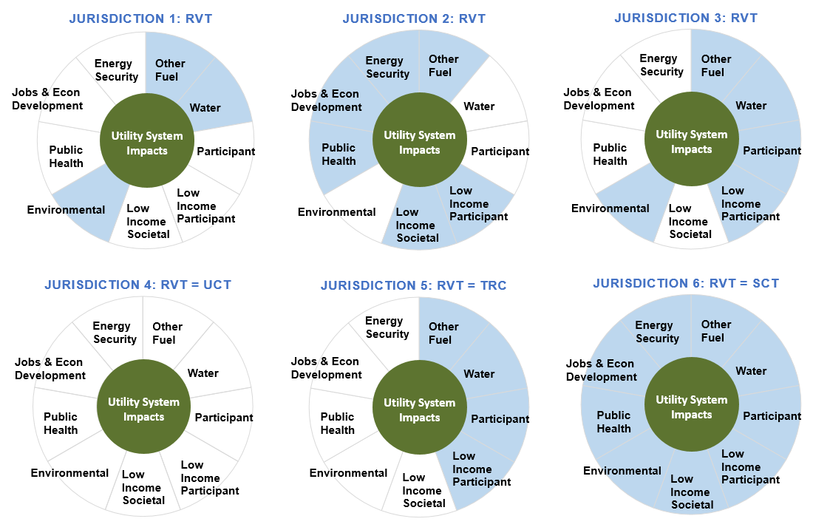
Relationship of Resource Value Test (RVT) to Traditional Tests – Results May Align or Not

Slide 10
How States Can Apply the NSPM
Comprehensive review of current test *
  What’s included
  How it is applied
Review/refine select provisions of current test
Build new state test from “ground up”
* NH process

Slide 11
NSPM Case Studies
How has it worked in other states?
Arkansas
Minnesota
Rhode Island
(and a few words about Connecticut)

Slide 12
Applying the NSPM in
Arkansas
(Case Study Link)

Slide 13
Arkansas Case Study: Background
AR Order states: “The Commission directs the PWC to consider the findings and recommendations of the NSPM as it resumes work on the next three-year cycle of planning and to address the carbon pricing issue in that context.”
Scope: review alignment of current CE testing practice with NSPM. Submit report to PSC by end of October
Process Overview:
  Parties Working Collaboratively (PWC) stakeholder group, PSC staff, utilities, NGOs, Chris Neme and Julie Michals - process led by evaluation team (Katherine Johnson and Scott Dimetrosky)
  April-Oct 2018: series of calls and final in-person meeting in Sept
  Oct 31, 2019: Case Study Report submitted to Commission. Currently waiting on Commission response/order

Slide 14
Arkansas Case Study: Key Questions Considered
Test Framework
Does current AR test include all impacts of policy interest to the state?
  Any included that maybe should not be?
  Any not included that maybe should be?
Is the full range of utility system impacts included?
How could AR account for any impacts that should be added?
  What methodologies approach(es) could be used?
Test Application
Are key principles of applying cost-effectiveness tests being followed?
  Selection of discount rate
  Treatment of free riders/spillover
  Application level

Slide 15
Arkansas: Process by RVF Steps
Step 1 | Identify and articulate the jurisdiction’s applicable policy goals. | Catalogued/Summarized relevant policy documents
Step 2 | Include all utility system costs and benefits. | Assessed alignment of current test with policy goals Most policy goals already addressed by current test A couple of secondary ones that are not
Step 3 | Decide which additional non-utility system costs and benefits to include in the test, based on applicable policy goals. | Catalog utility system impacts included by each utility
Step 4 | Ensure the test is symmetrical in considering both costs and benefits. | Review options for quantifying any impacts that should be included, but currently are not Avoided future carbon regulation impacts (directed by PUC) Any other utility system impacts missing Non-utility impacts deemed important given policy goals Participant NEBs (given policy goal of including participant impacts)
Step 5 | Ensure the analysis is forward-looking, incremental, and long-term. | Assess alignment of application principles with current AR practice One utility not treating free rider costs as Manual suggests Other potential issues (discount rate, screening level, etc.)
Step 6 | Develop methodologies and inputs to account for all impacts, including hard-to-quantify impacts. | Develop plan and timeline for AR test refinement
Step 7 | Ensure transparency in presenting the analysis and the results. | Report to AR PUC

Slide 16
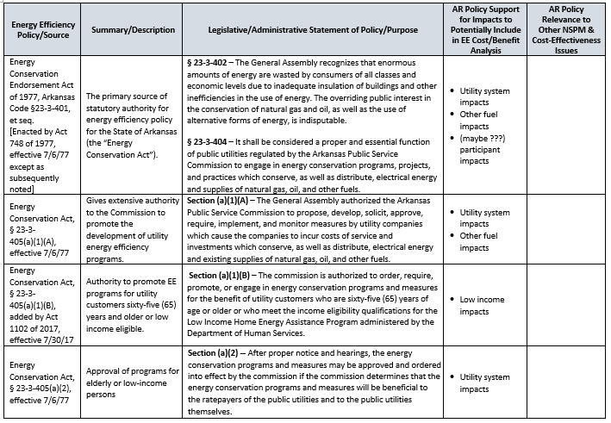
Arkansas: Policy Review Excerpt

Slide 17
Arkansas: Utility System Impact Inventory

Slide 18
Arkansas Case Study Key Findings
AR PSC existing guidance addresses biggest utility system impacts, but…
  not all utilities fully following guidance
  some smaller impacts not addressed (risk, ancillary services, etc.)
Current AR test may include all impacts relevant to state policies, but…
  More guidance needed on a couple of possible additions based on ‘intent’
Asymmetrical treatment of participant impacts
  All costs, but only selected participant NEBs (water, O&M) are accounted for
Lots of inconsistency across utilities
  Some not including avoided T&D (contrary to APSC guidance)
  Some use average rather than marginal line losses (contrary to APSC guidance)
  Some include avoided future carbon regulation costs, others don’t
  Some discount rates based on WACC, others societal or blends
  One treats free rider rebates as a cost

Slide 19
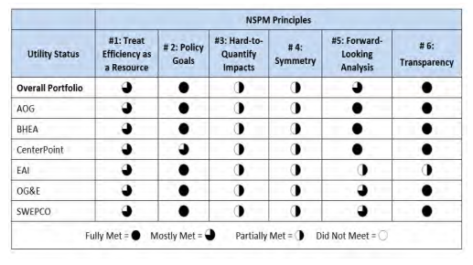
Arkansas Case Study: State Self-Scoring

Slide 20
Arkansas: Lessons for Future Applications
Organizing around 6 NSPM principles is helpful approach
  Can follow 7 step process or alignment with 6 principles
  Focus case study on both (a) what’s in test and (b) how test applied
NSPM is valuable in identifying inconsistencies across utilities
  Need more guidance on when statewide consistency is appropriate
Need more guidance on valuing other utility system impacts
  Risk, ancillary services, avoided credit & collection costs, etc.
Guidance on addressing participant impact asymmetry would help
  Need to recognize/address impracticality of quantifying all participant NEBs
  Address range of options – prioritize key NEBs, adjust costs, etc.
Guidance on how to address/value avoided future environmental regulation costs would be helpful
  AR PSC was interested in NSPM guidance to address carbon benefits, but NSPM only addresses how to determine whether they should be included, not how to value

Slide 21
Applying the NSPM in
Minnesota
(Case Study Link)

Slide 22
Minnesota Case Study: Process
MN Department of Commerce hired Synapse Energy Economics to apply the NSPM to Minnesota cost-effectiveness practices (January-August 2018)
Conducted surveys: Division of Energy Resources, Excel Energy, CenterPoint Energy, Minnesota Center for Energy and the Environment, Great River Energy, Fresh Energy, Public Service Commission
Reviewed relevant statutes, regulations, commission orders, state energy plans, and other policy directives to identify and articulate relevant policy goals
Reviewed all the utility system impacts that are currently accounted for by the Minnesota electric and gas utilities
Cataloged all non-utility system impacts currently included in the Minnesota cost-effectiveness tests
Assessed whether any additional non-utility system impacts should be included in primary test to be consistent with MN applicable policy goals
Drafted recommendations for modifying Minnesota cost-effectiveness practices to address relevant policy goals (September 2018)

Slide 23
Minnesota: Background
Large array of MN policy directives related to energy resources
Next Generation Energy Act directs utilities to consider costs and benefits to:
    the utility
    society
    program participants
    ratepayers
In practice:
    The Societal Cost test is primary
    The Utility Cost test is secondary
    The Participant test is secondary
    The Ratepayer Impact Measure test is secondary, but not really used

Slide 24
Minnesota: Key Questions Considered
Test Framework
Can tests be streamlined?
MN uses the Societal Cost test as the primary test but also considers the results of the Utility Cost test
Are utility system avoided costs consistent?
MN electric and gas utilities used avoided costs that are developed independently and are potentially inconsistent
Should MN include participant non-energy benefits in Societal Cost test?
MN did not include participant NEBs in this test
How should MN treat low-income impacts?
  MN did not require low-income programs to pass a CE test

Slide 25
Societal Cost Test as Applied in Minnesota
Utility System Impacts
Utility System Impacts, partially included
Non-utility system impacts, included
Non-utility system impacts, partially included
Non-utility system impacts, not included

Slide 26
RVF Step 1: Articulate Policy Goals
NSPM: Primary test should reflect relevant policy goals.
  The CA Standard Practice Manual does not address policy goals well.
Policy goals come in many forms:
  Legislation
  Regulations
  Commission orders
  State energy plans
  Environmental plans
  Executive directives
Policies can, and frequently are, updated over time.
Stakeholders should provide input to policy interpretation.
Utility regulators are not responsible for all state policy goals, but they are responsible for those related to utility industries.

Slide 27
RVF Step 2: Include All Utility System Impacts
Utility system impacts = all the costs and benefits that are experienced by electric utilities (in the case of electric EE) or gas utilities (in the cases of gas EE) on behalf of customers
Utility system impacts = all those impacts that affect a utility’s revenue requirements:
  either as an increase in revenue requirements (e.g., EE costs)
  or a decrease in revenue requirements (e.g., avoided costs)
All utility system impacts should be included

Slide 28
RVF Step 2: Include All Utility System Impacts
Should be the foundation of every cost-effectiveness test.
  Central to the principle of treating efficiency as a resource
Minnesota utilities do not universally include the following:
  Shareholder incentive costs
  Wholesale price suppression effects
  Avoided credit and collection costs
  Avoided RPS costs
  Avoided costs of meeting CO2 goals
  Reduced risk
  Improved reliability
Recommendation:
These impacts should be included in all CE tests
Including these impacts is not a policy decision

Slide 29
Utility Cost Test as Applied in Minnesota
Benefits:
Avoided energy, capacity, T&D
Avoided losses & ancillary services
Wholesale price suppression
Avoided cost of envtl compliance
Avoided credit & collection costs
Avoided RPS costs
Improved reliability
Reduced risk
Utility System Impacts
Costs:
EM&V costs
  EE measure costs
  EE program costs
  Shareholder incentives
Utility System Impacts, partially included
Non-utility system impacts, not included

Slide 30
RVF Step 3: Account for Relevant Non-Utility System Impacts
The decision on whether to include any non-utility system impact in the primary test should:
Be guided by the state’s relevant policy goals
Be informed by a transparent discussion of those goals
Be informed by stakeholder input

Slide 31
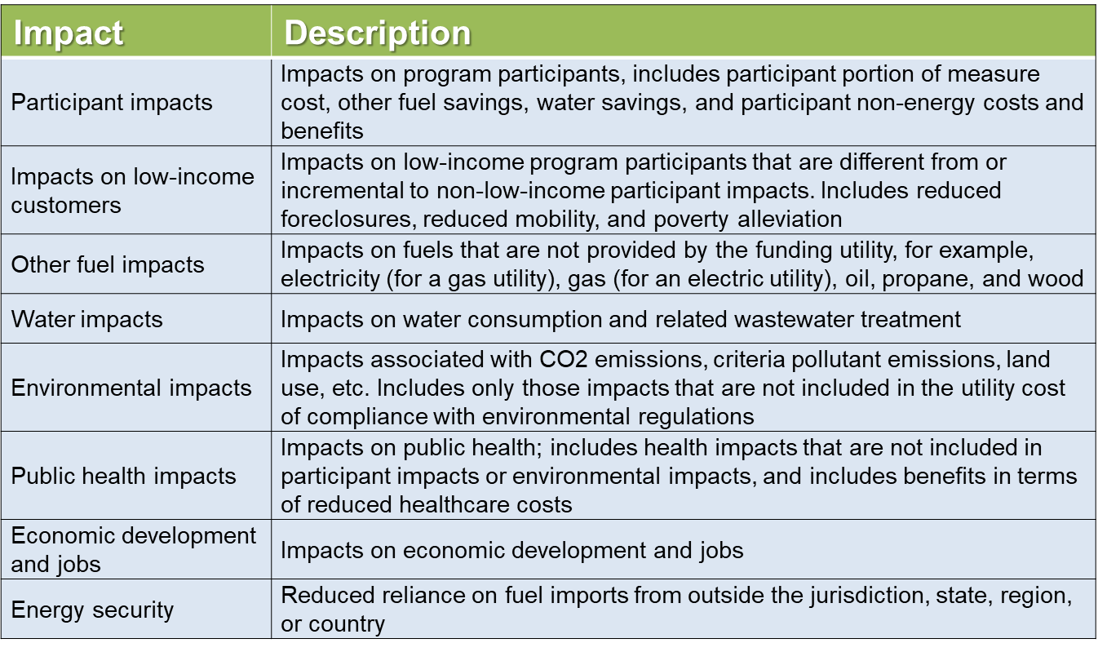
Examples of Non-Utility System Impacts

Slide 32
Step 3a: Whether to Include Participant Impacts
MN Current practice:
  Participant costs are included in the Societal Cost and the Participant Cost tests.
  Participant non-energy benefits are not included in any tests.
Policy directives:
  In determining cost-effectiveness, the commissioner shall consider the costs and benefits to ratepayers, the utility, participants, and society. - Minn. Stat. § 216B.241, subd. 1c (f)
    This suggests that participant impacts are important, but also that the Participant Cost test can be used to consider them.
  There are many references in legislation to consideration of societal impacts.
    These suggest that participant impacts should be accounted for somehow.
  Synapse interviews with stakeholders:
    There is a clear reluctance to account for participant NEBs, due to uncertainty and the difficulty of quantifying them.

Slide 33
Step 3a: Whether to Include Participant Impacts cont.
This is a policy decision (based on jurisdiction’s policy goals).
  Policies may support inclusion of certain participant impacts (e.g., low-income, other fuels, etc.) but not necessarily all participant impacts.
If participant costs are included, participant benefits should also be included (to ensure symmetry and avoid bias), even hard-to-quantify benefits
Key questions to consider:
  Why does it matter what participants pay?
    Especially given that participants always benefit.
  Why should non-participants pay for benefits to participants?
    Especially benefits that are hard to quantify.

Slide 34
MN: Recommendation on Participant Impacts
The question is whether to include these in the primary test.
Options
  Include both participant costs and benefits (including NEBs).
  Exclude both participant costs and benefits.
Recommendation (for Stakeholders to consider and inform)
  Use a new ‘Minnesota Test’ as primary test, which excludes both participant costs and benefits
  Use the Societal Cost test as a secondary test, and include participant impacts (including the most important participant NEBs).
  Use the Participant Cost test as a secondary test, and include participant impacts (including the most important participant NEBs).

Slide 35
Points and Counterpoints on Inclusion of Participant Impacts (Table 8 from NSPM)
Reasons for Including Participant Impacts | Counter-Points
Including participant impacts accounts for the costs on all utility customers: participants and non-participants. | Participant impacts fall outside the scope of utility system impacts. If EE is treated purely as a utility system resource, then participant impacts are less relevant.
Including participant impacts accounts for the total cost of the resource. If the cost of a resource is split between two entities, then it might appear to be cost-effective when it is not. | If regulators prefer to account for the total cost of a resource in order to address concerns about costs being split between two entities, it is necessary to also account for the total benefits. This objective essentially requires the use of the SCT. If this objective is important enough, jurisdictions could use an SCT as a pre-screening test and an RVT as the primary test.
Including participant impacts will help protect program participants. Excluding such costs might result in participants paying “too much” for efficiency. | Including participant impacts will not accurately capture the benefits of program participants, because in practice the primary participant benefit is typically represented in terms of avoided utility costs, not reduced customer bills. The Participant Cost test is one way to protect participants. In addition, program design is the best way to protect program participants, and sound program design will result in participants being better off.
Excluding participant impacts would exclude low-income participant benefits from the analysis | Low-income participant impacts can be included in the RVT, without including all participant impacts, if justified by policy goals. Well-defined low-income programs do not require participant costs, which eliminates the typical rationale for including participant impacts.
Excluding participant impacts would exclude other fuel and water impacts from the analysis. | Other fuel and water impacts can be included in the primary test, without including all participant impacts, if justified by policy goals.

Slide 36
RVF Step 3b-e: Other Impacts
3a) Low Income Impacts
3b) Other Fuel Impacts
3c) Environmental Impacts
3d) Socio economic impacts
For each area, study:
  Reviewed current practice
  Reviewed policy directives
  Made recommendation

Slide 37
RVF Step 4: Ensure Symmetry Across Benefits and Costs
Ensure that the test includes costs and benefits symmetrically.
  If a category of cost is included, corresponding benefits should be too. (For example, if participant costs are included, participant benefits should also be included.)
Symmetry is necessary to avoid bias:
  If some costs are excluded, the framework will be biased in favor of EE.
  If some benefits are excluded, the framework will be biased against EE.
  Bias in either direction can result in misallocation of resources (over or under investment)
    higher than necessary costs to meet energy needs
    too little or too much investment in actions to achieve jurisdiction's energy-related policies goals

Slide 38
RVF Step 5: Incremental, Forward-Looking, and Long-Term
Incremental: What would have occurred relative to baseline.
    Has implications for avoided costs.
Forward-looking: Sunk costs and benefits are not relevant to cost-effectiveness analysis.
    Has implications regarding the Rate Impact Measure (RIM) test.
Long-term: Analysis should capture full remaining lifecycle costs and benefits.
    Has implications for the length of the study period.

Slide 39
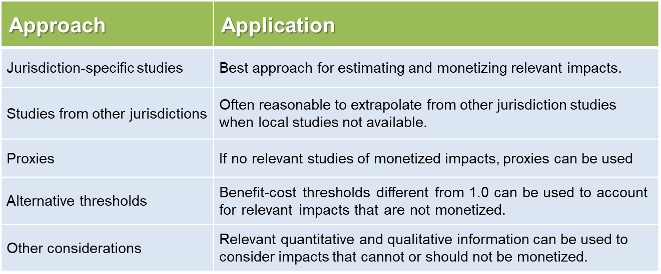
RVF Step 6: Develop Methodologies and Inputs
Inputs should be developed for all relevant impacts, even those that are difficult to quantify and monetize.
Ignoring some impacts because they are difficult to monetize will lead to skewed results.
Example approaches for developing inputs:

Slide 40
RVF Step 7: Transparency
Current Practice
  Minnesota has a robust reporting process through the Energy Savings Platform, the Technical Reference Manuals, and the gas BENCOST model.
  The Excel model for electric EE is not well documented, making it difficult to understand the methodologies used for the analysis.
Recommendation
  Commerce should organize an investigation of EE cost-effectiveness practices, including a review of state policy goals.
  The electric utilities should improve their EE cost-effectiveness model, using the gas BENCOST model as an example.

Slide 41
Recommended Minnesota Test
Utility System Impacts
Utility System Impacts, included
Non-utility system impacts, included
Non-utility system impacts, not included

Slide 42
Lessons from Minnesota Case Study
Relevant state energy policies exist in various forms across government (i.e., legislation, state energy plans, Commission orders)
  Important that NH PUC and other agencies take lead on this, with input from stakeholders to help inform interpretation
Which utility / non-utility system impacts should be included depends on:
  what is relevant to state policies
  stakeholder input
  transparent discussion of state goals
Difficult to quantify inputs should not be excluded, but can be incorporated using approaches such as studies from this or other jurisdictions, proxies, alternative thresholds, or other information
Transparency measures including reports and stakeholder meetings are key components of energy efficiency testing

Slide 43
BREAK

Slide 44
Applying the NSPM in
Rhode Island
(Case Study Link)

Slide 45
Rhode Island Case Study - Background
Public Utilities Commission: 2016 Docket 4600 incorporated stakeholder input on rate design principles and cost-effectiveness framework for EE and other DERs
  Previously used the TRC Test to assess EE cost-effectiveness
NSPM not yet published at time of Docket 4600
  But draft NSPM in circulation and principles were applied
Data Sources Used
  Avoided cost inputs from New England Avoided Energy Supply Cost Study
  Participant non-energy benefits based on studies performed for MA electric and gas utilities
  Separate studies for low-income, residential, and commercial/industrial sectors

Slide 46
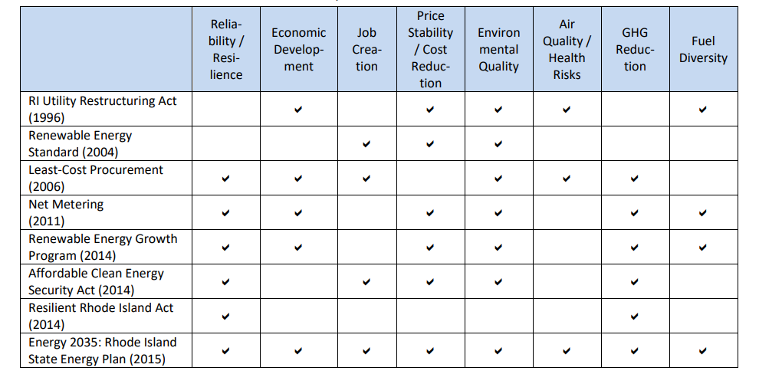
RI – Alignment with NSPM Principles
  Principle #1: Efficiency as a Resource
  Efficiency has been historically incorporated in Rhode Island regulation (such as the RI System Reliability and Least-Cost Procurement statute), a precedent confirmed through the NSPM review process
  Principle #2: Articulate Applicable Policy Goals
  RI Office of Energy Resources assessed and documented state statutes and policies relevant to EE

Slide 47
RI – Alignment with NSPM Principles (2)
  Principle #3: Account for All Relevant Impacts
  Historically incorporated in Rhode Island, with further recognition based on review of applicable policies:
      Risk impacts
      Environmental Impacts
      Jobs and Economic Development Impacts
      Societal low-income Impacts
      Public Health Impacts
      Energy Security Impacts
  Division directed to propose methodologies for quantifying and monetizing costs and benefits to be added in new test
  Principle #4: Ensure Symmetry
  Rhode Island historically accounted for both participant costs and benefits symmetrically, already in keeping with this principle

Slide 48
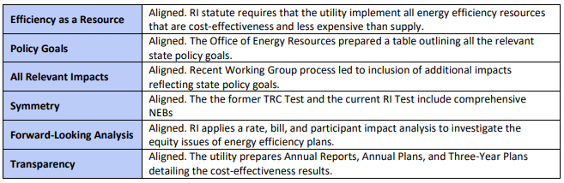
Rhode Island: End Result
Developed new “Rhode Island” Test to better align with state policies
  Recognizes some benefits and costs related to DER, not EE
  RI Case Study – documents extent of alignment with NSPM principles:

Slide 49
Rhode Island 2018-19 Developments
Division of Public Utilities and Carriers (DPUC) has drafted a supplemental report to support use of the RI Test: The Rhode Island Cost-Effectiveness Framework: Methodologies for Developing Inputs for Distributed Energy Resources, which:
  Presents approved Rhode Island Framework and RI Test
  Clarifies which impacts represent costs vs benefits
  Consolidates overlapping impacts
  Recommends sources and methodologies for developing EE inputs
  Recommends proxy values for hard-to-quantify inputs
  Identifies inputs that require additional analysis before they can be used in the framework
National Grid RI will be applying RI Test to its AMI proposal in 2019

Slide 50
Connecticut and the NSPM
(a case study in progress)

Slide 51
Examples of benefits that could be considered for Resource Value Test
DEEP Slide, Summary to EEB, 12/12/18

Slide 52
3. New Cost-Effectiveness Screening Resources (to help support NSPM Application)

Slide 53
NSPM Outreach & Support Strategy
Build visibility and basic understanding
Develop supporting materials and resources
Conduct state outreach
Provide technical assistance

Slide 54
Resources to support NSPM Application
Policy Summary Template tables
Database of State Efficiency Screening Practices (DSESP)
National Standard Practice Manual for Distributed Energy Resources (NSPM for DERs)
  Forthcoming updated NSPM which will assist regulators, utilities, and related stakeholders in conducting benefit-cost analyses for all types of DERs (including demand response, distributed solar, distributed storage, and electric vehicles)

Slide 55
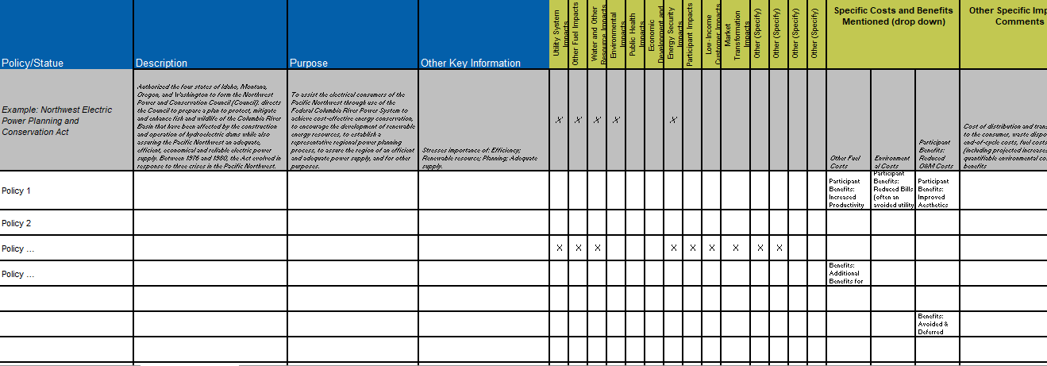
a. Policy Summary Template Tables:
Policy Inventory

Slide 56
a. Policy Summary Template Tables:
Current CE Policy Alignment
Category | Impact | Category Identified in Policy Inventory | Specific Input Identified in Policy Inventory | Currently Used in Cost-effectiveness?
 |  |  |  | Utility/PA 1 | Utility/PA 2 | Utility/PA N
Utility Costs | Measure Costs (utility portion) | Yes | -
 | Other Financial or Technical Support Costs |  | -
 | Program Administration Costs |  | -
 | Evaluation, Measurement, & Verification |  | -
 | Marketing and Outreach |  | -
 | Shareholder/Utility Incentive Costs |  | -
 | Other – describe
Utility Benefits | Avoided Energy Costs |  | -
 | Avoided Generating Capacity Costs |  | -
 | Avoided T&D Capacity Costs |  | -
 | Avoided T&D Line Losses - Energy kWh |  | -
 | Avoided T&D Line Losses - Peak kW |  | -
 | Avoided Ancillary Services |  | -
 | Wholesale Energy Price Suppression Effects- Energy kWh |  | -
 | Wholesale Energy Price Suppression Effects - Peak kW |  | -
 | Avoided Costs of Complying with RPS |  | -
 | Avoided Environmental Compliance Costs |  | -
 | Avoided Bad Debt, Arrearages, etc. |  | -
 | Reduced Risk / Fuel Diversity |  | -
 | Increased Reliability and Resilience |  | -
 | Other - describe
Other Fuel Impacts | Other Fuel Costs | Yes | -
 | Other Fuel Benefits |  | -
Water and Other Resource Impacts | Water and Other Resource Costs | Yes | -
 | Water and Other Resource Benefits |  | -
Environmental Impacts | Environmental Costs | - | Yes
 | Environmental Benefits |  | -
Public Health Impacts | Public Health Costs | - | -
 | Public Health Benefits |  | -
Economic Development and Job Impacts | Economic Development and Job Costs | - | -
 | Economic Development and Job Benefits |  | -
Energy Security Impacts | Energy Security Costs | Yes | -
 | Energy Security Benefits |  | -
Participant Costs | Measure Costs (customer portion) | Yes | -
 | Financial Costs (customer portion) |  | -
 | Transaction Costs |  | -
 | Increased O&M Costs |  | -
 | Increased Other Fuel Consumption |  | -
 | Increased Water Consumption |  | -
 | Other – describe
Participant Benefits | Reduced Bills (often an avoided utility system costs) |  | -
 | Reduced O&M Costs |  | -
 | Increased Comfort |  | Yes
 | Increased Health & Safety |  | Yes
 | Increased Productivity |  | Yes
 | Improved Aesthetics |  | -
 | Property Improvements |  | -
 | Reduced Other Fuel Consumption |  | -
 | Reduced Water Consumption |  | Yes
 | Additional Benefits for Low-Income Customers |  | Yes
 | Avoided & Deferred Equipment Replacement Costs |  | -
 | Other - describe
 | Other - describe
Low Income Customer Impacts | Low Income Customer Cost | Yes | -
 | Low Income Customer Benefits |  | -
Other (Specify) |  | Yes
Other (Specify) |  | Yes
Other (Specify) |  | Yes

Slide 57
a. Policy Summary Template Tables:
Optional CE Test Inputs
Category | Impact | Utility/PA 1 Responses (from CurrentCE Policy Alignment) | Values Used* | Units | Source(s) of Values | Other Questions
Utility Costs | Measure Costs (utility portion)
 | Other Financial or Technical Support Costs
 | Program Administration Costs
 | Evaluation, Measurement, & Verification
 | Marketing and Outreach
 | Shareholder/Utility Incentive Costs
 | Other – describe
Utility Benefits | Avoided Energy Costs* |  |  |  |  | Are values differentiated by season, on vs. off peak, etc.?
 | Avoided Generating Capacity Costs
 | Avoided T&D Capacity Costs
 | Avoided T&D Line Losses - Energy kWh |  |  | % loss rate |  | Are values based on average or marginal loss rates?
 | Avoided T&D Line Losses - Peak kW |  |  | % loss rate |  | Are values based on average or marginal loss rates?
 | Avoided Ancillary Services
 | Wholesale Energy Price Suppression Effects- Energy kWh
 | Wholesale Energy Price Suppression Effects - Peak kW
 | Avoided Costs of Complying with RPS |  |  |  |  | Based on avoided future compliance costs or damage costs?
 | Avoided Environmental Compliance Costs |  |  | $/ton CO2 |  | Based on avoided future compliance costs or damage costs?
 | Avoided Bad Debt, Arrearages, etc. |  |  |  |  | For which programs are values applied? All? Just low income?
 | Reduced Risk / Fuel Diversity |  |  |  |  | How are values applied?
 | Increased Reliability and Resilience
 | Other - describe
Other Fuel Impacts | Other Fuel Costs
 | Other Fuel Benefits
Water and Other Resource Impacts | Water and Other Resource Costs
 | Water and Other Resource Benefits
Environmental Impacts | Environmental Costs
 | Environmental Benefits
Public Health Impacts | Public Health Costs
 | Public Health Benefits
Economic Development and Job Impacts | Economic Development and Job Costs
 | Economic Development and Job Benefits
Energy Security Impacts | Energy Security Costs
 | Energy Security Benefits
Participant Costs** | Measure Costs (customer portion)
 | Financial Costs (customer portion)
 | Transaction Costs
 | Increased O&M Costs
 | Increased Other Fuel Consumption
 | Increased Water Consumption
 | Other - describe
Participant Benefits** | Reduced Bills (often an avoided utility system costs)
 | Reduced O&M Costs
 | Increased Comfort
 | Increased Health & Safety
 | Increased Productivity
 | Improved Aesthetics
 | Property Improvements
 | Reduced Other Fuel Consumption
 | Reduced Water Consumption
 | Additional Benefits for Low-Income Customers
 | Avoided & Deferred Equipment Replacement Costs
 | Other - describe
Low Income Customer Impacts | Low Income Customer Cost
 | Low Income Customer Benefits
Non-Monetized Factors | Economic Development and Job Impacts
 | Market Transformation Impacts
 | Other Non-Monetized Impacts
Other (Specify)
Other (Specify)
Other (Specify)
Other Key Questions | What Discount Rate is Used? |  |  | % |  | Is it real or nominal?
 | Are incentives to free-riders treated as an admin cost? (specify Yes or No in "Values" column) |  | (Yes or No)

Slide 58
b. NSPM Database of State Efficiency Screening Practices (DSESP)
Comparison of State Practices and Supporting Sources
Utility System Costs
CE Overview
Non-Utility System Costs
New Hampshire
Utility System Benefits
Other Info
Non-Utility System Benefits
Synapse and ACEEE research

Slide 59
DSESC Format
Workbook Tabs
Introduction
Instructions
Definitions
Summary of States
View Single State
State Comparison
    CE Test Application
    Utility System Impacts
    Non-Utility System Impacts
Guidance Documents
References

Slide 60
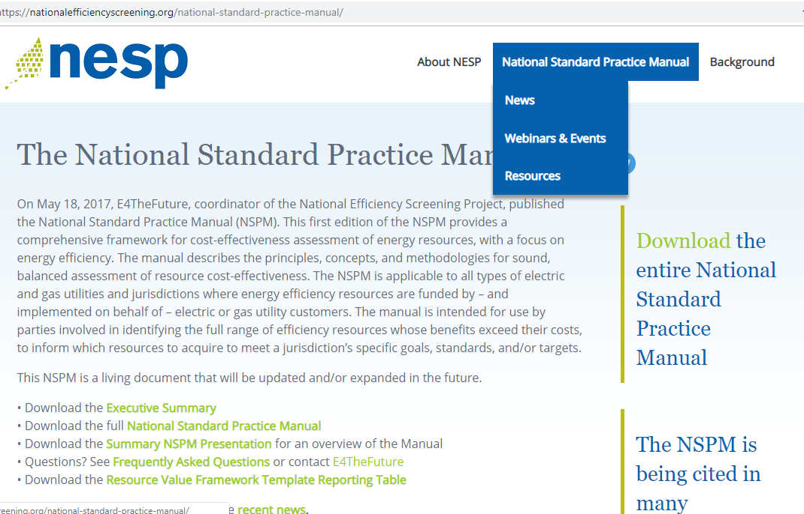
NSPM Website

Slide 61
Q&A

Slide 62
Thank you!
Julie Michals
NSPM Project Coordinator jmichals@e4thefuture.org
Visit www.nationalefficiencyscreening.org to download the full NSPM, an Executive Summary, a summary presentation and Frequently Asked Questions
For additional questions, email NSPM@nationalefficiencyscreening.org

