Slide 1
Stakeholder Meeting Home Energy Assistance Program
July 24, 2018

Slide 2
Home Energy Assistance (HEA) Program
Weatherize homes occupied by low income customers
Reduce energy costs (more efficient)
Make homes more comfortable and address health and safety
Heating System Replacements
No cost to customer: 100% of weatherization and heating systems are paid for by NH EE Programs (or other funding)
Eligibility:
Qualify for Fuel Assistance (starts at 200% of Federal poverty, can increase to 60% State Median Income)
Qualify for Electric Assistance
Subsidized Housing
Multifamily, 4 units and under – 50% of residents must qualify
Multifamily, 5 units and more – 60% of residents must qualify

Slide 3
HEA Ramp-up for 3-Year Plan

Slide 4
HEA Spending over the past 10 years (Electric & Gas)
Percent to Plan

Slide 5
HEA Spending in 2017 (From Utility End of Year Filings)
($714,175)
($199,996)

Slide 6
HEA Spending in 2017 (From Utility End of Year Filings)
Utility | Plan | Actual | Difference
Eversource | $3,450,394 | $2,930,672 | ($519,722)
Liberty | $392,168 | $352,518 | ($39,650)
NHEC | $284,308 | $280,148 | ($4,160)
Unitil | $538,874 | $388,231 | ($150,643)
Total Electric | $4,665,744 | $3,951,569 | (714,175)
Liberty Gas | $1,005,700 | $825,671 | ($180,029)
Unitil Gas | $241,086 | $221,119 | (19,967)
Total Gas | $1,246,786 | $1,046,790 | ($199,996)
Total Electric and Gas | $5,912,530 | $4,998,359 | ($914,171)

Slide 7
HEA Spending by Budget Category for 2017

Slide 8
Eversource 2017 Year-End Funding Reconciliation
Funding | 2017 Plan | 2017 Actual | Difference
Annual MWH Sales | 8,027,604 | 7,685,117 | (342,478)
SBC | $15,894,656 | $15,111,351 | $ (783,305)
RGGI | $ 1,897,931 | $ 1,850,475 | $ (47,456)
FCM | $3,617,101 | $3,808,323 | $ 191,222
Interest | $ 0 | $89,776 | $89,776
Carryforward | $ 0 | $(482,656) | $(482,656)
Total | $21,409,656 | $20,377,270 | $ (1,032,418)

Slide 9
Partnership with CAA’s and OSI
Community Action Agencies utilize funding sources from both the utilities, the federal government (through OSI) and other sources
The CAA completes comprehensive projects for the customer and splits invoicing, using each available funding source
Programs claim energy savings based on the measures they are billed for

Slide 10
Funding Sources
HEA – Cost effectiveness based on a Benefit to Cost calculation using Utility Avoided Costs. Projects are screened based on the combined B/C ratio of a package of measures
HEA - Typically pays for majority of measures which provide energy savings, in order to obtain the biggest B/C
HEA - also absorbs some of the necessary Health and Safety associated with installation of measures. Auditor maintains a package B/C above 1
HEA - also assisting with replacement of Energy Star heating systems (25% of total budget)

Slide 11
Funding Sources
DOE Weatherization Assistance Program (WAP)– Cost effectiveness based on a Savings to Investment Ratio. Projects are screened on a measure by measure SIR with some H&S measures counted separately.
DOE WAP funds typically are not used for heating systems.
DOE WAP- Pays for some measures HEA can’t absorb, such as Health and Safety/Repairs when they pulldown the B/C too much for HEA but there are enough energy saving measures to stay above an SIR of 1.
DOE WAP funds are also used for any job not in a CORE Utility territory (municipal electric) that cannot be leveraged with HEA funds.

Slide 12
Funding Sources
Building Weatherization Program (BWP) – Similar to DOE WAP with different guidelines allowing CAA’s to utilize funds as Heating or weatherization related
Heating Repair Replacement Program (HRRP) - Heating Repair and Replacement funds only used to replace or repair heating systems and distribution
Other sources (CDBG, USDA, United Way, Town Welfare, DES…) Rules vary depending on source of funding

Slide 13
Federal funds received for July 1, 2017, through June 30, 2018
US DOE WAP (Weatherization Assistance Program) grant to NH: $1,523,657 (new funds, there was no carry-over from PY16)
Production: $1,247,697
Projected job completions: 212
Actual job completions: 202 (incomplete numbers, waiting for full June reporting)
T&TA: $275,960
US HHS LIHEAP $ for HRRP (Heating Repair and Replacement Program, heating system expenses only): $1,100,000
US HHS LIHEAP $ for BWP (Building Weatherization Program, full wxn, similar to WAP and HEA, no T&TA; spending can continue through July 31, 2018): $2,000,000
Projected job completions: 389 (some will also be counted as WAP completions due to funding from both)
Actual job completions: 401 (incomplete numbers, waiting for full June and all of July reporting)

Slide 14
Federal funds anticipated for July 1, 2018, through June 30, 2019
US DOE WAP grant to NH: $1,682,864 (new funds) plus estimated $33,300 (carry-over funds from PY17) = $1,716,164.
Production: $1,360,743 (new funds) plus estimated $18,300 (carry-over funds from PY17) = $1,379,043.
Projected job completions: 228
Actual job completions: None yet
T&TA: $322,121 (new funds) plus estimated $15,000 (carry-over funds from PY17) = $337,121
US HHS LIHEAP $ for HRRP (heating system expenses only): $1,100,000
US HHS LIHEAP $ for BWP (full wxn, similar to WAP and HEA, no T&TA): $700,000
Projected job completions: 136 (some will also be counted as WAP completions due to funding from both)
Actual job completions: None yet.

Slide 15
Typical Year

Slide 16
2017

Slide 17
Funding Sources Charts
Fiscal Year – July to June
Funding Source | Typical Prior Year | 2017/2018 | 2018/2019
WAP | $ 1,000,000 | $ 1,523,657 | $ 1,716,164
HRRP | $ 500,000 | $ 1,100,000 | $ 1,100,000
BWP | $ - | $ 2,000,000 | $ 700,000
Total | $ 1,500,000 | $ 4,623,657 | $ 3,516,164
Fiscal Year – Calendar Year
Funding Source | 2016 (actual) | 2017 (actual) | 2018 (budget)
Utility HEA (electric and gas) | $4,843,563 | $4,998,359 | $7,782,736

Slide 18
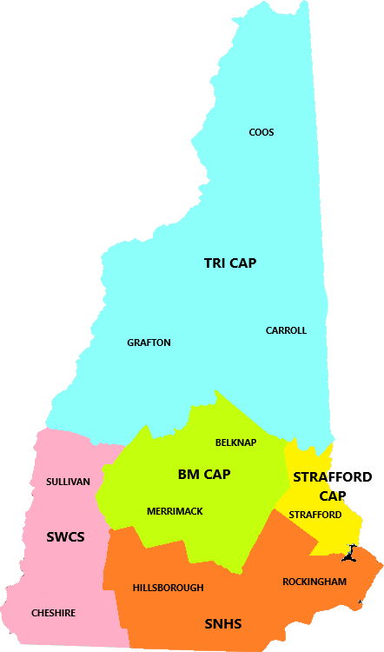
Low-Income Eligibility List
Number of households qualified for FAP in 2018 is 29,791
BMCA – 4,604
SNHS – 13,010
SWCS – 4,019
SCCA – 2,570
TCCA – 5,588
Number of FAP households that asked for weatherization services during their application in 2018 is 8,268
Census data for number of households at or below 200% of the federal poverty level in NH is approximately 112,700

Slide 19
High level benchmarking with other states

Slide 20
Completed and Projected 2018 HEA Weatherization Projects

Slide 21
HEA in 2018
Number of homes served
Utility | Goal | Completed | In-process | Prospective | Potential % to Goal
Eversource | 596 | 298 | 198 | 300 | 134%
Liberty Electric | 48 | 18 | 6 | 36 | 125%
NHEC | 42 | 23 | 11 | 9 | 102%
Unitil | 83 | 48 | 18 | 24 | 110%
Liberty Gas | 262 | 52 | 35 | 258 | 132%
Unitil Gas | 60 | 12 | 38 | 10 | 100%

Slide 22
Moving Forward
Utilities are focused on working with partners (NH OSI, CAAs and others) to ensure utilization of funds and achievement of goals for 2018-2020
Planning to fund 2019 HEA budgets at 17%
2017 was an unusual year with a large influx of federal funds in the second half
2019 Budget is ramping up significantly
Rolling funds, over or under, from year to year specifically within this program has broader impacts to budgeting process
Over the course of time the Utilities and CAAs have worked hard to meet our commitment to this program and are focused on continuing to meet it in the future

