Slide 1
Responsive Demand:
Lessons for a low-carbon transformation
21 June 2019
Roundtable discussion
NH Energy Efficiency & Sustainable Energy Board
Notes:
Welcome, and big bonus points for joining a webinar on demand response five days before Christmas! That is a true demonstration of “demand response!”
My objective today is to look at US experience with DR at a high level, to set it in the context of the transformation to a decarbonized energy system and to see what inferences we can draw from it. I will wrap up my prepared slides in time to allow time for a good discussion of the points I’m going to raise, as well as any other points my presentation might inspire among participants.

Slide 2
Key points:
Direction of travel best understood in context of market fundamentals
Role of responsive demand undergoing fundamental transformation
Success depends on who can play and how they’re compensated
Technology, retail tariff design & consumer education are key enablers…or barriers
Notes:
The key points I intend to illustrate are as follows:
The direction of travel we are taking in some areas, and that we need to take to exploit the potential value of DR in a low-carbon system, is best understood…. In other words, if we want to separate the past of demand response from the future of demand response, we need to go back to the basics of what we mean by a reliable electric supply and how the market is meant to form prices to reflect that.
The fundamentally different relationship between supply and demand in a decarbonized power system leads to a fundamentally different value proposition for demand response. We can no longer afford the historical assumption of a master-slave relationship between, respectively, demand and supply – we need it to become much more of a partnership to the extent that’s cost-effective and practical.
These paradigm shifts create, in turn, a need to revisit the questions of who can play in the DR game, how, and what they can expect to receive for doing so. The ITC revolution obviously plays a big role in this.
Finally, regulation and government policy have a big and active role. Getting the market fundamentals right is necessary, but it is certainly not sufficient.

Slide 3
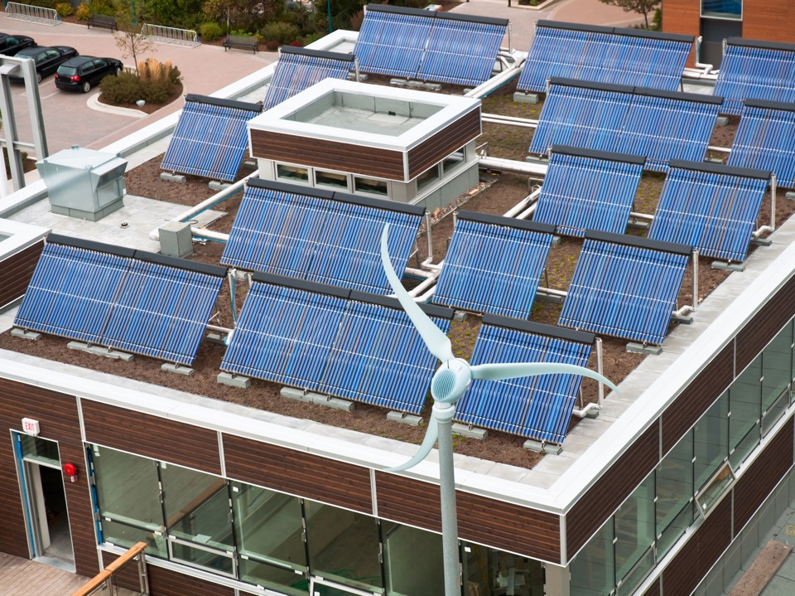
Context
1
What are we talking about?
Notes:
Section Title Slide
Usage:
This slide is the primary style for a section title slide.
The background image could stay the same as the presentation title slide’s or be another image that is specific to the section.
This slide layout is intended to be used for all section title slides in the presentation, with the section title and/or background image being the differentiator.
Customization:
To change the image, right click on the image and select Format Background > Insert picture from > File > Browse to Picture > Insert.
Bear In Mind:
Make sure that after you have changed the image, that it fills the entire slide’s space. You can do this by clicking on the image, then clicking on the Crop button in the Format Picture toolbar, and adjusting as needed.
If you change the background image on the Master Slide View, be aware that this will be the background slide for each section divider in the presentation.

Slide 4
Reliability, objectively
Imputed Average Value of Lost Load
One event in ten years
24 hours in ten years
Optimal?
Average value of lost load ($/MWh)
Price cap
Annual duration of firm load curtailment (hours/year)
(Assumes new-build CT as marginal capacity @ $106,000/MW-yr)
Source: W. Hogan, Harvard University, Kennedy School of Government.
Notes:
Resource adequacy – as we consider the challenges of how much and what kinds of resources are “adequate” to match supply and demand reliably in a system with high shares of variable renewables and/or limited flexibility nuclear supply, it’s worth revisiting what ”adequate” means objectively. Adequacy is an optimization function – more is not necessarily better, and reducing unserved load is not always good value for money. The reality is that the standards we observe, either explicitly or implicitly, in most industrialized systems imply that consumers value uninterrupted supplies for all of their energy service needs at €30,000-250,000/MWh. That’s clearly absurd, even if you assume that electricity is a “non-excludable” product – that it is a “public good.”
Usage:
This layout provides structure for a live chart with supporting description.
Customization:
Right-click on the chart to access format toolbars and the underlying data.
Edit this live chart and/or the data using MS Excel
If you change the chart type, make sure that it still uses the appropriate colors from the color palette; use the chart theme to automatically apply the proper color subtones
The subheading in this case is intended to also serve as the title of the chart. However, you can also create a smaller title right above the chart in 16pt if desired.

Slide 5
New role for responsive demand
“Demand response”: Exploiting the fact the VoLL* for a given end use is often far less than what it costs to ensure (and far more than the price we’re charging to ensure it)
Specific VoLL
*Value of lost load: the value lost when electricity for a given end use is curtailed.
**Maybe we should start looking at “VoSL” – Value of Shifting Load.
Notes:
Demand is, of course, one side of the supply/demand curve, and as the cost and performance of instrumentation and communication technologies and platforms continue to improve, the historical assumption of a vertical demand curve – of inelastic demand – is less and less valid. Electricity is becoming “excludable” for more and more loads. For the energy market to be a real energy MARKET, prices need to reflect ALL of the demand on system resources and the marginal costs of ALL actions required to balance the system, including the opportunity cost of drawing down reserves to produce an additional kWh of energy. The sweet spot for a great deal of responsive demand probably lies in the historical “no man’s land” between actual and implied price caps on the one hand, and the assumed blanket value of lost load on the other.

Slide 6
The real supply curve:
Generation merit order
Emergency gen & other
Drawdown of required reserves

Slide 7
Is there a different way to look at this?
We’re talking about a fundamental change in the nature of the supply mix
Can we really afford to continue to build a power system and charge customers based on the assumption that they are happy to pay $35,000-$250,000/MWh for the luxury of no one shifting their flexible loads by a few hours?
Notes:
1 Column Body Text Slide
Usage:
This is an example for a basic text page with a substantial amount of body copy in the recommended text size for all body copy in the presentation and a section title header included above the title.
42pt Arial Bold is the recommended Header text size
26pt Arial Bold is the recommended body header
22pt Arial is the recommended body text size. The visual hierarchy is very clear for the viewer and it can be read from a ways away.
Customization:
To keep all the right spacing and formatting remember to move the text boxes under the title down, when the title extends to more than one line.
Bear In Mind:
If the amount of content you want to include does not fit into one slide, consider editing down the amount or breaking it up to continue onto the next slide.
Text smaller than 20pt is discouraged, as it creates legibility issues when projected and can leads to excessive content volume.

Slide 8
The changing role of demand response
2
From limited-use capacity to everyday energy
Notes:
Section Title Slide
Usage:
This slide is the primary style for a section title slide.
The background image could stay the same as the presentation title slide’s or be another image that is specific to the section.
This slide layout is intended to be used for all section title slides in the presentation, with the section title and/or background image being the differentiator.
Customization:
To change the image, right click on the image and select Format Background > Insert picture from > File > Browse to Picture > Insert.
Bear In Mind:
Make sure that after you have changed the image, that it fills the entire slide’s space. You can do this by clicking on the image, then clicking on the Crop button in the Format Picture toolbar, and adjusting as needed.
If you change the background image on the Master Slide View, be aware that this will be the background slide for each section divider in the presentation.

Slide 9
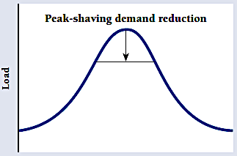
DR as limited capacity resource
Traditional Demand Response
Notes:
Historically, we’ve thought of “demand response” as an option purchased from a few large customers by utilities to interrupt load a very small number of times a year for very limited periods of time to avoid the need to impose voltage reductions or, in the worst case, rolling curtailments of “firm” load elsewhere. In other words, DR was seen as a capacity resource, a substitute for super-peaking generation. This functionality had a certain value in a traditional system in which gross load was roughly equal to net load and nearly all resources were dispatchable to follow load. This functionality will still have value, but it has little relevance to the challenges and opportunities in a decarbonized power system.

Slide 10
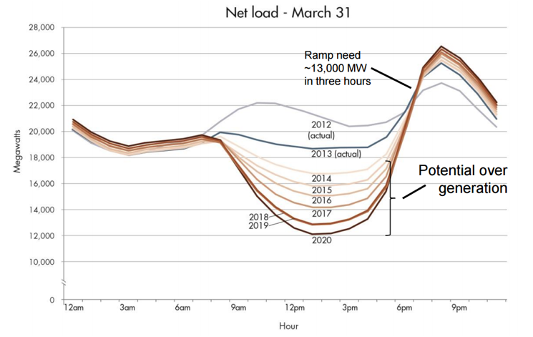
Flexibility is the scarce resource
The infamous CAISO “Duck Curve”
Notes:
In a decarbonized power system,

Slide 11
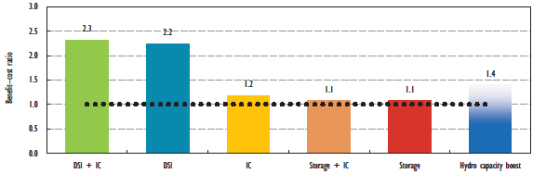
System flexibility: More valuable than ever
Benefit-cost ratios of different flexibility options
Source: IEA, The Power of Transformation (2014)

Slide 12
Controllable load acting as supply
Example:
PJM frequency regulation signal
vs.
Water heater power consumption +/- 2.25kW base point
Source: PJM
Notes:
Pros: Inventoried as a contracted resource; dispatchable by system operator
Cons: Limited by requirements to compete in relevant wholesale markets (forward commitments, frequency and duration of calls, size, locational issues, etc.); “fuel cost” of paying for scheduled load must be accounted for

Slide 13
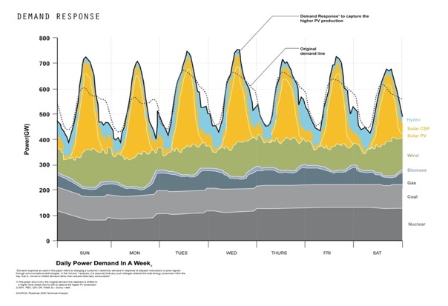
New role for responsive demand
Moving from a world where we forecast load and schedule generation, to a world where we forecast generation and schedule load
will now need to shape, not just shave, demand
Notes:
Right-click on the chart to access format toolbars and the underlying data.

Slide 14
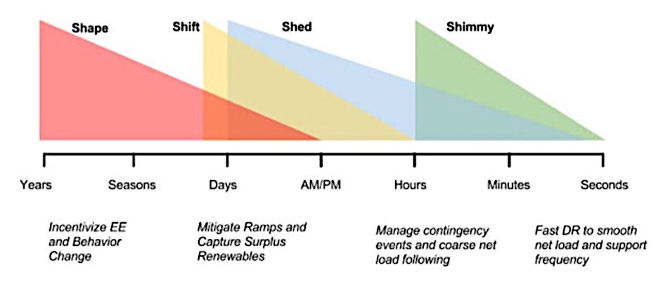
New roles for responsive demand
Source: “2025 California Demand Response Potential Study,” Lawrence Berkeley Lab (March 2017)
Notes:
Right-click on the chart to access format toolbars and the underlying data.

Slide 15
Participation and compensation
3
The right to play & to be paid for the value delivered
Notes:
Section Title Slide
Usage:
This slide is the primary style for a section title slide.
The background image could stay the same as the presentation title slide’s or be another image that is specific to the section.
This slide layout is intended to be used for all section title slides in the presentation, with the section title and/or background image being the differentiator.
Customization:
To change the image, right click on the image and select Format Background > Insert picture from > File > Browse to Picture > Insert.
Bear In Mind:
Make sure that after you have changed the image, that it fills the entire slide’s space. You can do this by clicking on the image, then clicking on the Crop button in the Format Picture toolbar, and adjusting as needed.
If you change the background image on the Master Slide View, be aware that this will be the background slide for each section divider in the presentation.

Slide 16
Demand response in PJM’s RPM
Source: PJM Demand Response Strategy (June 2017)

Slide 17
Diversity of value…lack of access
Notes:
PJM’s attempts to ”fit” dispatchable DR into its capacity

Slide 18
Capital-intensive ≠ capacity-intensive

Slide 19
Dispatchable demand response
Source: PJM and Enbala

Slide 20
Price-responsive DR: the next frontier
Example: ERCOT Real Time Pricing pilot – 14,700 customers, $500-600/MWh price – 5% reduction or shift in demand
Source: ERCOT Demand Side Working Group (2017 report)

Slide 21
Innovation: 3rd party access is essential

Slide 22
Other considerations:
Retail tariff design matters…a lot
Consumer education is critical
Distribution-level “grid constraint engines”
Optimize (eliminate?) TSO/DSO interface
I[T/D]SO?
Others?

