Slide 1
New Hampshire Statewide Energy Efficiency Plan 2020 Update and Beyond
New Hampshire Office of the Consumer Advocate
EESE Board Update
May 17, 2019

Slide 2
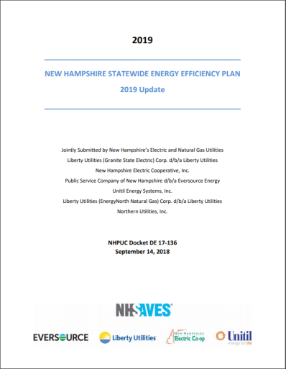
2019 Energy Efficiency Plan Update Presentation Outline
Historical Context and SBC
Update on 2019 Plan Commitments
Bill and Rate Impact Analysis
Active Demand Reduction Pilot
Cost-Effectiveness Screening
Performance Incentives
Energy Optimization
2020 Update and Beyond
Potential Study
EESE Board EERS Committee Stakeholder Consultant
Timeline

Slide 3
Historical Context and SBC: Building Upon Decades of Success
Early 1990s: Commission approves first C&LM Plans
Early 2000s: SBC-funded “CORE” EE Programs established
Late 2017: 2018-20 Plan Settlement establishes working groups
Late 1990s: NH Restructures, EE programs nearly eliminated
August 2016: EERS significantly increases savings targets, embraces all cost-effective EE as long term goal
December 2018: Settlement and working groups provide insight into 2020 and beyond
Funded by System Benefits Charge, FCM, and non-rebated RGGI
Investments undergo rigorous EM&V to ensure net benefit under Total Resource Cost Test
2019 Budgets of $47 million Electric, $10 million Gas

Slide 4
Historical Context and SBC SBC and Customer Rates

Slide 5
Historical Context and SBC SBC Then and Now
Order No. 25,932 (August 2016) establishes an EERS
Near term electric goals as a percent of 2014 delivered sales:
2018= .8%; 2019= 1.0%; 2020= 1.3% (page 55)
SBC rate increase to achieve those goals (page 52):
2018-20 Plan & 2019 Settlement | Eversource | Unitil | Liberty
2018 | $0.00455 | $0.00456 | $0.00457
2019 | $0.00586 | $0.00576 | $0.00535
C&LM Adjustment Factor | Liberty
1991 | $0.00739
1992 | $0.00805

Slide 6
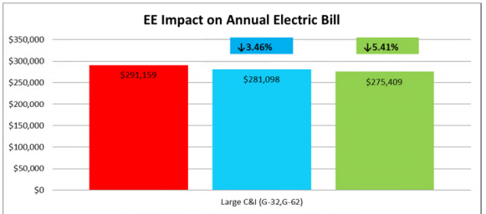
Update on 2019 Plan Commitments: Bill Impact Analysis
Customers pay bills, not rates:
Previous plans and orders provide only rate impact of programs
2019 Settlement requires “bill impact analysis, including rate impacts, bill impacts and participant impacts.”
Analysis pending…
National Grid RI Example:
Accounts for program participation, and average customer’s bill impacts
We will do this analysis
Average customer bill savings, if EE program
EE program participant bill savings
Customer bill without EE

Slide 7
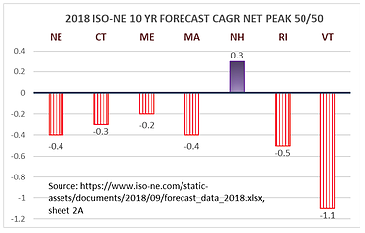
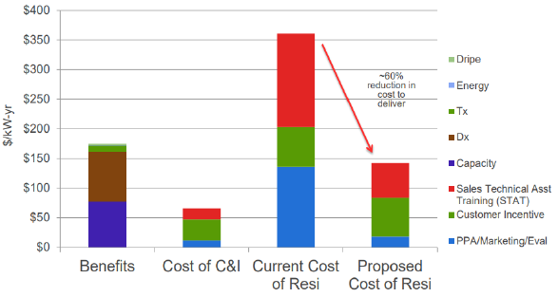
Update on 2019 Plan Commitments: Active Demand Reduction Pilot
Growing focus on reducing peak demand and improved load factor throughout New England
Top 10% of hours account for 40% of annual electricity spend
2019 Settlement requires Eversource and Unitil C&I Active Demand Reduction Demonstration Projects; proposed projects approved April 5, 2019
 | Eversource | Unitil
Program Expenses | $250,000 | $93,765
Participants | 75 | 5
Summer MW Target | 5MW | 1.8MW

Slide 8
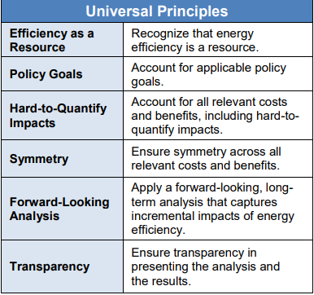
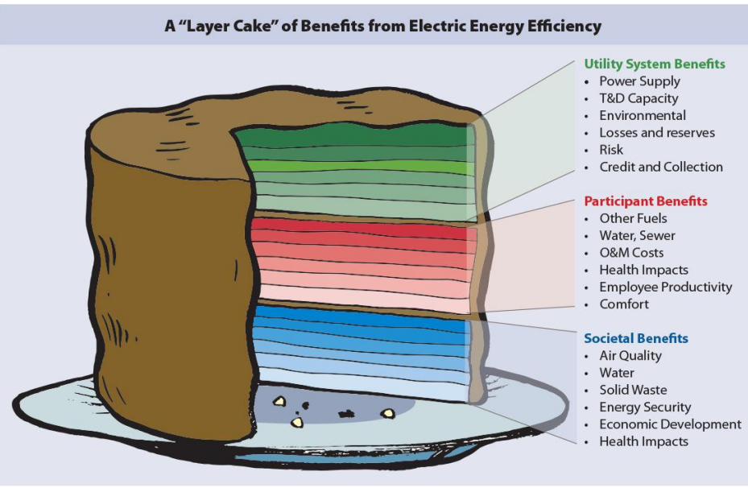
Update on 2019 Plan Commitments: Cost-Effectiveness Screening
2019 Settlement requires application of National Standard Practice Manual
EE Programs need to provide more benefits than they cost
NH has used CSPM’s Total Resource Cost Test for 2+ decades
National Standard Practice Manual Resource Value Framework provides updated guidance
UCT
TRC
SCT

Slide 9
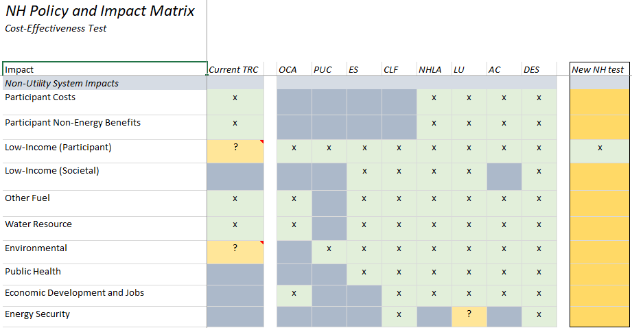
Update on 2019 Plan Commitments: Cost-Effectiveness Screening
Review included 33 statutes, 31 Commission Orders, and policy documents, including State Energy Plan
Many interpret our policies as not including participant costs/benefits
Places greater emphasis on the costs and benefits to utility ratepayers, rather than just the program participants
Exception is low income participants, because their costs look more like utility (ratepayer) costs
Debate remains re: unregulated fuel/water savings, societal impacts
Actual outcome TBD…

Slide 10
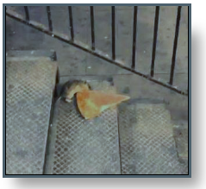
Update on 2019 Plan Commitments: Performance Incentives
2019 Settlement required performance incentive to incorporate a demand metric and study metrics to address income eligible participation barriers/disincentives
Group recruited technical assistance of ACEEE’s Martin Kushler
Framework of several metrics (QPIs) appears to have growing support, but many details remain to be resolved
The latest compromise draft allocates performance incentive pool according to these metrics:
35% = Lifetime Savings (kWh)
10% = Annual Savings (kWh)
12% = Summer Peak Savings (kW)
8% = Winter Peak Savings (kW)
35% = Value ($ Resource Benefits (-) Utility Costs)
“I’m a rat, show me some cheese.”
-John Rowe

Slide 11
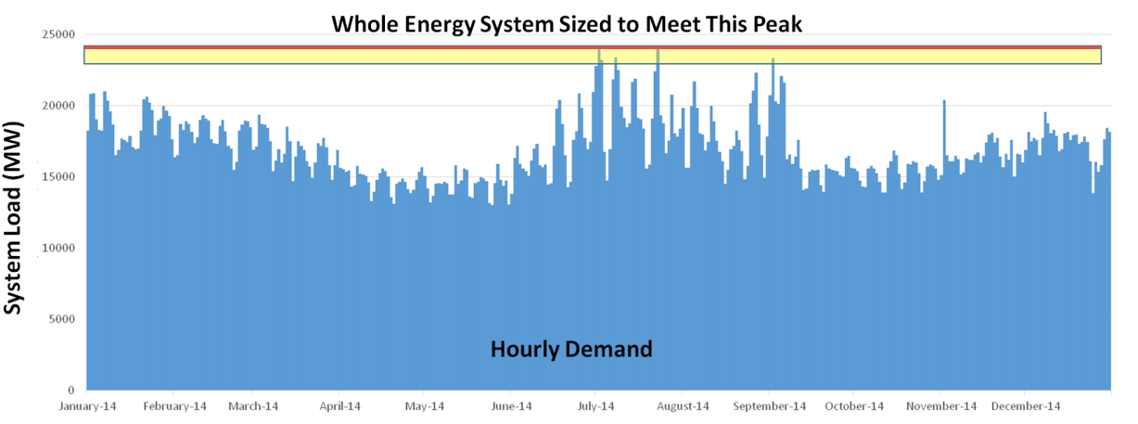
Update on 2019 Plan Commitments: Energy Optimization
Consultant developing a report based on research and interviews to provide information relating to:
Current NH treatment of potential Energy Optimization measures
Trends in other Northeast states in accounting for unregulated fuel savings during a fuel switch
Measure characterization, including for various measures the:
Energy savings by fuel type
Energy cost savings
Total installed cost
Phase one deliverable complete
Summary of other states pending…
Latent Ratepayer Value

Slide 12
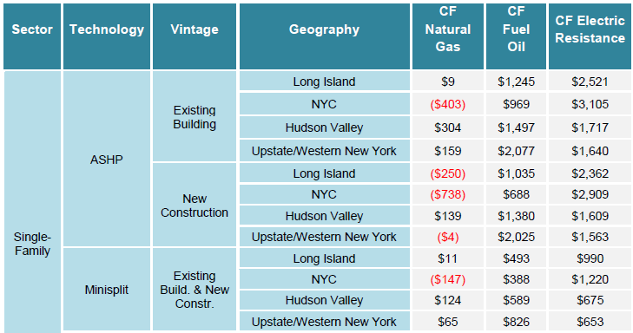
Update on 2019 Plan Commitments: Energy Optimization (Cont’d)
VT Analysis of Energy Optimization Rate Impacts
Bills and rates can go down, but we have to get it right by:
Limiting demand growth
Encouraging demand flexibility
Limiting cost shift
NY DPS 2019 Heat Pump Net Energy Bill Savings Analysis

Slide 13
Update on 2019 Plan Commitments: Energy Optimization (Cont’d)
MA 2021 Benefit Cost Table
Worth noting:
Only about half (2,800) of air source heat pumps (ASHPs) treated as fuel switching
When partial displacement of existing fuel, rebates cover 30-50% of cost
Propane fuel switches far more cost effective than oil

Slide 14
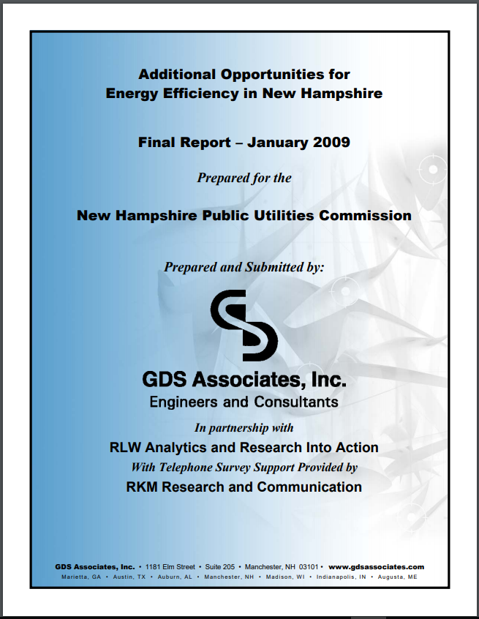
2020 Update and Beyond: Potential Study
Potential studies show regulators and program administrators the best place to invest ratepayer dollars and inform high level targets
Last potential study in 2009, markets and baselines changed significantly
Forthcoming potential study will place significant emphasis on studying baselines associated with existing building stock
May be impacted by forthcoming benefit cost working group recommendations (energy optimization, cost benefit screening)
RFP released and 4 proposals pending evaluation
Should take about a year to complete

Slide 15
2020 Update and Beyond: EESE Board EERS Committee Consultant
2018 and 2019 Settlement allocated SBC dollars to a consultant to help EESE Board, EERS Committee, and other stakeholders participate meaningfully in the PA’s planning process
Consultant funding solidifies EESE Board’s role in program planning process, brings closer to what US DOE’s SEE Action Network identifies as “enhanced stakeholder board”
MA, RI, CT all have similar board consultant who works with stakeholders and PAs to help ensure optimal program strategies and measure mix
EESE Board EERS Committee worked with PUC Staff to craft RFP and received two proposals, which are pending evaluation

Slide 16
2020 Update and Beyond: Timeline
2020 Update Filing and Review Sep-Dec 2019
EERS Committee Stakeholder Planning Process
Utilities file draft plan with Commission
Stakeholder Consultant Chosen
July/Aug 2019
April 1, 2020
Aug-Dec 2020
Soon…
Oct ’19- Feb ‘20
July 1, 2020
NSPM Report and Energy Optimization Study filed with Commission
Utilities submit draft plan to EERS Committee for input/review
NH PUC Docket Process
Potential Study Ongoing

Slide 17
Discussion
New Hampshire Office of the Consumer Advocate
21 South Fruit Street Suite 18, Concord, NH 03301
www.OCA.NH.Gov

