Slide 1
Advancing Clean Energy Investment in Northern New England
March 15, 2019
Presentation for the NH Energy Efficiency and Sustainable Energy Board
Concord, New Hampshire
Notes:
Bruce

Slide 2

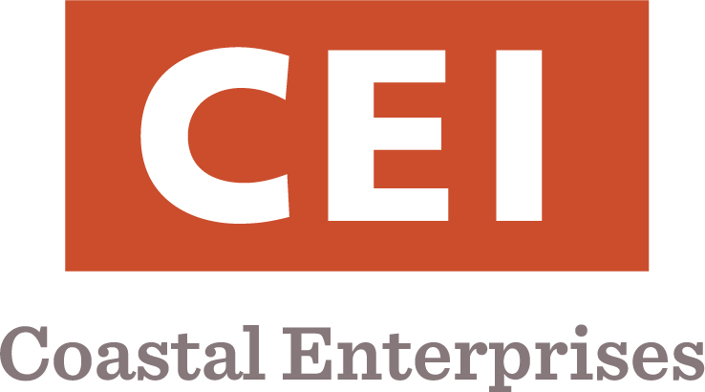
Why this Report was Commissioned – Bruce Clendenning, The Nature Conservancy - NH
Overview of the Study - Christine Donovan, VEIC
Clean Energy Investment Recommendations and Discussion – Liz Curry, Philip Picotte, Brian Pine, Jennifer Wallace-Brodeur, VEIC
Next Steps – Bruce Clendenning, The Nature Conservancy – NH
Notes:
Bruce

Slide 3
Why this Work was Commissioned
Notes:
Bruce

Slide 4
Project Purpose
TNC and CEI sought to understand the biggest barriers to clean energy investment in Northern New England, and whether there are innovative finance mechanisms that can help overcome the barriers.
This led to identification of key strategies to drive investment toward energy efficiency, renewable energy, and clean transportation.
Both transformative, systems-level changes as well as tactical changes were desired that enable the sustained, orderly development the clean energy market.
Recommendations were selected with an eye on core competencies, areas of strength, and spheres of influence of TNC and CEI
Notes:
Bruce

Slide 5
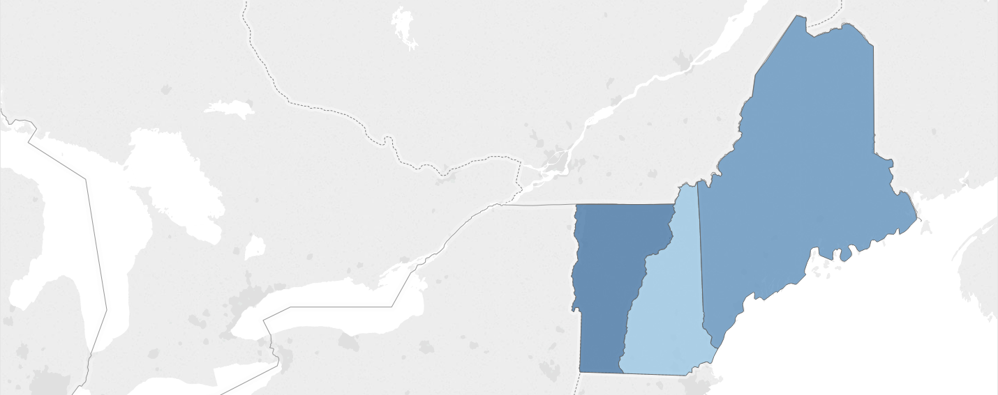
Clean Energy Jobs
Maine
Efficiency: 8,084
Renewables: 2,756
New Hampshire
Efficiency: 10,869
Renewables: 3,376
Vermont
Efficiency: 10,918
Renewables: 3,490
Source: New Energy America, Fifty State Clean Energy Jobs Report, 2017
Notes:
Bruce
It is all about jobs, jobs, and more jobs
Many clean energy jobs are local jobs that can not be out sourced to a foreign country

Slide 6
Project Approach & Team
Notes:
Christine

Slide 7
Project Approach
Conducted literature search and reviewed 50+ clean energy financing reports
Conducted telephone interviews with 25+ national, regional, and state clean energy funding, financing, economic development, project development, and transportation electrification professionals
Completed a qualitative assessment of gaps in the supply and demand of clean energy funding and financing in the region
Reflected on VEIC’s experience leveraging private investment via funding and financing through Efficiency Vermont, the DC SEU, and Efficiency Smart
Selected recommendations through an iterative process with TNC and CEI informed by their knowledge, expertise, and desired outcomes
Notes:
Christine

Slide 8
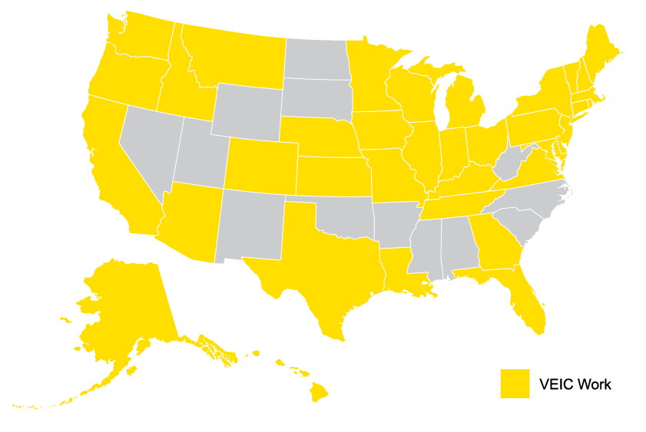
About VEIC
Mission-driven nonprofit
30+ years reducing economic & environmental costs of energy for all people
300+ staff in Vermont, New York, Ohio, & Washington DC
We design, deliver, and evaluate nationwide
  Energy efficiency
  Renewable energy
  Transportation
We “think and do”
  Consultants
  Engineers and technical assistance experts
  Data analytics and EM&V experts
  Financing strategy experts
Our Customers
  Utilities
  Government
  Businesses
  Foundations
  Environmental & consumer groups
Notes:
Christine

Slide 9
Notes:
Christine
Engaged in EE and thermal
Buildings and transportation
Delivering EE at 1.4 to 3.0 cents / kWh
For both regulated and voluntary markets
Independently-verified savings
With realization rates of 97-98%

Slide 10
What is a Clean Energy Economy?
Notes:
Christine

Slide 11


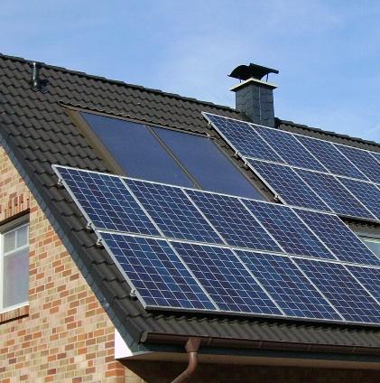
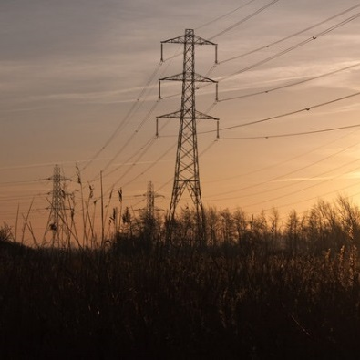
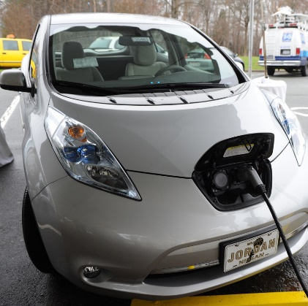
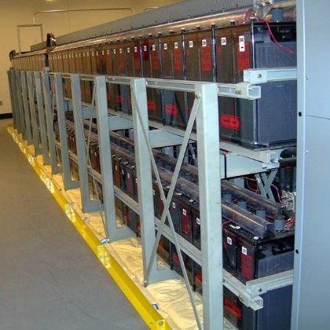

Efficient, Clean Energy – Affordable for All
Energy Efficiency
Demand Response
Distributed Clean Energy
Grid Modernization
Strategic Electrification
Affordable & Accessible for All
Storage
Notes:
Christine

Slide 12
Total Energy – Buildings and Transportation
Electricity
Transportation
Thermal
Notes:
Christine

Slide 13
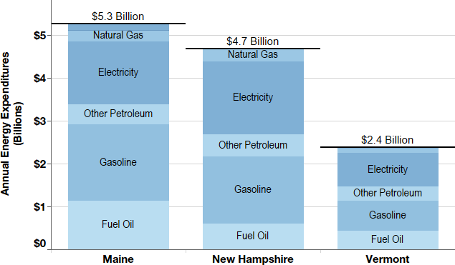
Annual End Use Energy Expenditures - 2016
Notes:
Christine

Slide 14
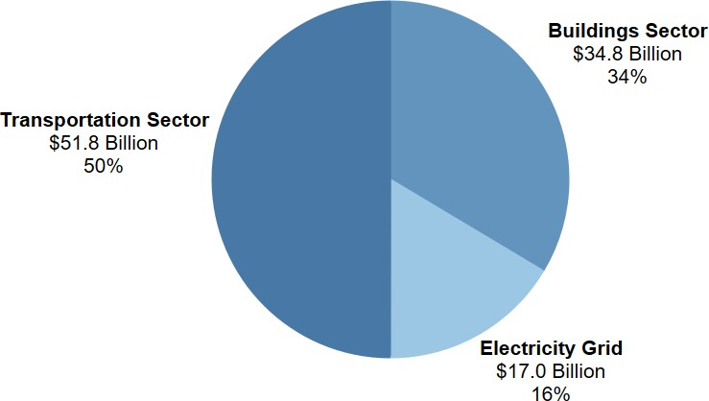
Investment Opportunity from Meeting
80% of State Goals
Notes:
Christine

Slide 15
Placing the Investment Opportunity in Context
$100 billion +/- investment opportunity over the next decade – much of which will be spent anyway – the goal is to ensure it is spent on clean energy options
    50% for EV purchases and infrastructure
    28% for residential retrofits and renewable heating
    6% for commercial retrofits and district energy
    16% for renewable generation
    Based on a framework by Energy Action Network and Catalyst Financial
Amount spent on energy currently: $12 billion +/- per year
Ratepayer and taxpayer funds will not be sufficient alone
Scaling up private investment – and scaling up use of public investment to leverage private investment – will be key to success
Notes:
Christine

Slide 16
Key Challenges & Opportunities
Notes:
Christine

Slide 17
What Does it Take for Success?
Favorable Policy & Regulatory Framework
Proven Technology, “Off the Shelf”
Delivery & Service Infrastructure & Workforce
Customer Demand
Investment – Funding & Financing
Notes:
Christine

Slide 18
Multiple Market ‘Segments’ to Serve
Residential | C&I | Transportation | Energy Supply & Infrastructure
Single family – Bankable | Small to medium businesses | Personal vehicles | Distributed solar PV
Single family – Low credit score | Commercial & industrial | Transit buses | Grid-scale solar PV
Multifamily – Bankable | Municipal, universities, schools, & hospitals | School buses | Storage
Multifamily – Renters |  | Freight transportation | Grid modernization
Mobile homes – Low credit score |  |  | Modern wood heating
 |  |  | Combined heat and power
Notes:
Christine

Slide 19
Basis for Selecting Which Challenges & Opportunities
Each challenge = an opportunity
The following were used as the basis for selecting which to focus on for this project:
  Areas in which TNC and CEI could have impact, in partnership with many other stakeholders
  Both “stretch” challenges (and opportunities) and those that are within reach, to enable early success while acknowledging the need to “reach”
  With potential for progress in at least one of the three states, recognizing the uniqueness of each state and differences in political contexts
Notes:
Christine

Slide 20
Key Challenges and Why Each Matters
Challenge | Why this matters
Lack of a carbon pricing mechanism. | Absent this, there is no market-based pricing signal that captures the cost of continued GHG emissions and seeks to drive investment away from GHG producing fossil-fuel based products.
Out dated “cost of service” regulatory approach for electric and gas utilities. | This results in electric and gas utilities not being properly incented or compensated for prudent investments in EE, DER, and transportation electrification.
A variety of policy and regulatory barriers exist for community solar PV at the state level. | This increases project development costs for community solar, decreases profitability compared to grid-scale solar, and therefore limits the interest of project developers to develop community solar. It also results in fewer cost effective solar PV options for renters (home and business) as well as for low and moderate income households.
Notes:
Christine

Slide 21
Key Challenges and Why Each Matters (con’t)
Challenge | Why this matters
Half of GHG emissions in the region is from transportation. Planning, policy, and regulatory frameworks do not effectively connect transportation planning, transportation electrification, and utility regulation. | Integrating these key ingredients is critical for a well-planned, cost effective, and appropriately funded and financed clean transportation future.
Light duty vehicles (cars and light trucks) account for about 80% of transportation GHG emissions in the region and market penetration of personal EVs is low. | This means the transition away from fossil-fuel based personal transportation is occurring slowly and will limit the ability to meet state climate goals.
Heavy duty vehicles (buses and freight) account for about 20% of transportation GHG emissions in the region and market penetration of electric buses and freight trucks is also low. | Similarly, this means the transition away from fossil-fuel based heavy duty transport is occurring slowly and will limit the ability to meet state climate goals.
Notes:
Christine

Slide 22
Key Challenges and Why Each Matters (con’t)
Challenge | Why this matters
Many EE loan offerings are underutilized. Even those that are well subscribed are serving only a portion of the buildings that could benefit from cost-effective EE and weatherization improvements. | The lack of demand for EE financing (even among those with bankable credit scores) is a signal that the consumers do not fully understand the value proposition of investing in cost-effective energy efficiency and weatherization improvements – reduced energy bills, increased comfort, and improved health.
C&I investments in cost-effective clean energy projects are limited by the need to preserve capital for other business needs. | This indicates the need for new financing models and tools directed at businesses and industries, that enable cost-effective investments in energy efficiency, weatherization, and process improvements using “off balance sheet” financing approaches.
Notes:
Christine

Slide 23
Key Challenges and Why Each Matters (con’t)
Challenge | Why this matters
Municipalities face competing demands for revenue generated from local taxes, even for cost-effective clean energy projects. | This means cost-effective energy efficiency, weatherization, and/or clean energy projects are sometimes not being implemented, even when they would reduce municipal energy bills and ultimately free up tax dollars for other uses or potentially reduce tax burdens.
There is a lack of affordable, accessible, and easy-to-use clean energy financing options for low to moderate income households and renters. | Similarly, this means cost-effective energy efficiency weatherization and/or clean energy projects are not undertaken, sometimes resulting in unnecessary discomfort, negative health impacts, and suffering.
Many different market actors provide a multitude of EE and RE products, services, and financing options. | This disaggregated approach to the market creates customer confusion and can result in no action being taken.
Notes:
Christine

Slide 24
Recommended Solutions
Notes:
Christine

Slide 25
Two Categories of Solutions are Recommended
Policy and regulatory strategies for scaling clean energy investment
  Including systems-level recommendations that will likely be controversial and may have significant political hurdles in one or more of the states
Modification of existing and development of new clean energy financing models and tools
  Including tactical and programmatic recommendations that do not involve systems-level changes to achieve
Each was assessed qualitatively for its impact on GHG reduction, job creation, and equity
Notes:
Christine

Slide 26

# 1
Implement Regional Carbon Pricing
Notes:
Brian
https://www.flickr.com/photos/volvob12b/31380554674/in/photolist-PNZxC7-b4kr9F-8h9cmG-b4krdc-b4kqTV-aHSm7F-b4krgD-9jimaF-b4kr2F-b4kr6p-duuaXE-6oeTQw-njNqhN-WV6L8w-5UqG8q-dqs8cu-SnLW4w-dssvLL-9pws1X-qpaf2E-26c5bLM-9jijfP-8qaEjV-8qdTnh-9Z6mcw-8qdNxA-hH6f7-as5hWx-dxrbgi-ntqWwJ-81beez-2coTU7k-9wKyQu-4X8osL-dq25pM-3eoe2z-p1FrxH-9u3dK7-dVht75-9u3d97-QWgang-nSSHXx-cZCLdh-hon4Ba-6zqJ1J-XwGM55-oPK9KA-5D8w93-HvQYXS-5HuX9v

Slide 27
What is Carbon Pricing?
Carbon pricing is NOT a tax.
  It can help leverage RGGI and the Transportation Climate Initiative.
Carbon pricing is a market-driven approach that can:
  Be used to set a long-term signal and emissions profile based on reductions needed to meet carbon-reduction targets (markets respond well to long-term, stable signals)
  Allow the market to determine the best mechanisms to reach the desired carbon-reduction outcomes
  Build on the history and success of RGGI and foster partnerships with other regional efforts like Western Climate Initiative
  Feature safety valves that check or modify costs and targets if goals are not being met
Notes:
Brian

Slide 28
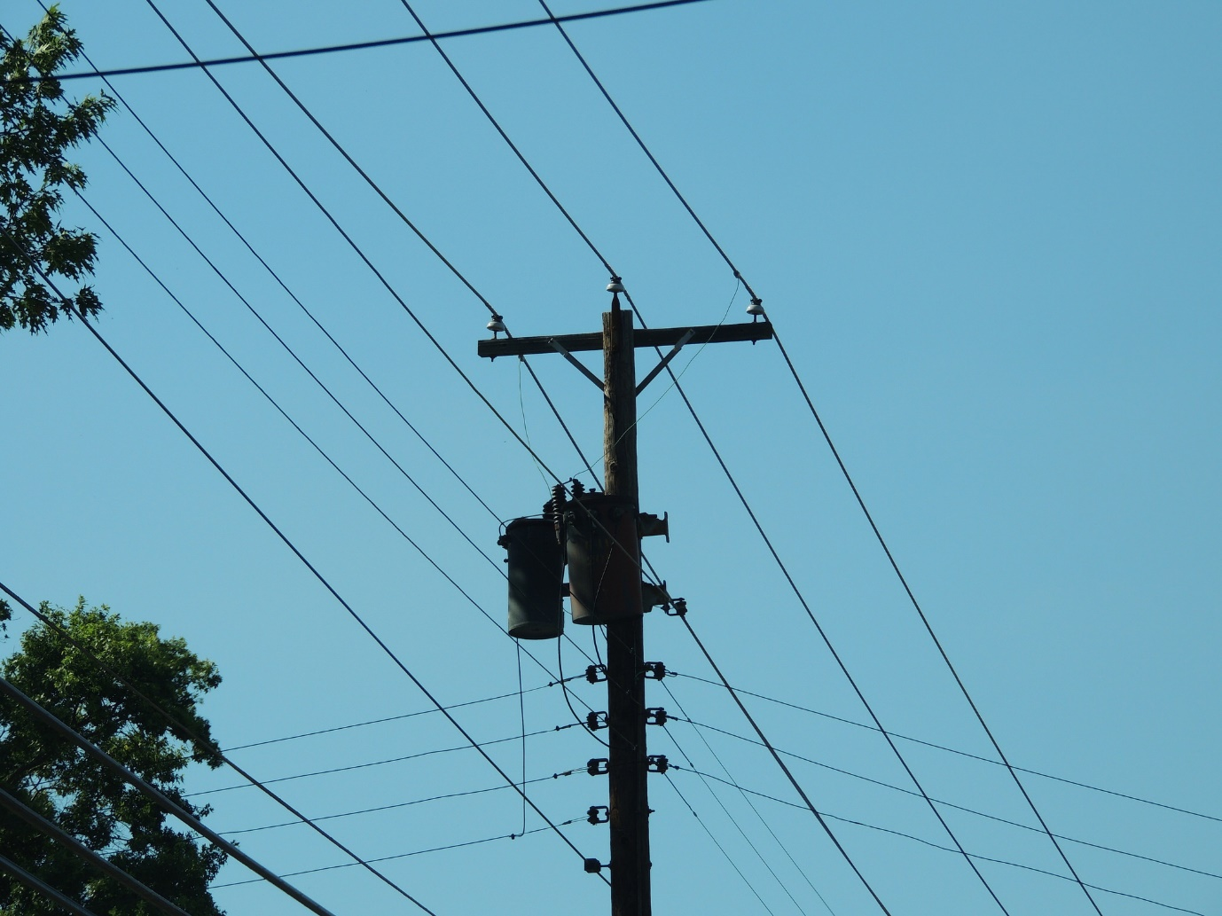
# 2
Advance Performance-Based Regulation
Notes:
Liz
https://www.flickr.com/photos/powerline64/25029431088/in/photolist-E8LnRj-gXBDF-26z8t93-FEfj7U-vWHvyJ-21LEvE9-HK2HY8-24ydDHU-2c7hw2L-cyFw9J-u5yfdS-nDbWtZ-k3Lo-6bwkdq-2eHc7rn-kNJrdB-7t5Auq-dLSKTQ-bp7pzg-4mVozA-6bnuC5-RSdEWM-SYcBFY-dBwSCa-7CjHE9-pFg2Bi-dA8XSg-6FerxM-cyFuQs-cyFvvj-4oaZuf-pvjoE4-rdLAwB-sv8vX1-pvpNYq-c8uheb-XzwYg-4EJphP-7V3MNz-amDExf-4EK27i-4EK28v-5CcXhq-4xjLcJ-qZadz-tcykNA-yhGniD-8ULw71-2bvytsi-5ZM28r

Slide 29
What is Performance-Based Regulation?
Performance-based regulation and performance incentives are a new regulatory approach and framework for transitioning to the “utility of the future”
We know that:
  The utility revenue base is changing and declining (plants, poles & wires)
  Consumption is decreasing in many regions – efficiency is working!
  Decentralized generation (distributed energy resources) must be integrated into grid management
  Utilities must invest in smart grid technology while maintaining conventional grid infrastructure
  There is considerable risk of rate increases to mitigate the impact of efficiency and renewables which leaves low-income people and small businesses the most vulnerable
  These industry dynamics are causing changes to the utility cost-of-service revenue model
Notes:
Liz

Slide 30
Traditional Evaluation of Utility Performance
System reliability
  Frequency & duration of interruptions
System safety
  Work-related injuries, deaths, illnesses, incidents
Customer satisfaction
  Survey data, complaints, service order responsiveness
Power plant performance
  Quantity of fuel burned & heat rate – average BTU per kWh net generation
Costs
  Cost of kW of installed capacity, O&M, average cost of fuel per kWh
Notes:
Liz

Slide 31
Emerging PBR Utility Evaluation
Overall system efficiency
  Average & peak load, usage per customer, plant efficiency, system losses
Customer engagement
  Energy efficiency, demand response, distributed generation, storage, EV’s, time-varying rates, customer data availability
Network support
  Advanced metering, distributed resource interconnection, interconnection of bulk renewables, smart grid infrastructure for third-party access, customer data control
Environmental goals
  Pollutants, carbon emissions & intensity, renewable generation
Notes:
Liz

Slide 32
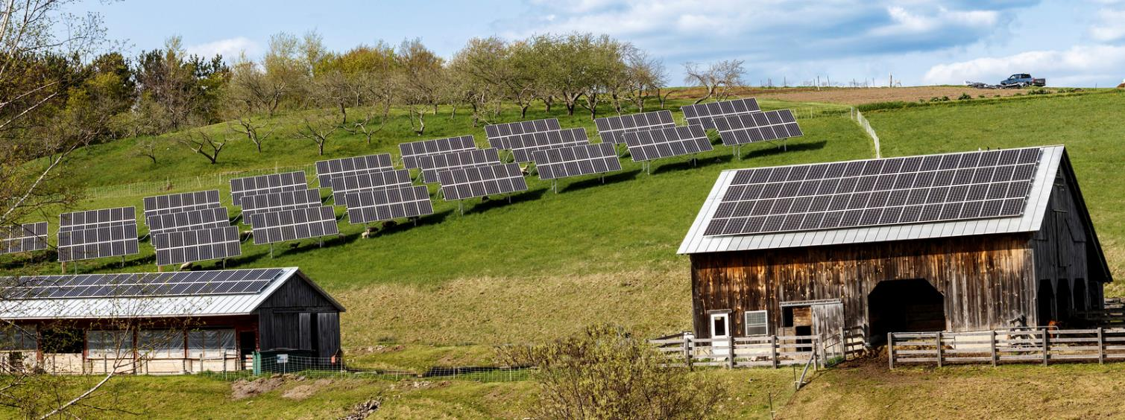
# 3
Address Community Solar Policy and Regulatory Barriers
Notes:
Philip
Photo: US DOE by Emily Boren; Vershire, Vermont

Slide 33
What is Community Solar?
“Community solar” is a solar PV system sited on a building or the ground whose electricity is shared by more than one household or business
By utilizing group net metering, participants opt-in to receive net metering credits that offset their electricity consumption
Community solar allows participants to benefit from solar PV even if they are:
  Not able to site a project at their own locations;
  Not able to afford the upfront cost; and/or
  Not eligible for loans or leases.
Notes:
Philip

Slide 34
State Policy and Regulatory Barriers are Limiting Community Solar
However, a variety of policy and regulatory barriers exist for community solar that:
  Increase the cost of capital for project developers;
  Decrease profitability compared to customer-sited or utility-scale projects; and therefore
  Limit the supply of projects.
Notes:
Philip

Slide 35
Strategies for Reducing Policy Risk to Help Lower Capital Costs
Raise the size of the cap on community net metering
Offer Payment in Lieu of Taxes (PILOT) or other predictable mechanisms to mitigate property tax impacts
Offer more affordable capital options, such as in- or out-of-state credit unions and banks
Notes:
Philip

Slide 36
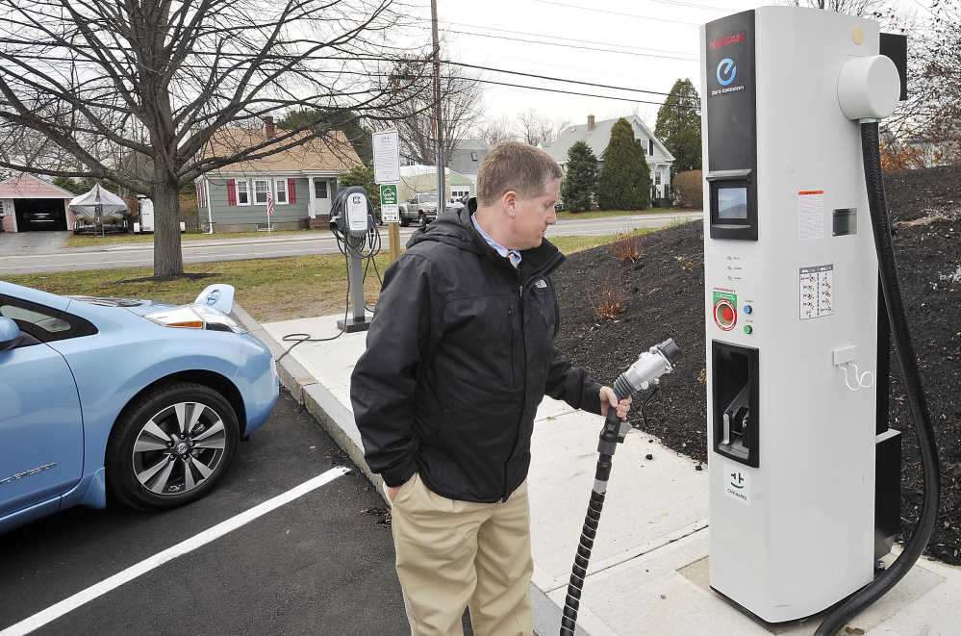
# 4
Engage in EV Policy and Regulatory Development
Photo: Portland Press Herald
Notes:
Jennifer

Slide 37
Why Utility Regulatory Change for EVs?
Market failures do not fully account for the societal impacts of fossil-fueled transportation
Energy and environmental regulatory agencies can address market failures and set the stage for utility and automaker investments in transportation electrification
State utility regulators are especially well positioned to help advance EV market transformation
This is because electric utilities have a unique role to play in transportation electrification
Notes:
Jennifer

Slide 38
Why Utility Regulatory Change for EVs (con’t) ?
State utility regulators should be encouraged to understand the benefits of transportation electrification
Regulators can also engage in uncontested workshops or investigation proceedings that allow for exploration of policies and programs that support EVs in the state
Setting regulatory ground rules on what (if any) EV activities utilities can engage in and recover from ratepayers increases likelihood of robust program offerings
Notes:
Jennifer

Slide 39
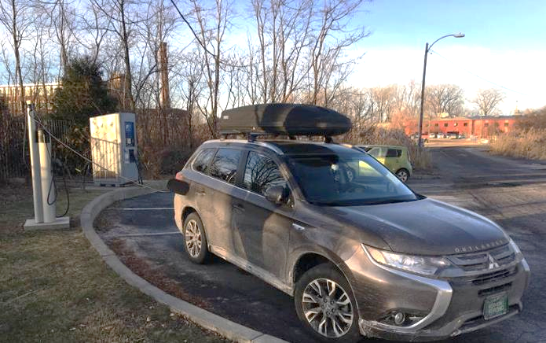
# 5
Enable EV Market Transformation
Notes:
Jennifer
Photo: Burlington, VT

Slide 40
Why Enable Plug-In EV Market Transformation?
The transportation sector is a major component of carbon pollution in the US and regionally. In ME, NH and VT personal vehicles are the primary means of mobility and access to jobs and services
Electrification of personal vehicles has the greatest near term potential to transition the sector to cleaner energy
Upfront cost is the primary barrier to plug-in EV ownership
Incentive funding programs are effective in increasing EV adoption, and should be implemented in conjunction with supportive regulatory policy and consumer engagement
Notes:
Jennifer

Slide 41
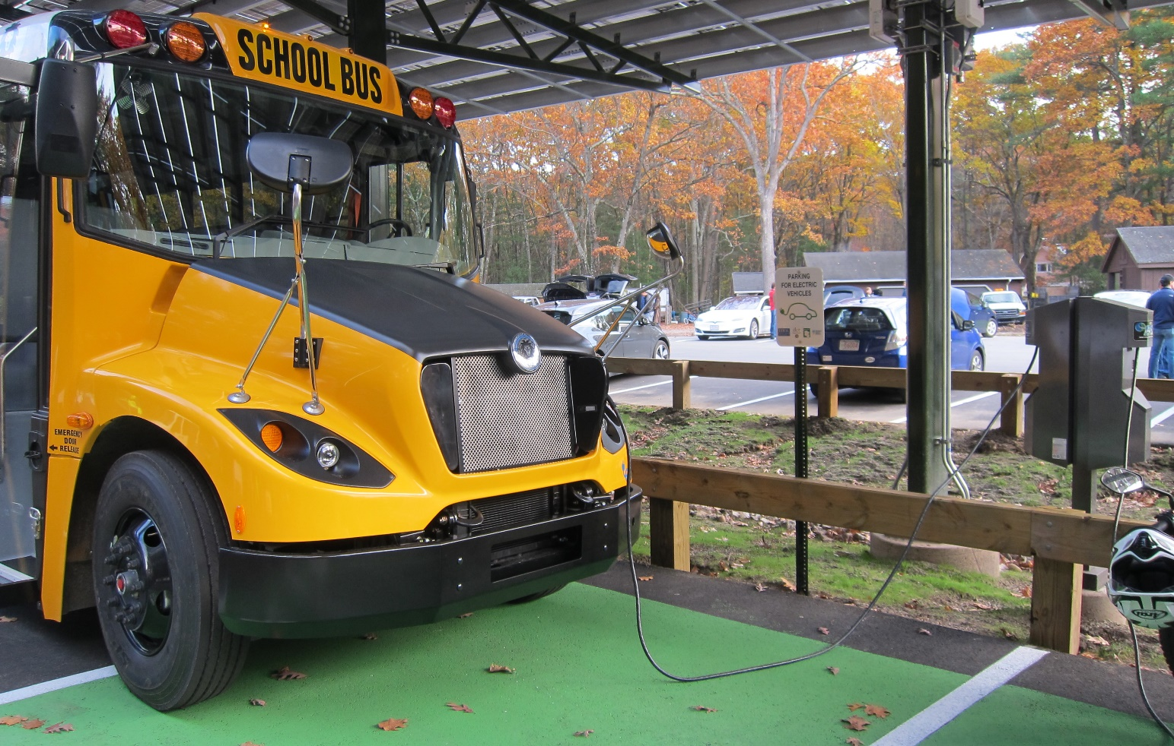
# 6
Support Electric Bus Market Transformation
Notes:
Jennifer

Slide 42
Why Transit & School Bus Implementation?
Heavy-duty vehicles (diesel buses and trucks) = about 20% of transportation energy use
Biofuels have difficulties operating in cold climates; environmental impacts of large-scale production and costs are limiting factors
Heavy duty electric vehicles are now in production that bring the same energy and environmental benefits as light duty EVs
Transit bus electrification the most mature, with school bus electrification rapidly advancing and other heavy-duty vehicle offerings also available
VW diesel mitigation settlement funding can be used for bus electrification
Notes:
Jennifer

Slide 43

# 7
Implement a Regional Clean Energy Underwriting Initiative
Notes:
Jennifer

Slide 44

Why Clean Energy Underwriting?
Underwriting aims for short-term cost-neutral payback with increased profit over time
Applies value of the energy savings to payback – capital investment reduces exposure to price volatility and stabilizes customer’s operations and maintenance cost centers.
Holistic benefits include:
Increased comfort which leads to productivity gains (research available upon request)
Green energy business development, job retention, & creation - energy efficiency investments retain capital in local economy (eanvt.org)
Demand management results in lower need for utility infrastructure investments
Notes:
Jennifer
Requires CDFI partnership with efficiency program administrators to be built or strengthened in all three states

Slide 45
Why Clean Energy Underwriting? (con’t)
Offers mutual value propositions for customer, utility, or efficiency program administrator and the CDFI
  Utility delivers incentives and receives energy savings and/or RECs towards regulatory metrics
  Customer receives utility incentives, favorable borrowing terms and holistic benefits (above)
  Market needs flexible financing options to address differing needs
  Opens new markets for CDFIs to grow scale of clean energy projects financed over time
  Opens additional leveraging opportunities for private and public resources (USDA REAP; NMTC, RECs, participation lending) that can contribute substantially to project economics
Notes:
Jennifer
Requires CDFI partnership with efficiency program administrators to be built or strengthened in all three states

Slide 46
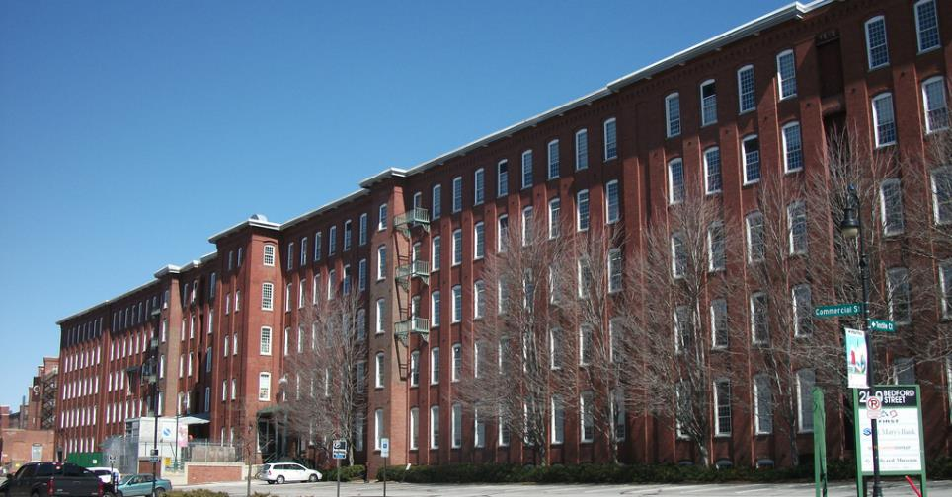
# 8
Implement C-PACE
Notes:
Brian
Photo: Manchester, NH

Slide 47
What is Commercial PACE (C-PACE)?
C-PACE is a tax assessment, not a loan
  Like other property-based tax assessments, C-PACE obligations stay with the property and unlike a mortgage, repayment cannot be accelerated at the time of sale
The criteria for accessing C-PACE capital are different from those of traditional financing and can supplement those sources
C-PACE is off balance sheet
  Only the current year’s assessment shows up on the owner’s balance sheet as a short-term liability. Each year’s tax obligation is recognized as an expense for that year
Notes:
Brian

Slide 48
C-PACE (cont’d)
C-PACE uses projected utility savings to pay for efficiency
Based on owner’s equity rather than future income
  The combination of any existing mortgages plus PACE assessment can = up to 100% of assessed value
  A building owner may be ineligible for conventional loans but eligible for PACE
Structured to recoup savings to cover costs
  Most C-PACE programs require avoided costs from reduced energy
  expenditures (or generation in the case of renewables) be equal or exceed the
  special tax assessment payments
  This means very low risk for lenders
Potential to fill financing gaps so that all cost-effective improvements can be made
Notes:
Brian

Slide 49
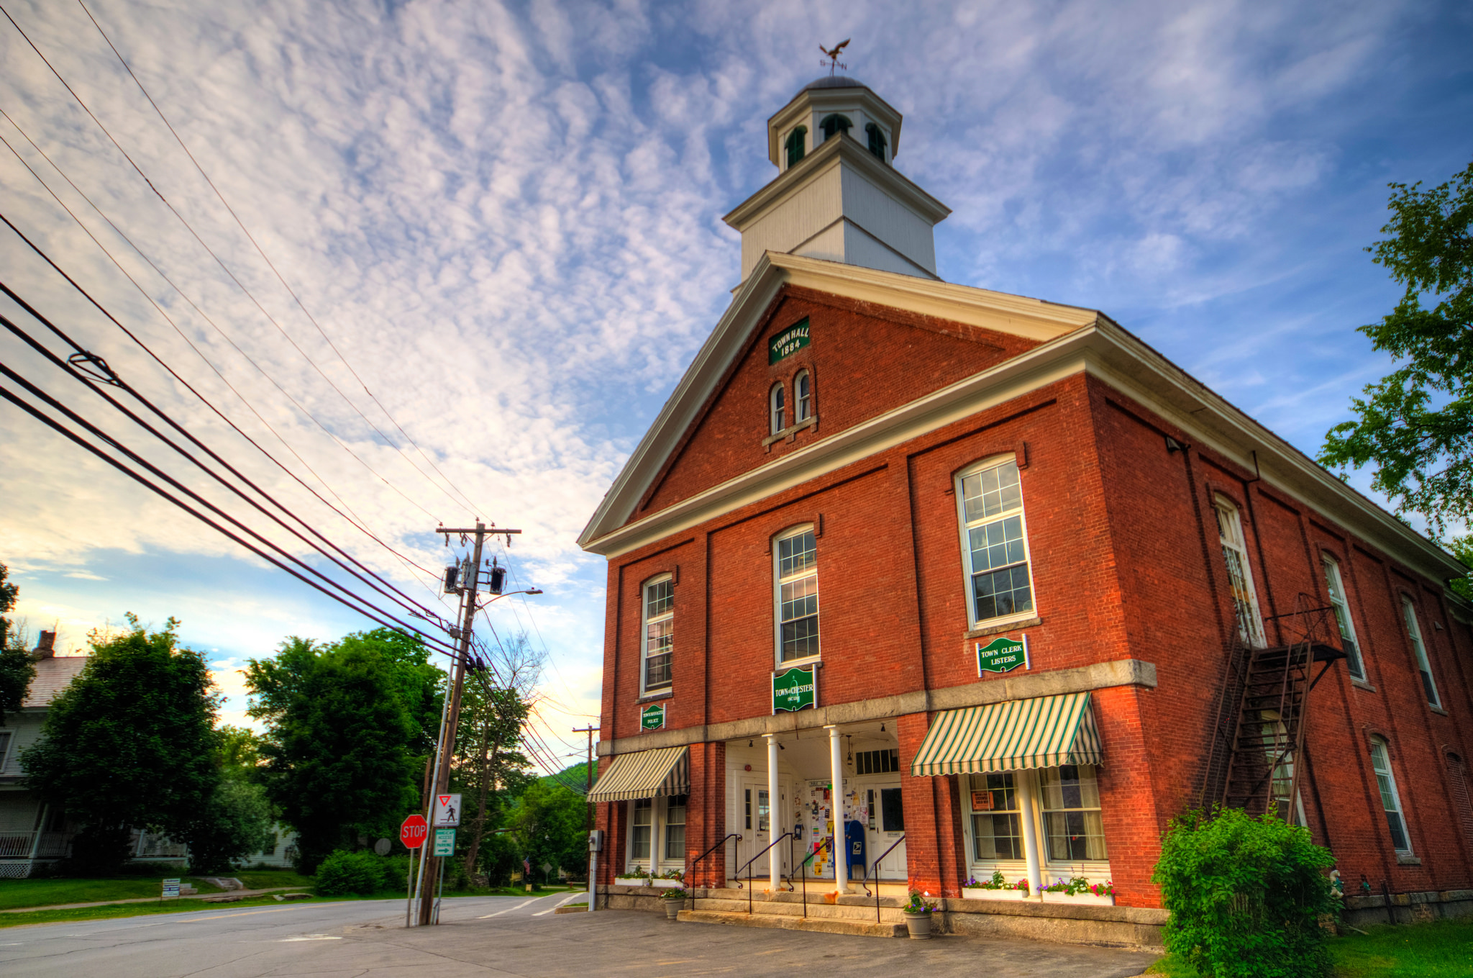
# 9
Expand Municipal
Lease-Purchasing
Notes:
Brian
Photo: Chester Town Hall, VT

Slide 50
What is Municipal Lease-Purchasing?
Municipal lease-purchase financing is a way to finance clean energy investments that reduce operating costs, lower carbon emissions, and create jobs without using the bonding capacity of the town or city.
An intermediary originate, underwrites, and services a loan for eligible projects. One underwriting approach is for the debt service payments to be covered by the energy costs savings resulting from the project.
A CDFI and/or a state economic development agency are examples of entities qualified to serve as an intermediary.
Notes:
Brian

Slide 51
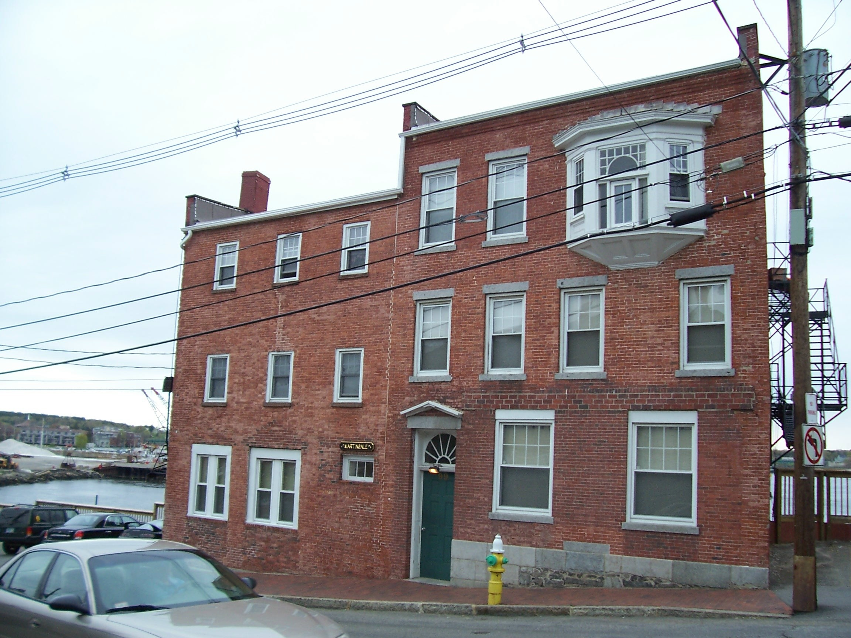
# 10
Expand Tariffed On-Bill Financing
Notes:
Liz
Photo: Portsmouth, NH
https://www.flickr.com/photos/nhoulihan/3605576106/in/photolist-6uBwah-23BYG3L-2dZjnPp-pNPGQt-JAe6x-ZWgS9c-8eb1Km-6K4h6u-6Jc7Zf-6J84y4-3TNopi-af8qQ9-FttaH-7y7gep-6Jsfns-52jGbw-nsqa8-oMDu9-6rR8WC-pwkcrz

Slide 52
What is Tariffed On-Bill Financing?
17 programs based on Pay As You Save (PAYS) in seven states – Arkansas, California, Hawaii, Kansas, Kentucky, New Hampshire, and North Carolina
Electric co-ops are early adopters as a cost-effective way to increase affordability, comfort and quality of life. Municipal utilities can overcome regulatory hurdles with TOBF
Reduces utility costs paid to wholesale suppliers (demand charges) through reduced usage and peak demand
Multifamily properties are eligible - rental property owners have incentive since obligation remains with the meter. Does not add to debt.
Old buildings with high savings opportunities more likely to avoid co-payment; others may have small co-payment
Notes:
Liz

Slide 53
Tariffed On-Bill Financing (con’t)
No credit checks since it is not a loan – LMI customers able to participate
No property lien, title insurance, etc. since there is no real estate loan
No risk of foreclosure or cloud on title with non-payment since no loan
No ratepayer subsidy except rebates since each customer pays their own way
Customer fee after retrofit set at 80% of savings. 20% of savings stays in members pocket – minimal risk of disconnection
Property owners required to notify next owner/tenant that TOBF charge remains with the meter – but lower than pre-retrofit bills
Notes:
Liz

Slide 54
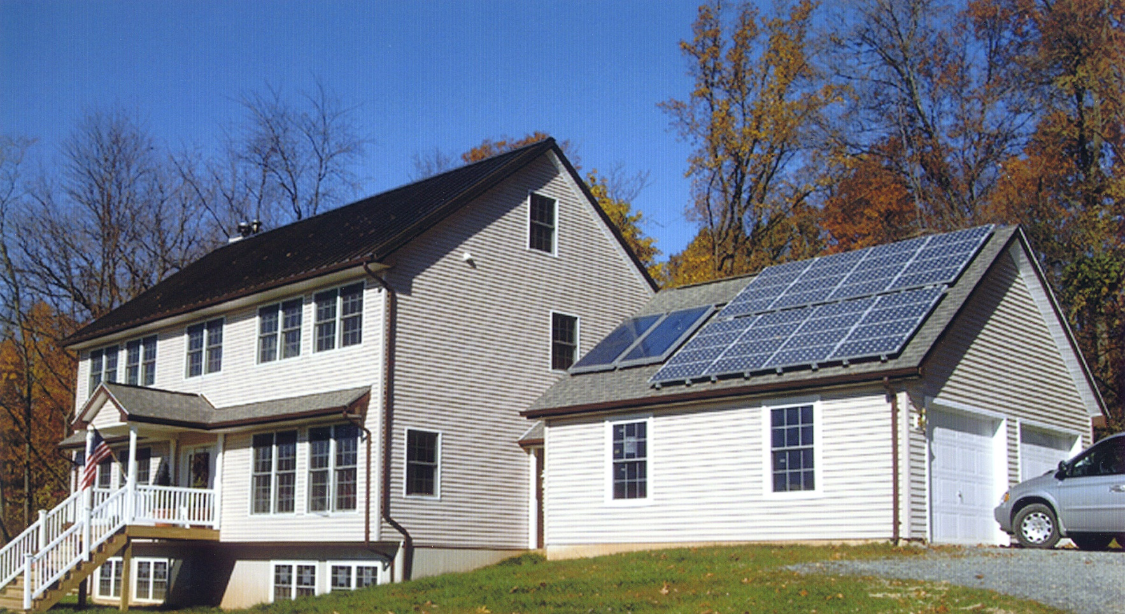
# 11
Continue Assessing a Green Bank
Notes:
Brian
Photo: US DOE

Slide 55
What is a Green Bank?
Typically created by state (or local) government to finance clean energy and environmentally beneficial projects exclusively
Typically they:
  Are publicly chartered financing institutions
  Have a mandate to invest in clean energy deployment
  Leverage public funds to stimulate private investment in clean energy
  Offer products across sectors, focusing on bridging market gaps
In operation in CT, NY, RI, HI, Montgomery County (MD)
  The smallest population served is 1 Million in Montgomery County (one of the wealthiest counties in the US)
The CT Green Bank is a model that has achieved major impacts
Notes:
Brian

Slide 56
Green Banks (con’t)
Feedback has been mixed on a regional nonprofit green bank
Some key issues to consider:
  Can a nonprofit entity achieve the same market advantage as publicly chartered financing institutions?
  Can a multi-state financing entity overcome the significant political, regulatory, and financing hurdles created by serving more than one state?
  How can a nonprofit achieve advantages similar to public finance authorities with significant balance sheets?
  How does a nonprofit leverage public funds to stimulate private investment?
  Can a regional green bank be capitalized by ratepayer / taxpayer funds that come from each member state?
  Has a regional nonprofit green bank been implemented anywhere yet?
Notes:
Brian
Green banks are chartered by state or county government as quasi-public entities. A multi-jurisdictional entity faces significant financial, regulatory, and political hurdles.
Private capital markets seek the certainty that comes with a political mandate for a publicly-chartered financing entity.
ME, NH, VT already have community economic development financing agencies that hold the most promise for clean energy financing.
Bond capacity for each state is limited so a green bank relying on bonds would compete with schools and other infrastructure for dollars.
Other green banks are capitalized with ratepayer funds, federal grants, or utility merger proceeds. These are either well used already or in short supply in the region.
Small population along with relatively low population density does not provide economies of scale for cost-effective customer acquisition or service delivery
Lack of political consensus for making public clean energy investments
Individual states are unable to attract private investment capital due to scale
Banks require capital and none of the states are seeking to issue bonds for this purpose
Markets value certainty and rely on legislative mandates to direct investments but the three states lack the desired level of certainty found in other markets with green banks

Slide 57
Conclusion
Notes:
Christine

Slide 58
In closing …
Focusing on transformative, systems-level changes means disruption
Disruption typically results in both supporters and opposition
Strategy development will be as important as the details of what is proposed
Proactive stakeholder engagement is key
Patience, flexibility, endurance will be needed
True market transformation is a long-term play, consider 5 to 10 years a success
  Based on VEIC experience in VT, RI, NJ, DC, and OH
Notes:
Christine

Slide 59
Next Steps
Notes:
Bruce

Slide 60
Next steps in:
Maine
New Hampshire
Vermont
Regionwide
Notes:
Bruce

Slide 61
We welcome your engagement !
  Participate in upcoming state strategy sessions
  Join in policy and legislative activities
  And more !
Notes:
Bruce

Slide 62
For more information:
Maine
Rob Wood, robert.wood@tnc.org; Keith Bisson, keith.bisson@cei.maine.org
New Hampshire
Bruce Clendenning, bruce.clendenning@tnc.org
Vermont
Phil Huffman, phuffman@tnc.org
Notes:
Bruce

Slide 63
Thank you!

