Slide 1
2016 ENERGY STAR® Products Program
October 25, 2018

Slide 2
Agenda
Background
Summary of Results
Electric Programs
Gas Programs

Slide 3
Program + Evaluation Background

Slide 4






Program Overview
Programs center on saving energy and capturing lost opportunity by providing incentives for ENERGY STAR-certified equipment and lighting products
Electric Programs
Gas Programs
Offered by all four NH utilities
Circuit rider ensures availability of qualifying products and promo materials
Lighting, appliances, water heating, space heating, and controls products
Includes a recycling component
Offered by Liberty and Unitil
Same circuit rider as the electric program
Water heating, space heating, and system controls products

Slide 5
Evaluation Overview
Component
Objective
Activities
Impact Evaluation
Verify ex ante savings
Assess appropriateness of ex ante savings
Calculate gross ex post savings
Assess prospective (2018-2020) savings
Participant Survey
Site Visits and Metering
Billing Analysis
Engineering Review
Process Evaluation
Assess participant satisfaction
Assess effectiveness of marketing and outreach
Identify barriers and how to overcome
Participant Survey
Stakeholder Interviews
Lighting Intercept Surveys
Lighting Pricing Assessment
Jurisdictional Scan
Benchmark measure offerings
Compare program design
Benchmarking

Slide 6
Sample Sizes and Sources
Activity
Sample Size
Source
Participant Survey
214 surveys
Program participant data
Home Site Visits
48 households
Program participant data (non-lighting)
Billing Analysis
80 households
Program participant data
Intercept Surveys and Pricing Assessment
11 stores
33 surveys
Websites of 43 brick-and-mortar locations (2 retailers)
Big-box retailers in NH
Jurisdictional Scan
16 programs / initiatives
Northeast programs

Slide 7

How Savings are Determined
Ex Ante
Reported
Ex Post
Perform M&V
Audited
Review program databases
$$Ex Ante Savings=Planned Savings Inputs ×ISR$$
$$Ex Post Savings=Evaluated Savings Inputs ×Evaluated ISR$$
$$Realization Rate= \frac{Ex Post Savings}{Ex Ante Savings}$$

Slide 8
Summary of Results

Slide 9
Program Savings
By Program Type
Electric Program Measures
Gas Program Measures

Slide 10
Savings Updates
Lighting Hours of Use
Proposed Daily Value | Proposed Annual Value | Precision at 90% Confidence
1.8 | 638.8 | 22.0%
Furnace and Boiler Savings
Measure | Baseline |  | Proposed Savings (Per-Unit MMBtu) | Precision at 90% Confidence
Boiler: ≥ 90% AFUE (up to 300 MBH) | Early Replacement | (80% AFUE) | 10.1 | 14.5%
 | Federal Standard | (82% AFUE) | 7.9 | 14.9%
 | Market Research | (85% AFUE) | 4.8 | 15.0%
Boiler: ≥ 95% AFUE (up to 300 MBH) | Early Replacement | (80% AFUE) | 13.8 | 14.5%
 | Federal Standard | (82% AFUE) | 11.7 | 14.9%
 | Market Research | (85% AFUE) | 8.7 | 15.0%
Furnace ≥ 95% AFUE w/ECM | Early Replacement | (78% AFUE) | 14.5 | 14.5%
 | Federal Standard | (80% AFUE) | 12.4 | 14.9%
 | Market Research | (85% AFUE) | 7.8 | 15.0%
Furnace ≥ 97% AFUE w/ECM | Early Replacement | (78% AFUE) | 15.7 | 14.5%
 | Federal Standard | (80% AFUE) | 13.7 | 14.9%
 | Market Research | (85% AFUE) | 9.1 | 15.0%

Slide 11
In-Service Rates
Percent of the rebated items that are in-service
Evaluated through participant self-report surveys
  Is the measure currently installed?
  Why are some of the measures not installed?
If fewer than 10 responses for a given measure, deemed at 100%
Measure | Ex Ante ISR | Ex Post ISR | Ex Post Precision at 90% Confidence | Source
LED Bulbs | 95.0% | 97.0% | 3.8% | Participant Survey
Efficient Lighting Fixtures | Interior: 96.4% | 97.7% | 6.4% | Participant Survey
 | Exterior: 100.0%
ENERGY STAR Clothes Washers | 100.0% | 98.2% | 3.0% | Participant Survey
ENERGY STAR Room Air Conditioners | 100.0% | 84.6% | 16.6% | Participant Survey

Slide 12
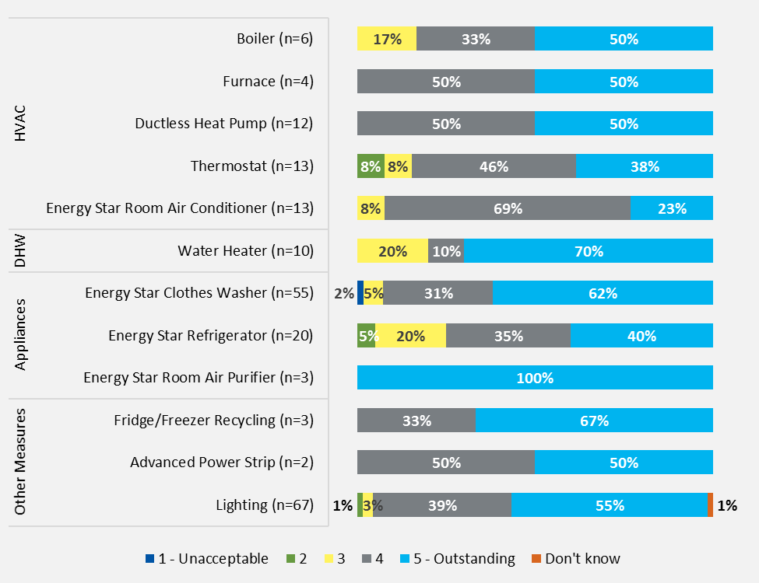
Program and Product Satisfaction
Overall program and product satisfaction were high
Average program satisfaction was a 4.2 out of 5.0
Respondents reported the time to receive their rebate as the least satisfactory (4.0 of 5.0) program aspect
Average product satisfaction was 4.4 out of 5.0

Slide 13
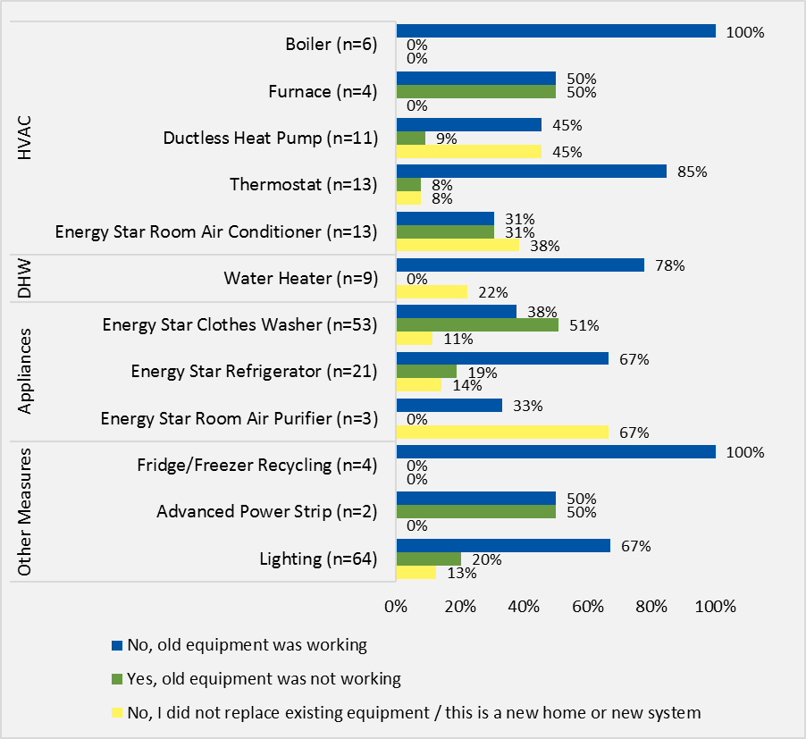
Early Replacement
Utilities may be under-claiming savings for rebated equipment that displaces working inefficient equipment
Over half (58%) of respondents replaced working equipment
Customers were not asked about the age or efficiency of the replaced equipment
Add figure note here

Slide 14
Key Findings and Recommendations
Main Takeaways
Half of survey respondents replaced working equipment; other states’ programs offer early retirement incentives
Metered lighting HOU are lower than planning estimates
Boiler and furnace savings vary significantly from ex ante assumptions
Consider additional research to determine age and efficiency of equipment replaced
Adopt HOU from Cadmus evaluation for prospective savings assumptions
Adopt savings assumptions from Cadmus billing analysis

Slide 15
Key Findings and Recommendations
Main Takeaways
Retailer and contractor partners would appreciate more training and communication
Customers are frustrated by gaps in program offerings and length of time to receive rebates
Work with retailers to incorporate program education into store-wide trainings
Increase communication with contractors
Improve transparency regarding rebate eligibility
Explore online rebate assistance and tracking tools

Slide 16
Electric Programs

Slide 17
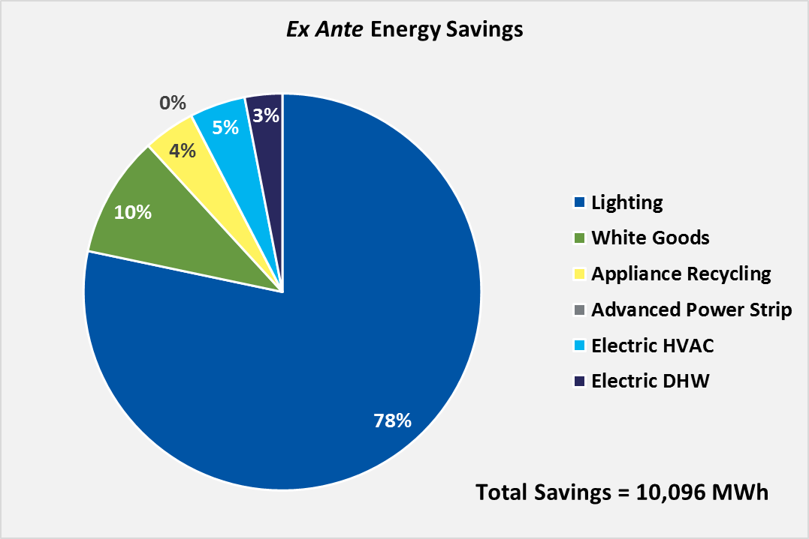
Program Breakdown
Program is primarily lighting driven
Evaluation focused on lighting:
Home visits
In-store intercept surveys
Pricing Assessment

Slide 18
Savings Approach
Evaluation activities focused on lighting measures
Measures
Savings Approach
Activities
Lighting
Engineering Review
Participant Survey
Site Visits and Metering
Engineering Review
Non-Lighting
Engineering Review
Participant Survey
Engineering Review

Slide 19
Home Lighting Visits
Room Type | Distribution of Bulbs | LED % | CFL % | Efficient % | Average Daily HOU
Bedroom | 18% | 14% | 28% | 19% | 1.54
Bathroom | 15% | 16% | 12% | 15% | 1.28
Kitchen | 13% | 12% | 11% | 12% | 2.72
Living Room | 12% | 15% | 7% | 12% | 3.29
Hall | 9% | 8% | 8% | 8% | 0.38
Basement | 8% | 9% | 13% | 10% | 1.27
Dining room | 6% | 5% | 5% | 5% | 0.93
Family room | 5% | 5% | 2% | 4% | 2.65
Outside | 3% | 3% | 3% | 3% | 1.41
Other | 3% | 4% | 1% | 3% | 1.25
Garage | 3% | 2% | 3% | 2% | 0.83
Office | 2% | 2% | 4% | 3% | 1.80
Closet | 1% | 1% | 2% | 1% | 0.49
Laundry | 1% | 1% | 1% | 1% | 0.60
Mechanical | 1% | 1% | 0% | 1% | 0.82
Overall Household Daily HOU – Weighted |  |  |  |  | 1.70 ± 0.37
Overall Household Daily LED HOU – Weighted |  |  |  |  | 1.75 ± 0.39
Measured 638.8 hours for LED lamps
Sample of 48 homes pulled from program participants (non-lighting participants)
Cadmus installed 446 meters from February – May
Removed ‘spoofed’ or damaged meters (2.7%)
Results weighted by distribution of lamps within home

Slide 20
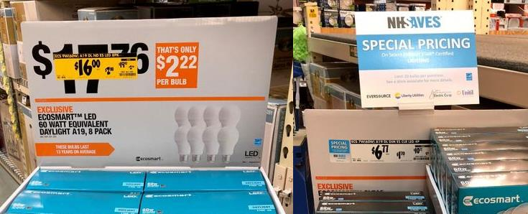



Lighting Intercept Surveys
Retailers actively promote non-program LEDs, sometimes alongside program LEDs
A small percentage of program lamp sales may be attributable to customers from neighboring states
VT
MA
ME

Slide 21
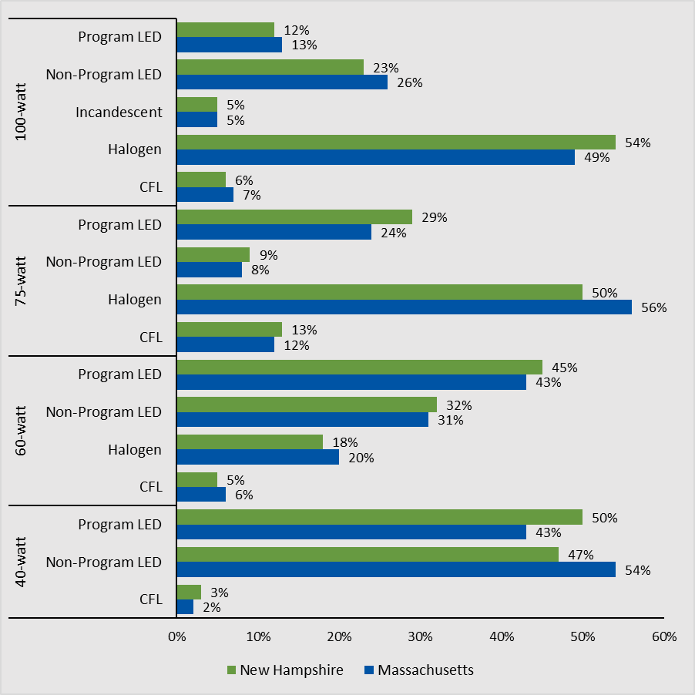
Lighting Price Assessment
Still room for growth in the 75-watt and 100-watt equivalent categories
Halogen lamps account for over 50% of available lamps in the 75- and 100-watt equivalence categories
Program LEDs account for half of 40-watt equivalent lamps and 45% of 60-watt equivalent lamps
Biggest factors influencing purchase decision: brightness and color temperature, energy savings, and price

Slide 22
Water Heater Fuel Type
Savings Source | Fuel Type | Ex Ante |  | Ex Post
 |  | Fuel Share | MMBtu | Fuel Share | MMBtu
Water Heater | Natural Gas | 23% | 0.1541 | 15% | 0.1003
 | Fuel Oil | 38% | 0.2546 | 27% | 0.1792
 | Propane | 2% | 0.0134 | 25% | 0.1653
Clothes Dryer | Natural Gas | 9% | 0.0315 | 9% | 0.0315
Total |  | -- | 0.4536 | -- | 0.4763
Home-inventory and online surveys collected information about water heater fuel type
Significantly higher rates of propane water heaters than assumed previously—candidates for HPWH?

Slide 23
Key Findings and Recommendations
Main Takeaways
Metered lighting HOU are lower than planning estimates
Room to increase LED share of 75- and 100-watt equivalent market
Some program lamps may be spilling into other jurisdictions
Adopt HOU from Cadmus evaluation for prospective savings assumptions
Target lighting markdowns toward 75-watt and 100-watt equivalent lamps.
Consider future research to quantify cross-service area and cross-customer class sales

Slide 24
Key Findings and Recommendations
Main Takeaways
Retailers sometimes promote non-program LEDs, alongside program LEDs
Assumptions for clothes washers fossil fuel savings differ from the evaluated fuel distribution
Collaborate with retailers to ensure that program and store promotions align and maximize incentive impacts
Adopt the water heating fuel distribution identified during the Cadmus evaluation to inform clothes washer savings for the 2018–2020 evaluation cycle.

Slide 25
Gas Programs

Slide 26
Savings Approach
Measures
Savings Approach
Activities
Furnaces and Boilers
Utility Billing Analysis
Engineering Review
Participant Survey
Site Visits and Metering
Utility Bill Analysis
Engineering Review
Other Measures
Engineering Review
Participant Survey
Engineering Review

Slide 27
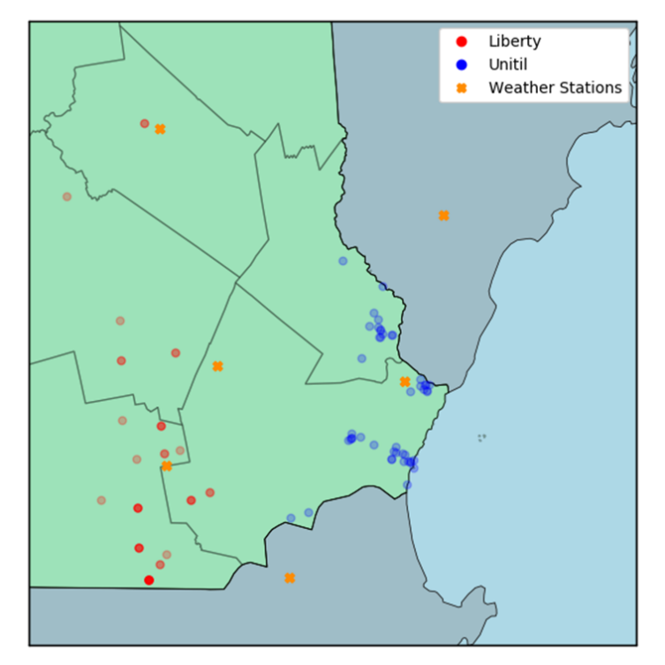
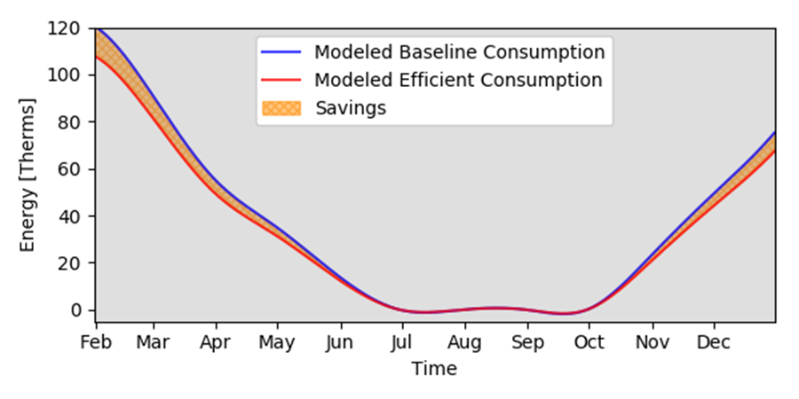
Utility Billing Analysis
Estimate savings for furnaces and boilers
Post-only billing analysis for 80 sites
Modeled savings for variety of baseline conditions

Slide 28
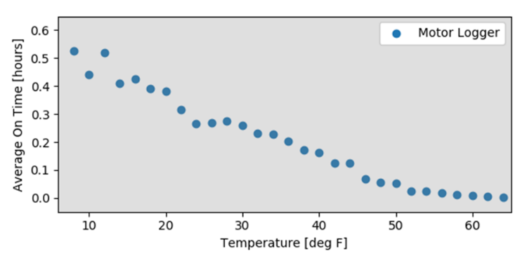
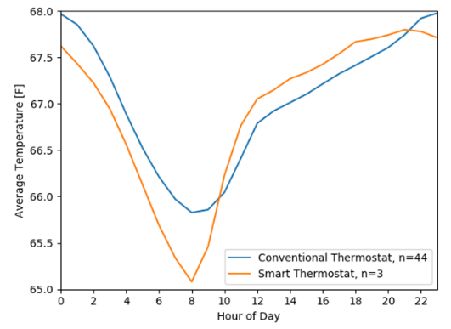
Metering Results
Supplement to billing analysis and gather in-home temperature data
Installed state loggers in 16 homes that replaced their gas furnaces
Generally good agreement with billing analysis results
Installed indoor-air temperature meters for each home visited (48 total)
Results represent period of late January/Feb – May; no extrapolation to the whole year
Conventional and smart thermostats display same trends, but different average setpoints

Slide 29
Savings Updates
Furnace and Boiler Savings
Measure | Baseline |  | Proposed Savings (Per-Unit MMBtu) | Precision at 90% Confidence
Boiler: ≥ 90% AFUE (up to 300 MBH) | Early Replacement | (80% AFUE) | 10.1 | 14.5%
 | Federal Standard | (82% AFUE) | 7.9 | 14.9%
 | Market Research | (85% AFUE) | 4.8 | 15.0%
Boiler: ≥ 95% AFUE (up to 300 MBH) | Early Replacement | (80% AFUE) | 13.8 | 14.5%
 | Federal Standard | (82% AFUE) | 11.7 | 14.9%
 | Market Research | (85% AFUE) | 8.7 | 15.0%
Furnace ≥ 95% AFUE w/ECM | Early Replacement | (78% AFUE) | 14.5 | 14.5%
 | Federal Standard | (80% AFUE) | 12.4 | 14.9%
 | Market Research | (85% AFUE) | 7.8 | 15.0%
Furnace ≥ 97% AFUE w/ECM | Early Replacement | (78% AFUE) | 15.7 | 14.5%
 | Federal Standard | (80% AFUE) | 13.7 | 14.9%
 | Market Research | (85% AFUE) | 9.1 | 15.0%

Slide 30
Key Findings and Recommendations
Main Takeaways
All surveyed boiler and 50% of furnace customers reported replacing working equipment
Boiler and furnace savings vary significantly with assumed baseline
Consider additional research to determine age and efficiency of equipment replaced
Adopt savings assumptions from Cadmus billing analysis

Slide 31
Thank You / Q&A

